Slide 1
KS1 SATS
2019

Slide 2
What are SATs?
SATs are the standard assessment tests that take place at the end of Year 2 and Year 6
These are national tests

Slide 3
Why do they happen?
These are summative assessments at the end of each key stage, allowing:
- government
- county
- schools
- parents
to compare against national data.
They form part of teachers assessment.

Slide 4
When do they take place?
KS1
Date | Activity
May 2019 | Key stage 1 test period

Slide 5
Reasoning and problem solving
Generally, children were shown to be fluent in the basic skills of maths, but a national area for development was applying this knowledge
for example: 26 + 36 =
Mrs Revell and Miss Blick ate a total of 62 sweets. Miss Blick ate 26. How many did Mrs Revell eat?

Slide 6
Reading question types
When teaching reading, there are 5 types of question that the children could encounter. These are:
- Retrieval
Predicting
Vocabulary
Inference
Sequencing

Slide 7
Stamina for reading
https://www.gov.uk/government/publications/ks1-english-reading-exemplification-working-at-the-expected-standard

Slide 8
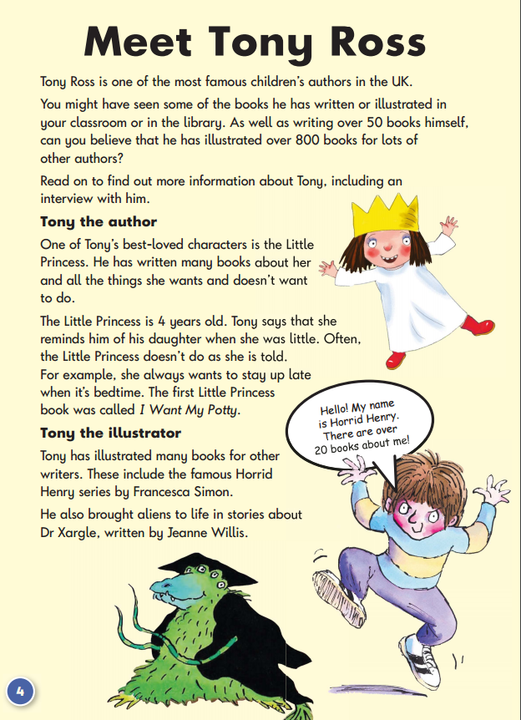

Example papers – KS1
Paper 1
Paper 2

Slide 9

Paper 1
Paper 2

Slide 10


Paper 1 - arithmetic
Paper 2 - reasoning

Slide 11
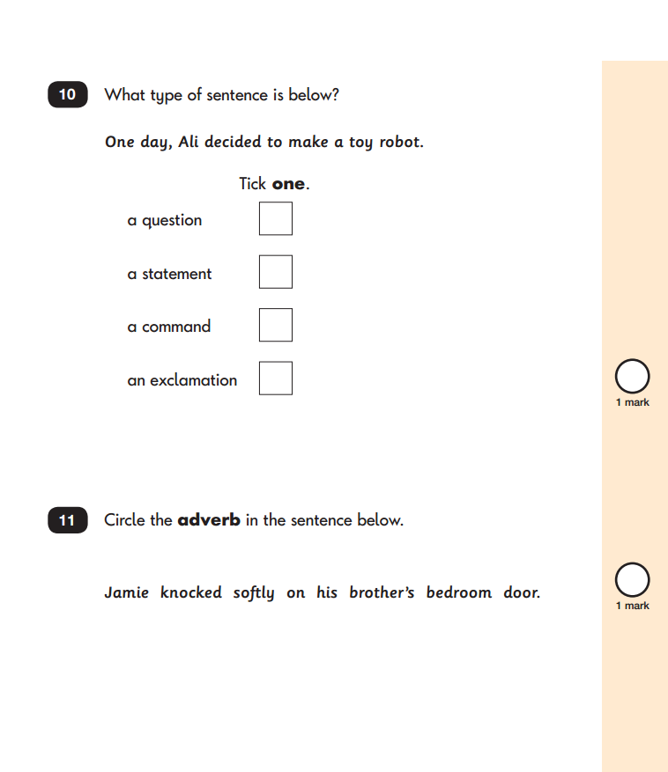
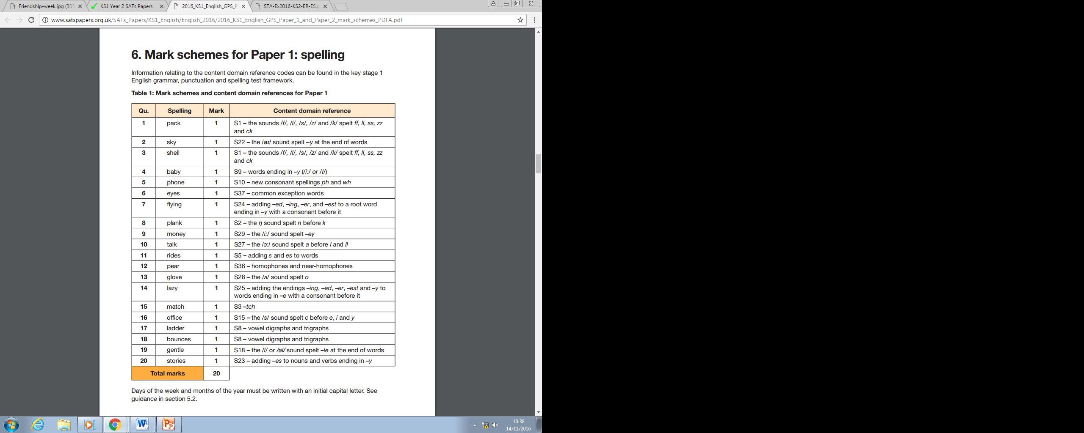
Punctuation and grammar
Spelling

Slide 12
How are we preparing?
Working on techniques and strategies that could help them when working through papers.
Focussing on effort and doing our best.
Ensuring secure learning is demonstrated as part of a broad curriculum.

Slide 13
Helpful Hints
Regularly hear your child read and question them on the text to a deeper level
Times tables and related division facts
Addition and subtraction fluency
CGP guides
Keep calm and carry on!

