Slide 1
EYFS Parent Information Evening
How to support your child’s Learning
Brockenhurst Primary School

Slide 2
Aims:
To look at teaching and learning in key areas of the EYFS
To look at how you can support your child’s learning and development at home
To answer any questions you may have

Slide 3
Reading and writing - Phonics
The teaching of phonics underpins the teaching of reading and writing in EYFS
Daily adult-led phonics input to learn the 44 sounds that make up all words in the English language
To develop the children’s ability to blend sounds for reading and segment sounds for writing (spelling)
A multi-sensory approach, heavily supported by the Read Write Inc. materials

Slide 4

Read, Write, Inc. Phonics

Slide 5

Fred Talk
Say “hello” to Fred.
Fred can only talk in sounds...
He says “c a t.” Not cat.
We call this Fred Talk.

Slide 6

Fred Fingers
c
a
Say the word
Say 3 fingers
Say the word in Fred Talk with the children touching a finger for each sound: c-a-t
Say the word again swiping across the 3 fingers
t

Slide 7

Ditty books
Practise reading the speed sounds.
Read the green and red words
Listen to the introduction
Discuss the vocabulary check
Read the story
Re-read the story and discuss ‘questions to talk about’
Re-read the story with fluency and expression
Practise reading the speed words

Slide 8
keywords
High frequency words
Children need to read them as sight vocabulary – not sounding them out
Increases their reading fluency
Fun ways to practise

Slide 9
Reading books
Practise early reading skills
Supported reading (by adult)
Gain fluency during frequent reading of the same books

Slide 10
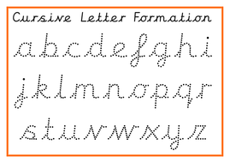
Writing and handwriting
Gross and fine motor skills
Funky fingers
Pencil rhyme for correct pencil grip
Lots of opportunities to mark make, sand, water, paintbrushes, chalks.
Pencil control
Letter formation

Slide 11
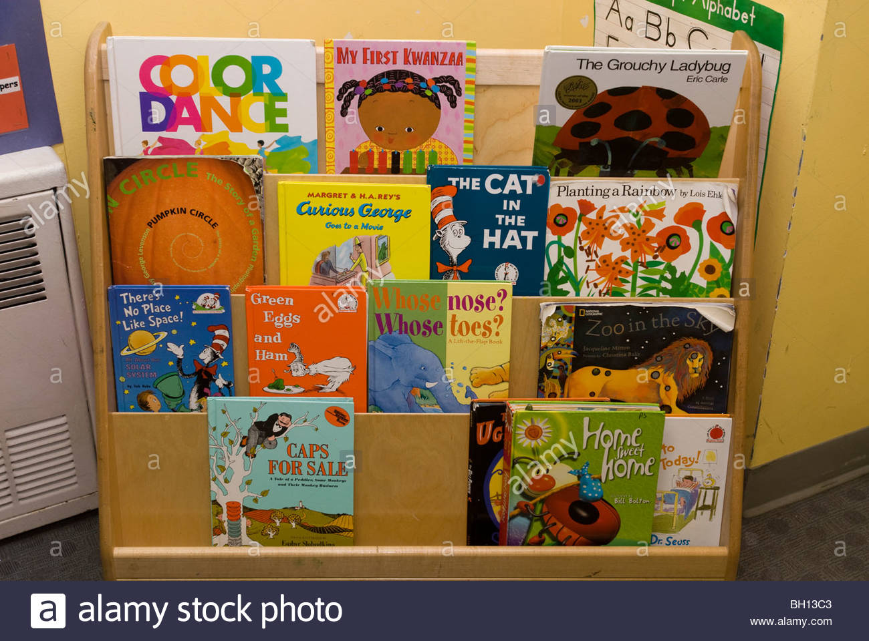
Library books
Books to share at home
Tuesday is library book changing day

Slide 12
maths
Early Learning Goal for numbers:
Children count reliably with numbers from one to 20, place them in order and say which number is one more or one less than a given number. Using quantities and objects, they add and subtract two single-digit numbers and count on or back to find the answer. They solve problems, including doubling, halving and sharing.
Early Learning Goal for shape, space and measures:
Children use everyday language to talk about size, weight, capacity, position, distance, time and money. They compare quantities and objects and solve problems. They recognise, create and describe patterns. They explore characteristics of everyday objects and shapes and use mathematical language to describe them.

Slide 13
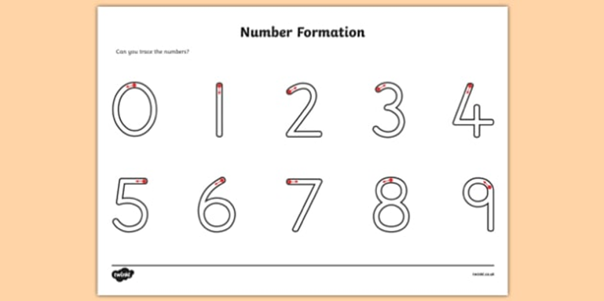
Number Formation

Slide 14
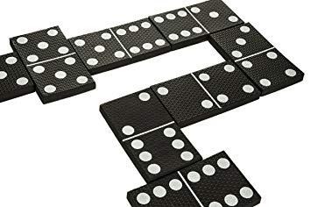
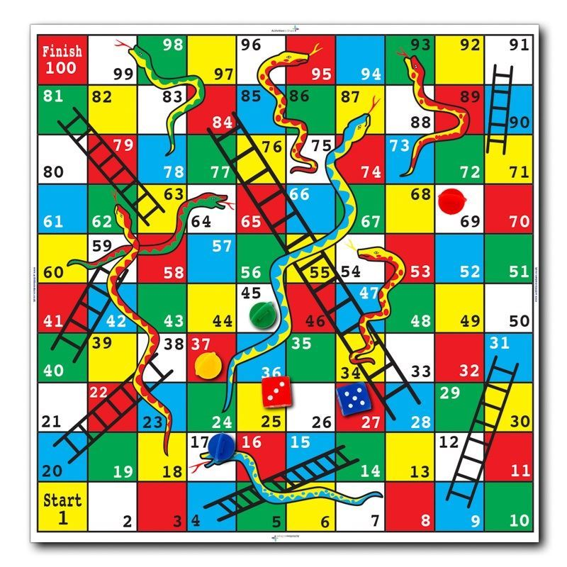
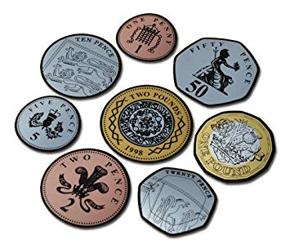
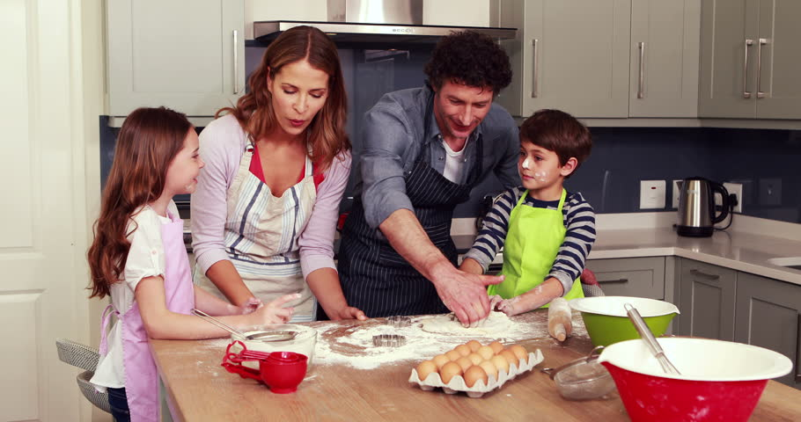
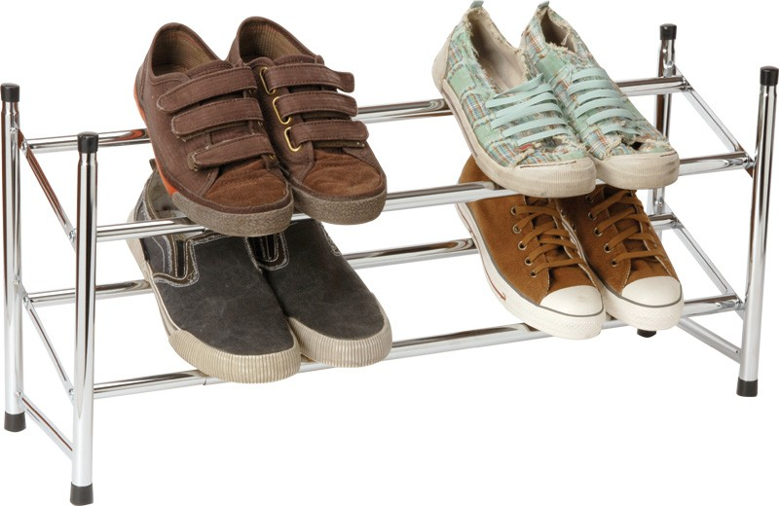

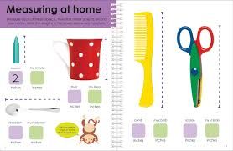
Maths at home
Games such as dominoes, snakes and ladders
Cooking with your child
Shopping, handling money
Talking about the time, looking at clocks
Counting – anything and everything
Measuring – what’s bigger, smaller, heavier, taller, shorter – comparing things

