Slide 2
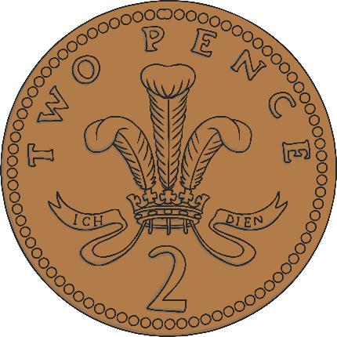
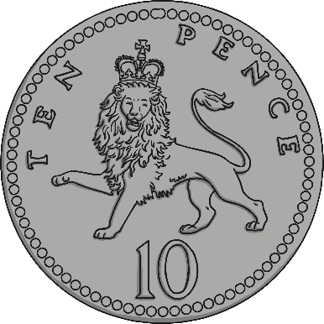
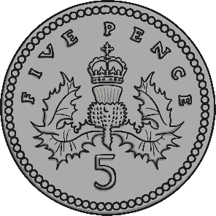
Coins
2p
5p
10p

Slide 3

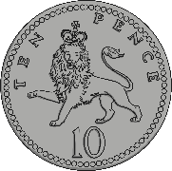
Count the coins in the jar.
40p
Answer

Slide 4
Count the coins in the jar.
Answer
60p

Slide 5
Count the coins in the jar.
50p
Answer

Slide 6
Count the coins in the jar.
90p
Answer

Slide 7
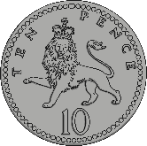

Challenge
If I put 10 10ps in my jar, how much money is in my jar?
=
10p
10p
10p
10p
10p
10p
10p
10p
10p
10p
£1
100p

Slide 8
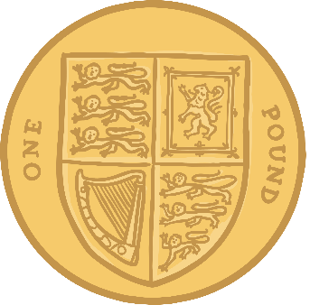
Count the coins in the jar.
£1
Answer

Slide 9
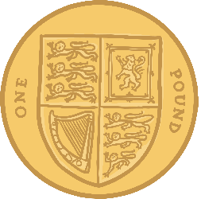
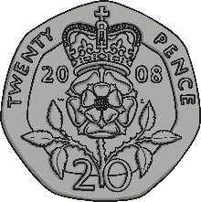
Count the coins in the jar.
£1.20
Answer

Slide 10
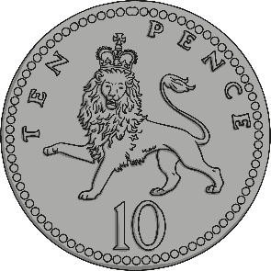
Count the coins in the jar.
Answer
£1.10

