Slide 1
Number Maze

Slide 2
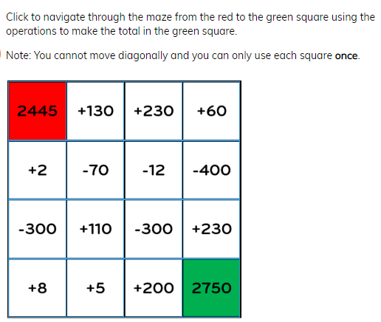
Ok! This looks impossible.
Where should we start?

Slide 3
That’s right Ned, a numberline.
2445
2750

Slide 4
What is the difference?
2445
2750

Slide 5
How much do the numbers go up?
2445
2750

Slide 6
So what numbers are big enough, but not too big, to get you there and will you have to subtract?
Good luck!

