Slide 1
Magic Nine

Slide 2
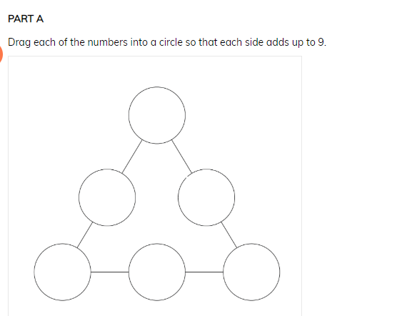
Each side, when added together must equal 9. You use the numbers 1-6. This is tricky … be patient

Slide 3
Callum! I said be patient!

Slide 4
First, play with the numbers.
If you have all the highest numbers together, like 6+5 +4
It’s going to equal something big = 15! Too high!

Slide 5
So, space the numbers out
4
6
5

Slide 6
Or ...
6
4
5

Slide 7
Now, add in the other numbers. Play with them until they all reach a total of nine. Good luck, let me know how you go.
4
6
5

