Slide 1
Numbers Inside the Grid
Warning not for the faint hearted
Also, the more slides you click the more help you get, it is best to be as independent as possible so try to click less.

Slide 2
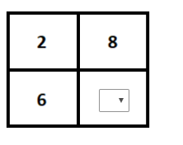
Part A
As you can see from the example, the numbers added together must equal 200.
 | 20 | 8
+ | 20 | 6
+ | 60 | ?
+ | 80 | ?
=

Slide 3
Part A
Add up the numbers to see how far you are away
 | 20 | 8
+ | 20 | 6
+ | 60 | ?
+ | 80 | ?
=

Slide 4
Part A
As you can see from the example, the numbers added together must equal 200.
 | 20 | 8
+ | 20 | 6
+ | 60 | ?
+ | 80 | ?
= | 180 | 14
180+14 = 194
200 - 192 = 6
Because there are 2 empty boxes i divide 6 by 2 = 3

Slide 5
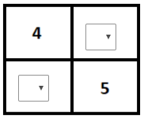
Part B
What do we have? How far are we away from 200?

Slide 6
Part B
What do we have? How far are we away from 200?
 | 40 | ?
+ | 40 | ?
+ | ? | 5
+ | ? | 5
=

Slide 7
Part B
200 - 90 = 110
The 2 missing numbers have to be a number bond of 10 otherwise the number will be wonky and not equal 200.
 | 40 | ?
+ | 40 | ?
+ | ? | 5
+ | ? | 5
= | 80 | 10

Slide 8
Ok too many clues - get on with it!

