Slide 2



Diving into Mastery Guidance for Educators
Each activity sheet is split into three sections, diving, deeper and deepest, which are represented by the following icons:
These carefully designed activities take your children through a learning journey, initially ensuring they are fluent with the key concept being taught; then applying this to a range of reasoning and problem-solving activities.
These sheets might not necessarily be used in a linear way. Some children might begin at the ‘Deeper’ section and in fact, others may ‘dive straight in’ to the ‘Deepest’ section if they have already mastered the skill and are applying this to show their depth of understanding.
Diving
Deeper
Deepest

Slide 3
Aim
Use written division methods in cases where the answer has up to two decimal places.

Slide 4
Divide Decimals by Integers
Diving
Complete this part-whole division calculation model.
9.63 ÷ 3
9.63
9 ones
6 tenths
3 hundredths
÷3
÷3
÷3
3 ones
2 tenths
1 hundredth
Now use a part-whole model like
the one above to calculate 8.48 ÷ 4.
8.48 ÷ 4 = 2.12

Slide 5
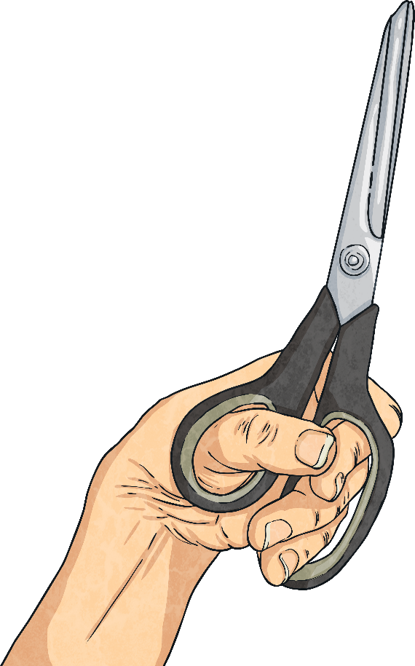

Divide Decimals by Integers
Diving
Charlie cuts a 45.6cm strip of paper into six equal pieces.
?
How long will each piece be?
45.6cm ÷ 6 = 7.6cm

Slide 6

Divide Decimals by Integers
Deeper
Ones | Tenths | Hundredths
Oscar has used this place value grid to
show how he worked out 1.64 ÷ 4 = 0.41
0.1
0.1
0.1
0.1
0.01
0.1
0.1
0.1
0.1
0.01
0.1
0.1
0.1
0.1
0.01
0.1
0.1
0.1
0.1
0.01
Oscar has used a method called exchanging in his place value grid.
Explain how you think this method works.
Oscar has exchanged the one in 1.64 for ten tenths. He already had six tenths so now has 16 tenths altogether. Oscar can now share out the 16 tenths and 4 hundredths equally into the four different groups. He can see that the answer is 0.41 because there are no ones, four tenths and one hundredth in each group.

Slide 7

Divide Decimals by Integers
Deepest
The first grid shown below is a decimal magic square.
Each row, column and diagonal add up to the same number.
Divide each of the numbers in the magic square by 4 and record the answer in the corresponding space
in the empty grid.
12.0 | 16.8 | 14.4
16.8 | 14.4 | 12.0
14.4 | 12.0 | 16.8
3.0
3.0 | 4.2 | 3.6
4.2 | 3.6 | 3.0
3.6 | 3.0 | 4.2
Now add each row, column and diagonal. Do they add up to the same number?
Yes
Look at your new magic square. Could you choose a different number
to divide each number by in that square? What did you find out?
The new magic square can be divided by numbers such as 2, 3, 4, 5 and 6 to give you new numbers with two decimal places. When the new numbers are added together, each row, column and diagonal will have the same total.

Slide 8


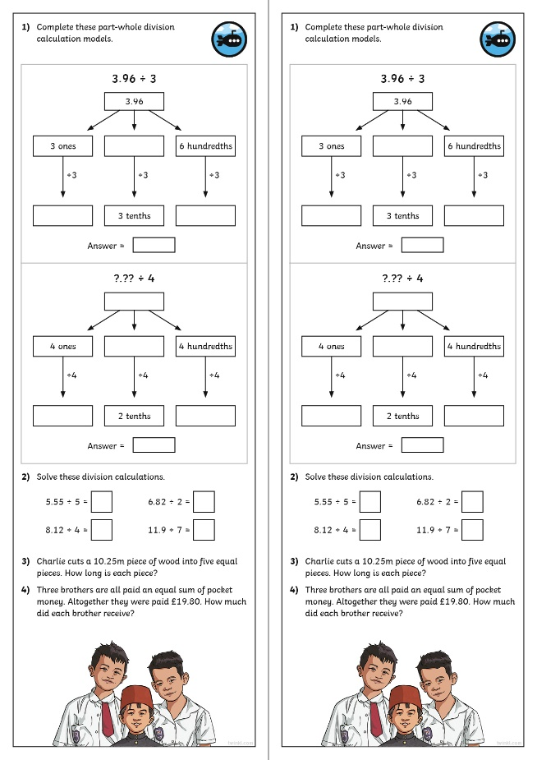
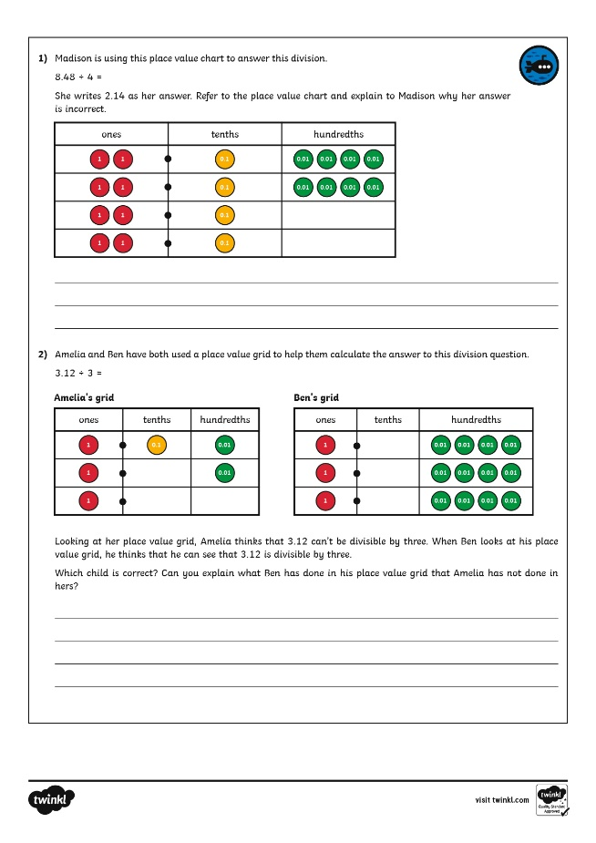
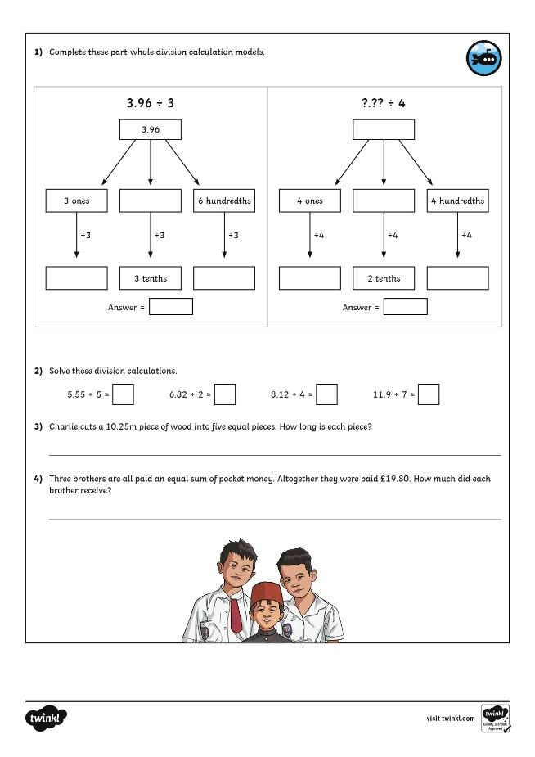
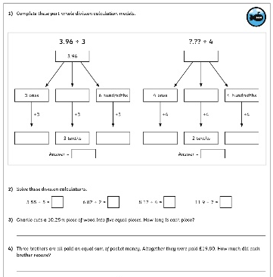
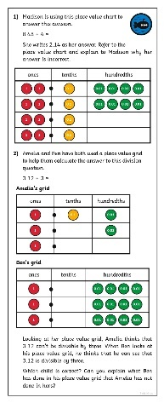
Divide Decimals by Integers
Dive in by completing your own activity!

Slide 9
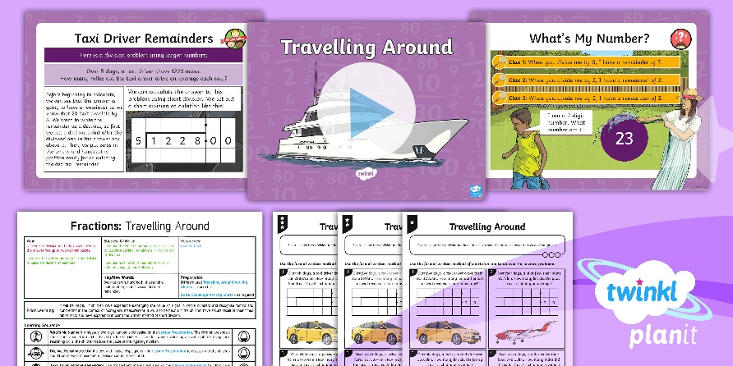
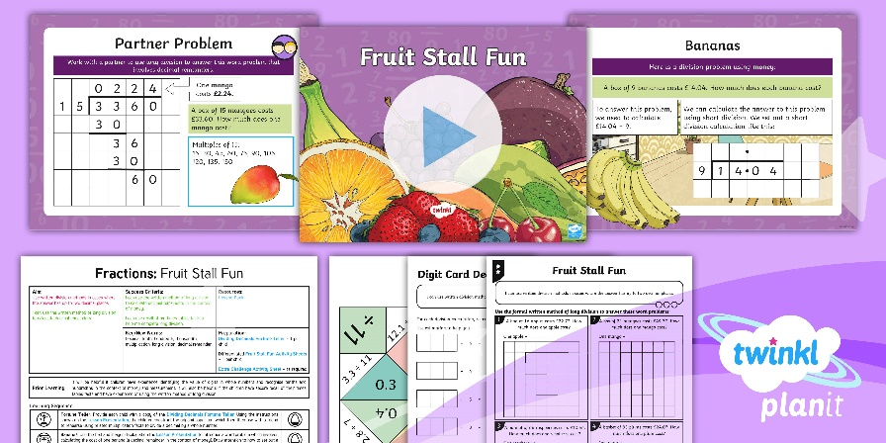

Need Planning to Complement this Resource?
National Curriculum Aim
Use written division methods in cases where the answer has up to two decimal places.
For more planning resources to support this aim, click here.
Twinkl PlanIt is our award-winning scheme of work
with over 4000 resources.

