Slide 1
The Key to Adding
Try and do this question without the slides, if you get stuck, have a look, but attempt it first.

Slide 2
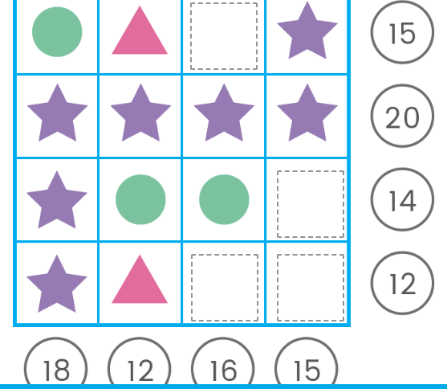
Look at the star line. It equals 20.
Take 20 and divide it by ? to give you = ?

Slide 3
Look at the star line. It equals 20.
Take 20 and divide it by 4 to give you = 5

Slide 4
Next, look at this line with the arrow pointing towards it. Hmmm … I think you can work this out ...

Slide 5
If not;
You have 3 stars which equal 5
So … 5+5+5+ = 15
18 (the total) - 15 =

Slide 6
We are nearly there.
Look at this line (arrow). Have a go yourself.

Slide 7
Ok, you should be working this out by yourself.
Star = 5
Circle = 3
5+3 = 8
12 - 8 = 4
4 divided by 2 (there are 2 circles) = ?

Slide 8
No more help!

