Slide 1
LO: Annotate my predictions about this story

Slide 2
Although this is a task that involves you writing all over the paper (yes you can use different colours) your handwriting must be neat.
If you run out of space in your books use the other page.

Slide 3
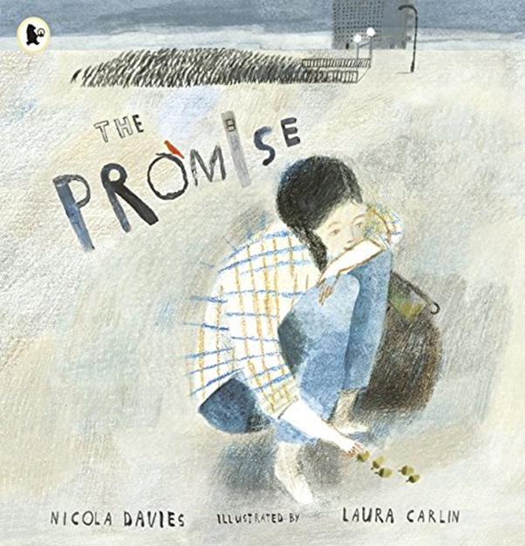
Look at the front cover of The Promise
What do you notice?
How does it make you feel?

Slide 4
On your pictures - annotate (scribble over) 6 interesting things you notice about the picture.
A tower block

Slide 5
Write 2 questions you have for the girl?
Why are you stood away from all the other people?

Slide 6
Write 2 interesting sentences about what it would be like to live there?
The land is dull and the people are grey and the air is thick with smog.

Slide 7
Write 2 predictions about the story.
I think that …
The bird will …
The colours of the book will ….

