Slide 2
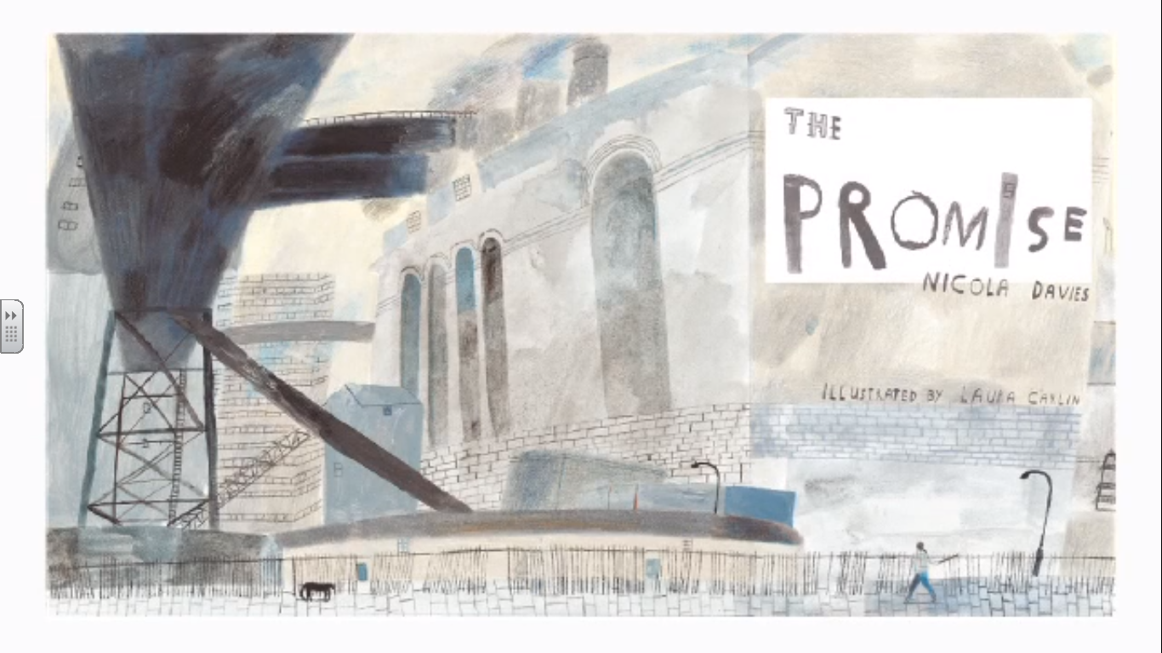

Slide 3
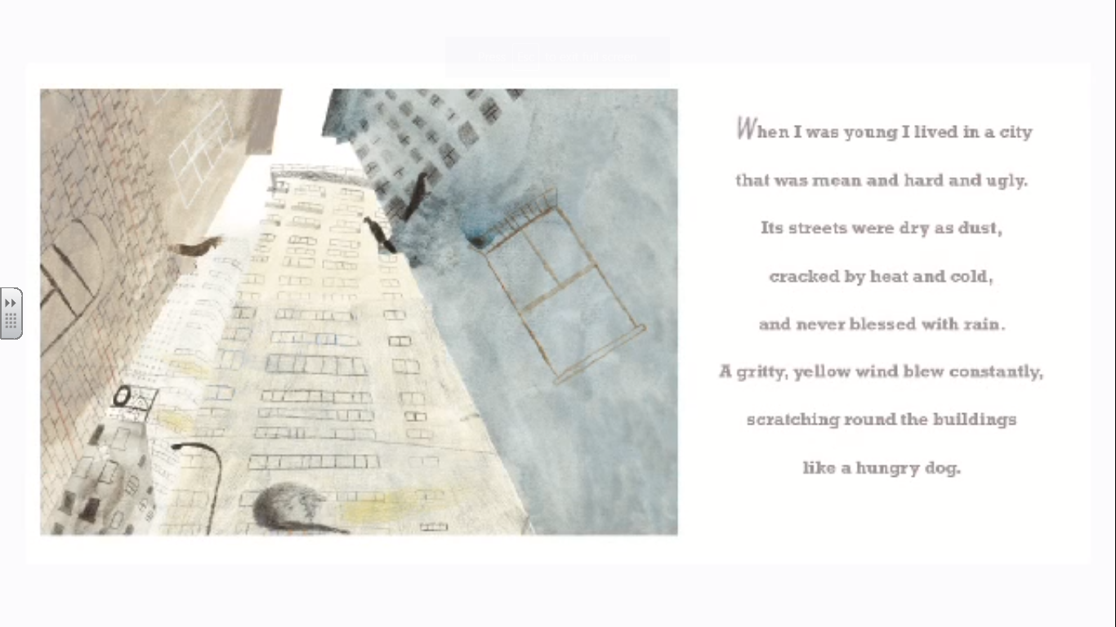

Slide 4
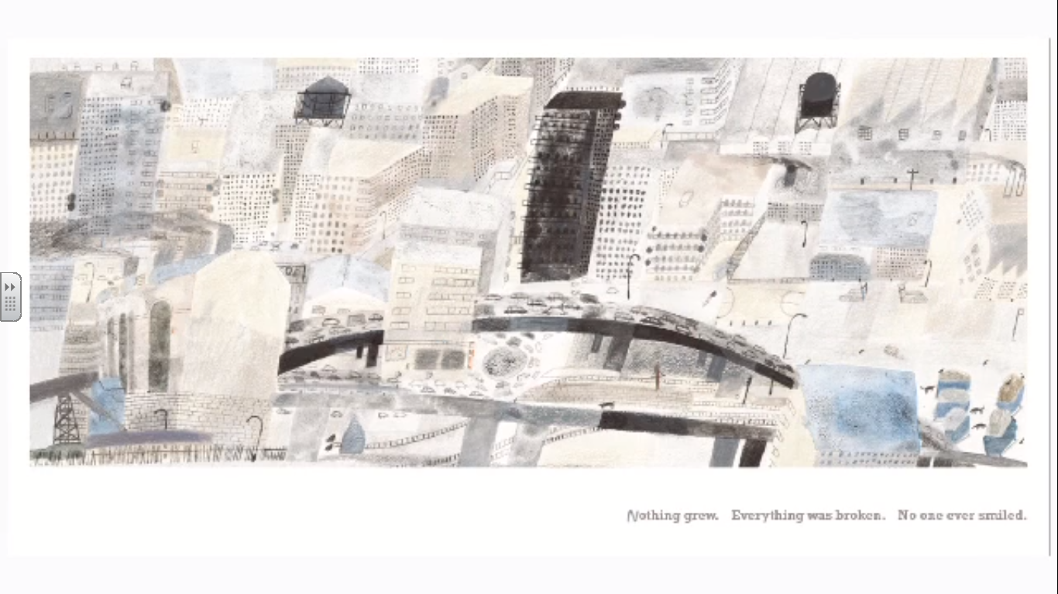

Slide 5
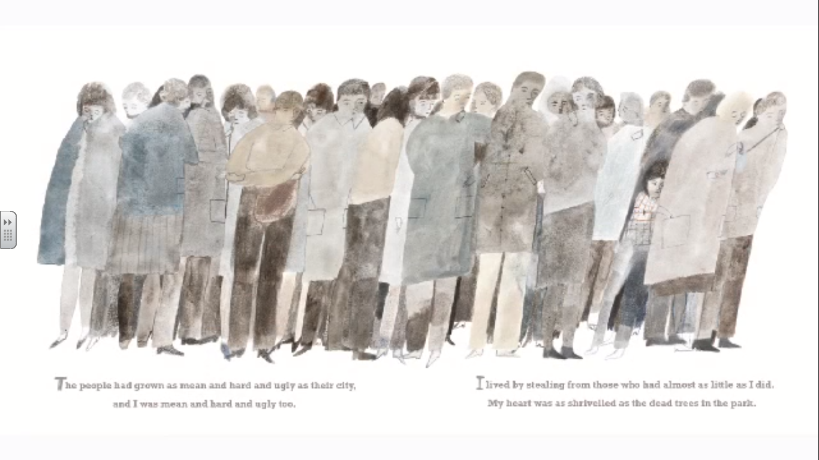

Slide 6
Find the meanings of these words and Phrases
Blessed
Gritty
Scratching round the buildings like a hungry dog
My heart was as shrivelled as the dead trees in the park
_
_
_
_

Slide 7
What would it be like to live here?
Write 4 quality sentences and use some key words from the book.

