Slide 1
Draw a picture
Can you follow the instructions to draw a picture?

Slide 2

Draw a tree

Slide 3
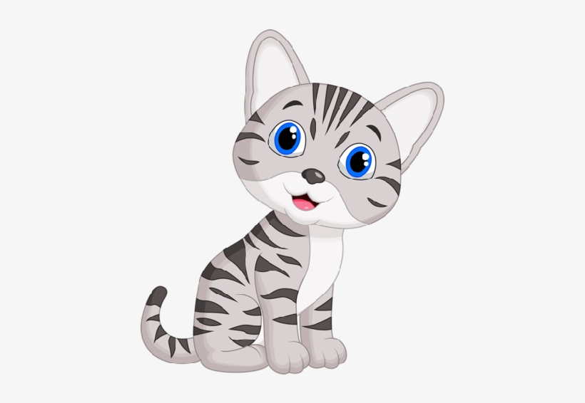
Draw a cat next to the tree.

Slide 4

Draw a slide.

Slide 5
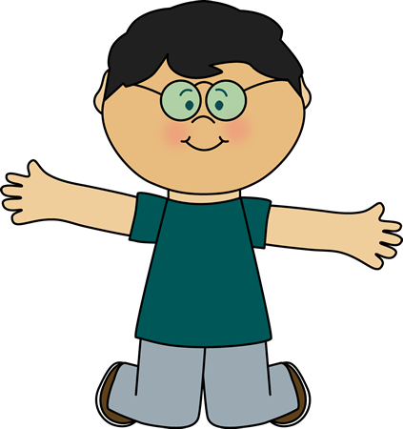
Draw a boy on the slide

Slide 6

Draw a ladybird under the slide

Slide 7

Draw a sun in the sky

Slide 8

Draw a cloud under the sun

Slide 9

Draw a bird next to the cloud.

Slide 10
Is your picture a bit like this:

Slide 11




