Slide 1
Mirror HUNT

Slide 2
Mirror Hunt
Can you have a hunt around your house and find all the mirrors you can find?
What shape are they?
Can you draw the mirrors you find and label the shape?

Slide 3
Here are some mirrors I found in my house:

Slide 4
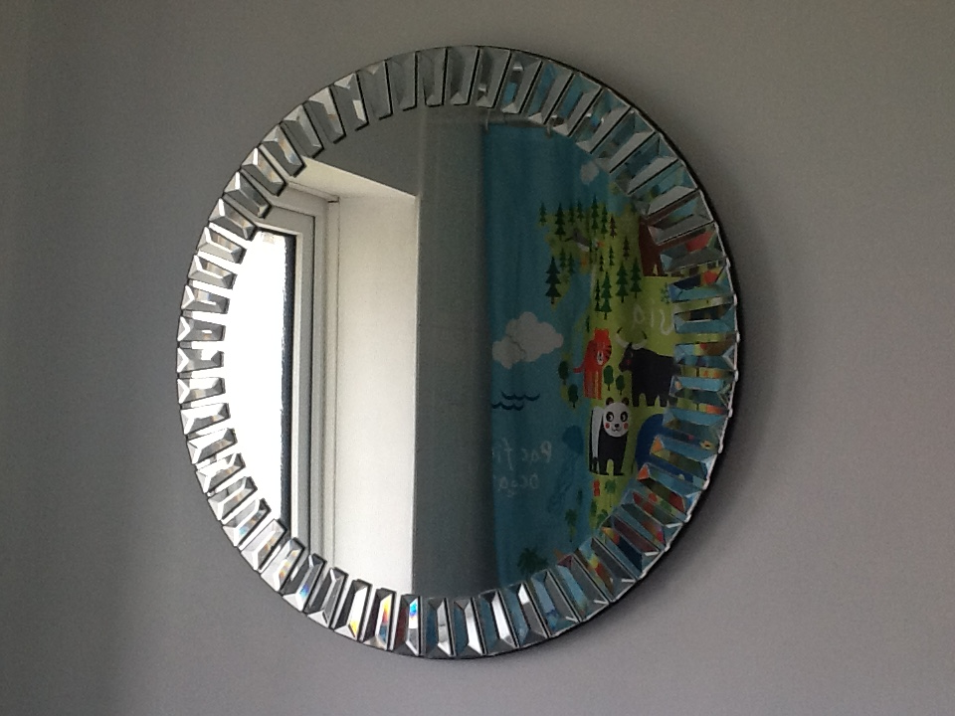
Circle

Slide 5
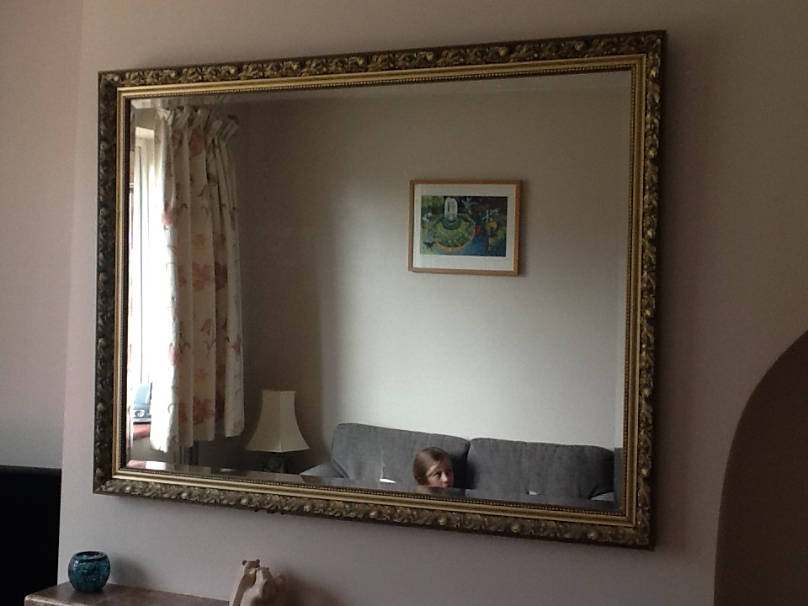
Rectangle

Slide 6
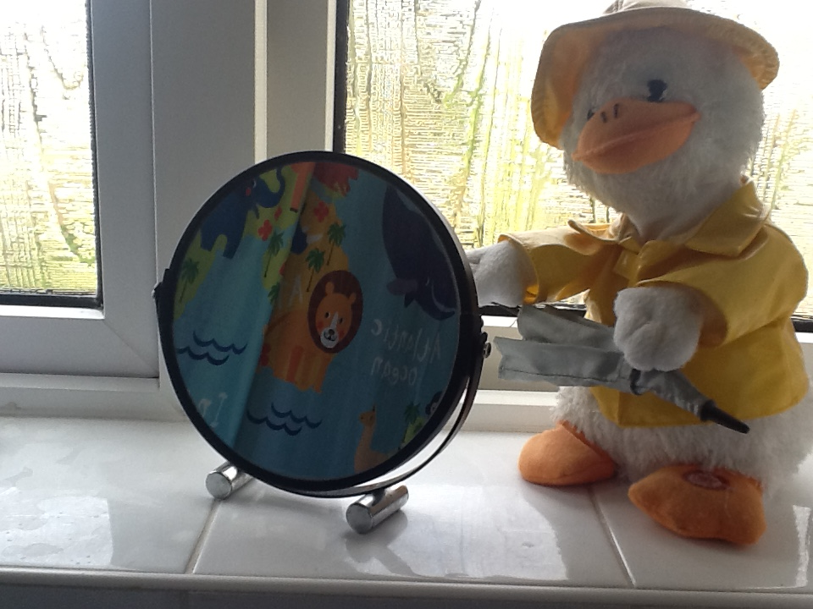
Circle

Slide 7
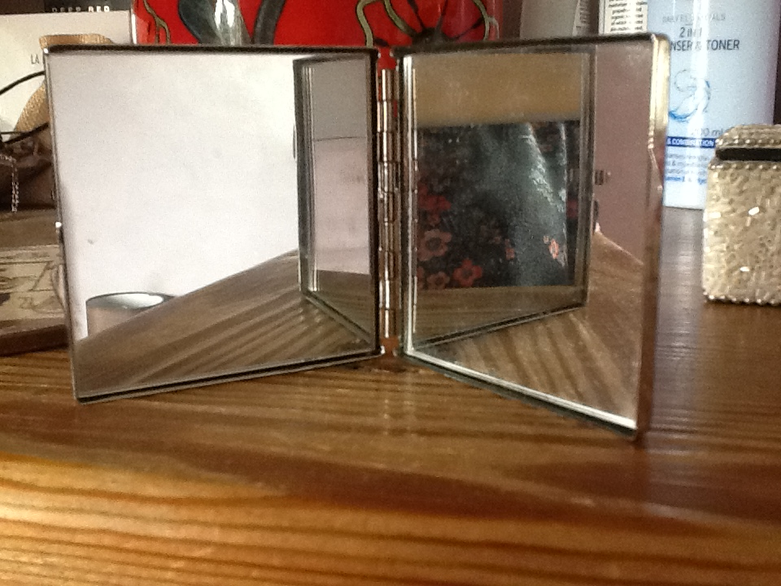
Squares

Slide 8
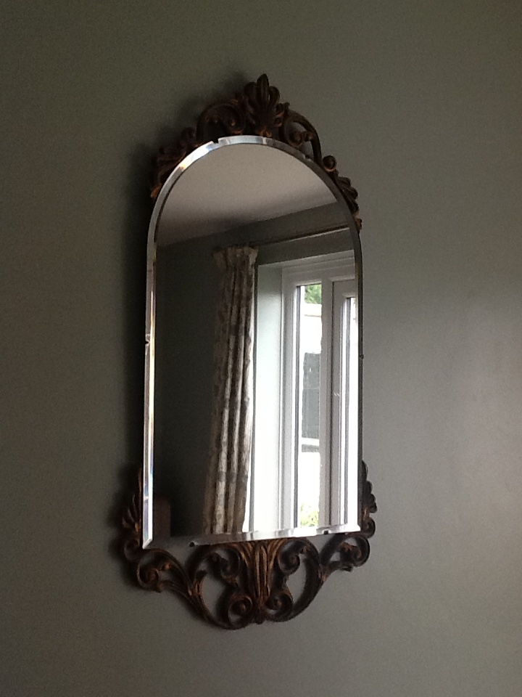
Arch
An arch looks like a square or rectangle with a semicircle on top.

