Slide 1
Matching Shape Hunt

Slide 2
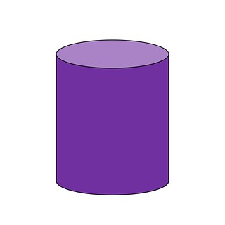
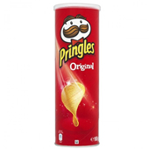
This tube of Pringles matches a cylinder.

Slide 3
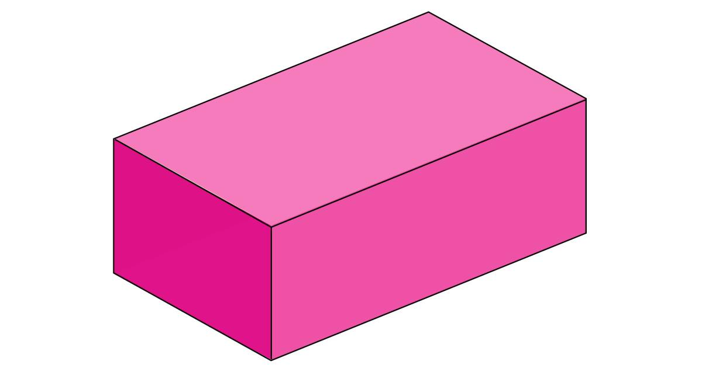
Can you find something in your home to match this shape:

Slide 4

Can you find something in your home to match this shape:

Slide 5
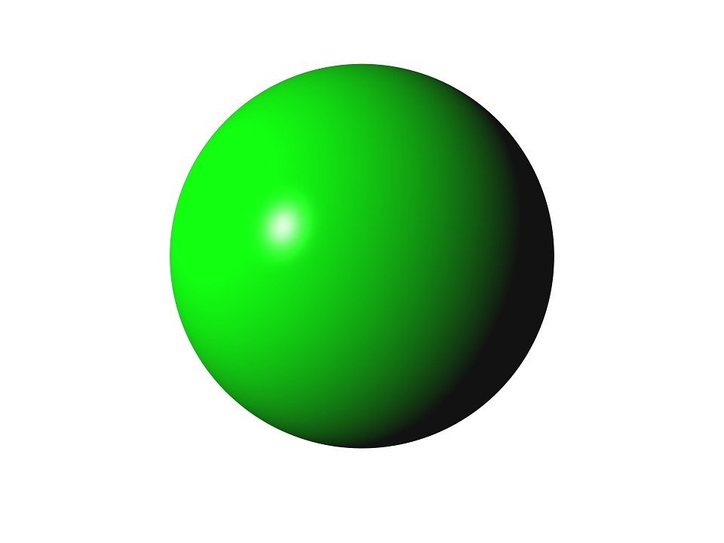
Can you find something in your home to match this shape:

Slide 6
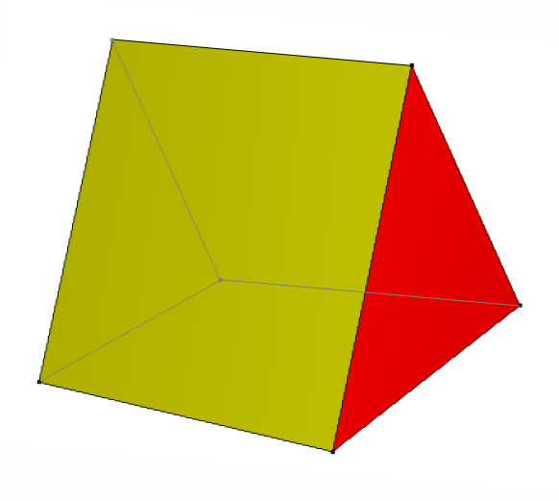
Can you find something in your home to match this shape:

Slide 7
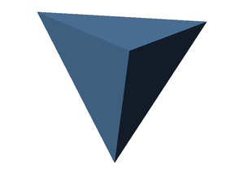
Can you find something in your home to match this shape:

Slide 8
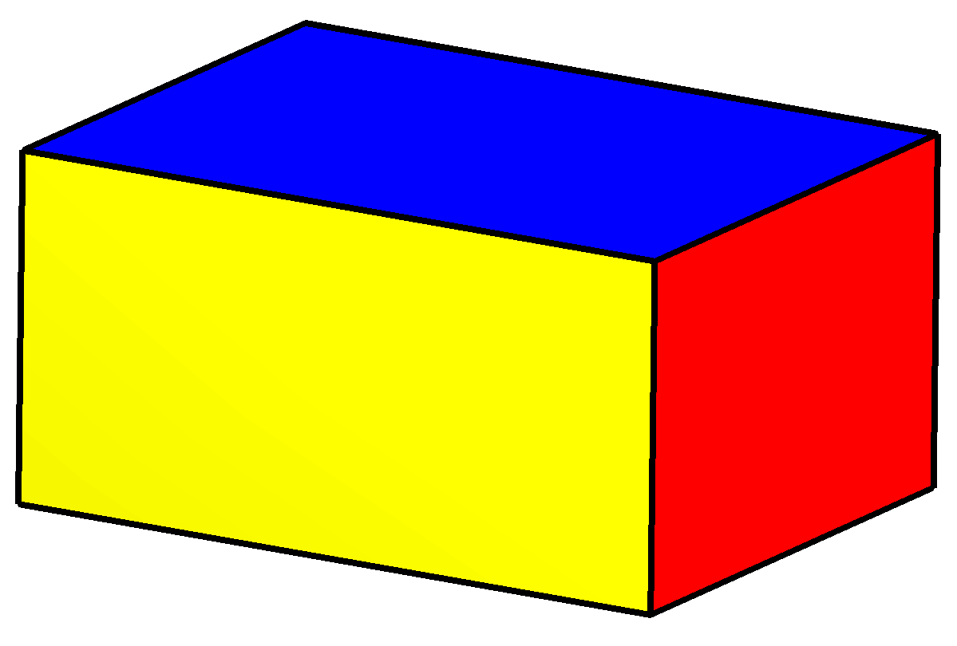
Can you find something in your home to match this shape:

Slide 9
Can you find something in your home to match this shape:

