Slide 1
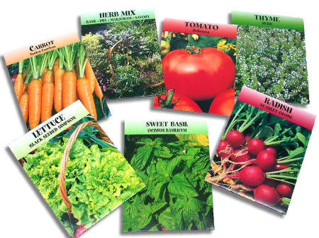
Planting Seeds

Slide 2
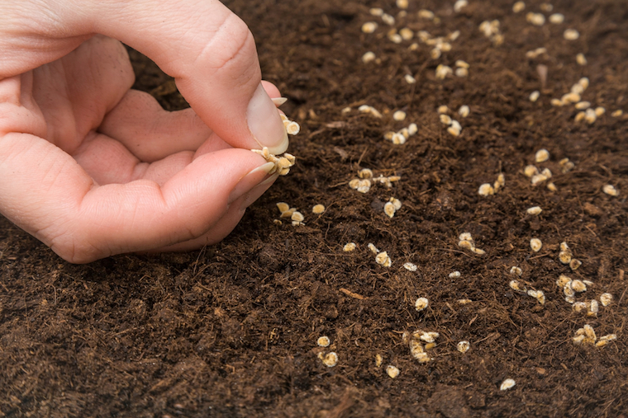
Do you remember planting tomato seeds?
They were tiny!

Slide 3
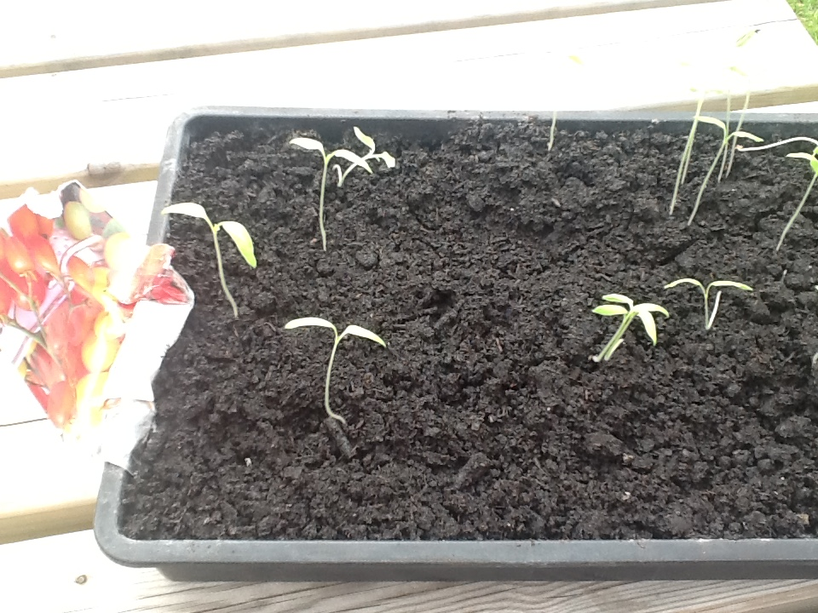
Look how much they’ve grown.

Slide 4
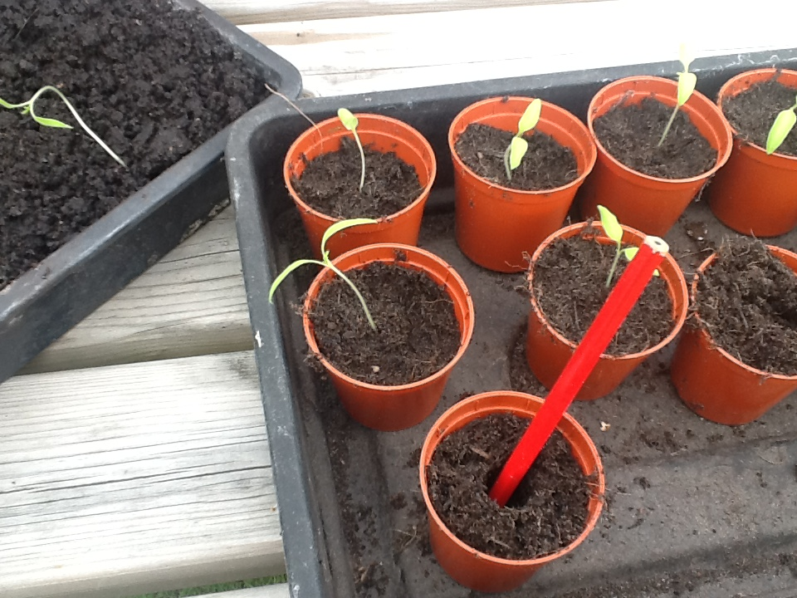
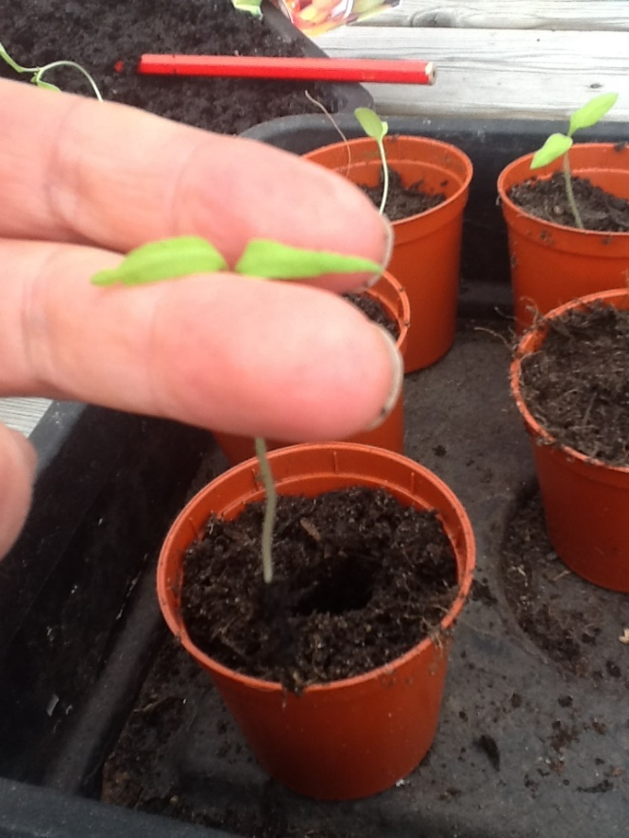
I have re-potted them today.

Slide 5
You can plant some seeds too.
Find the seeds in your home learning pack – they’re in a brown envelope. Don’t worry if you haven’t got a plant pot, you could use a yoghurt pot.

Slide 6
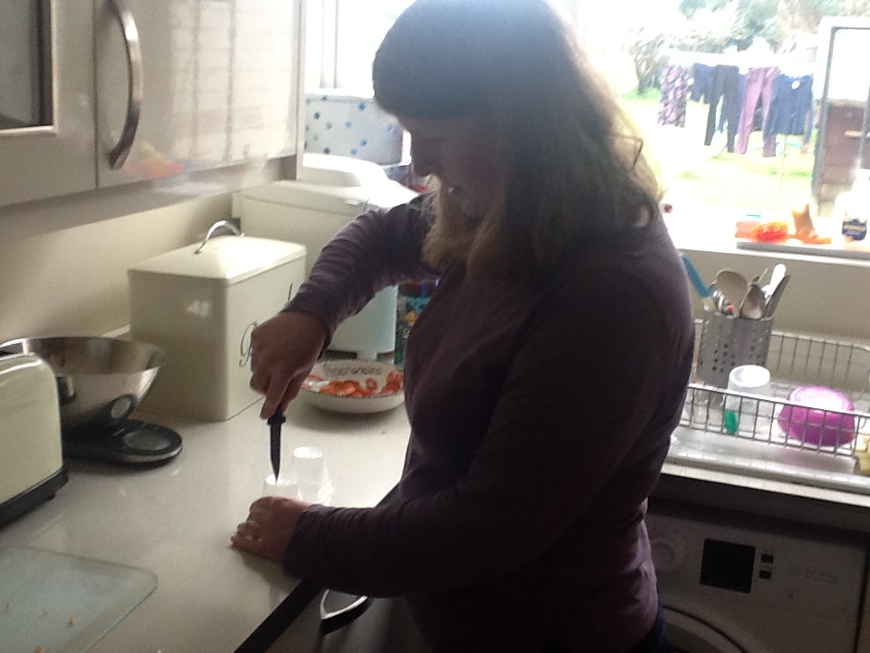
Put some holes in the bottom of your pots.

Slide 7
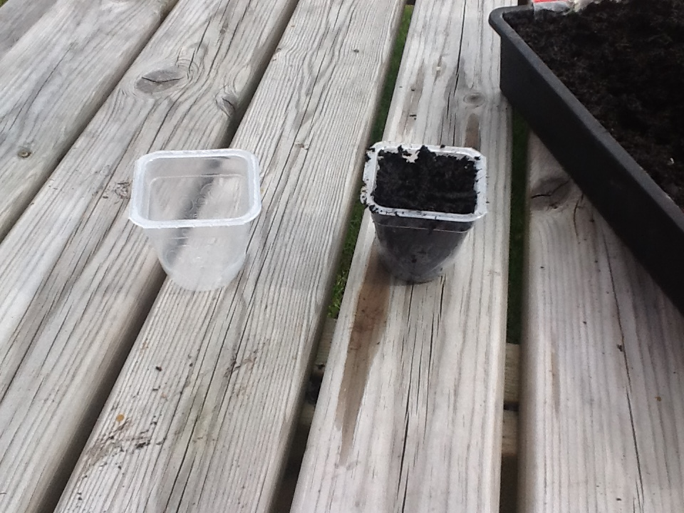
Fill your pots with compost or soil.

Slide 8
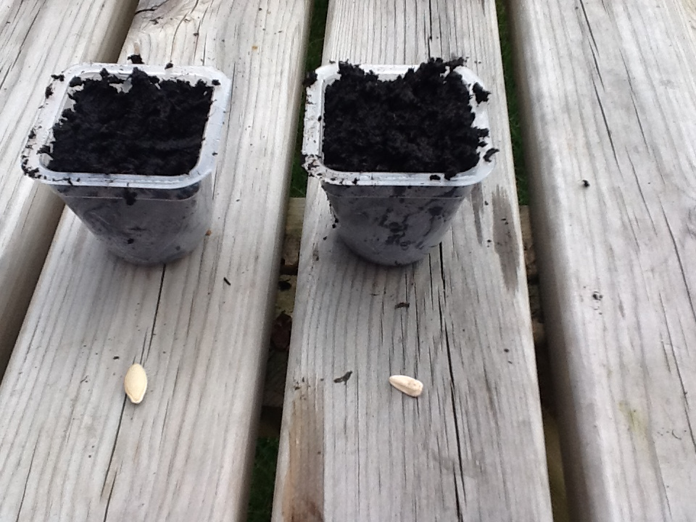
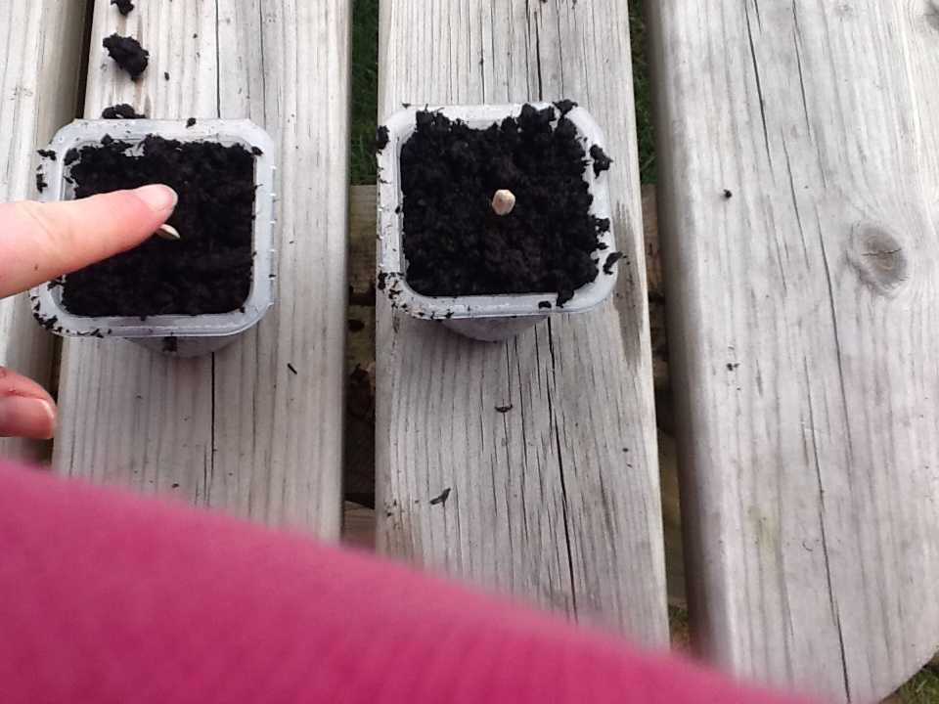
Find your seeds. Push them into the soil – pointy end down!

Slide 9
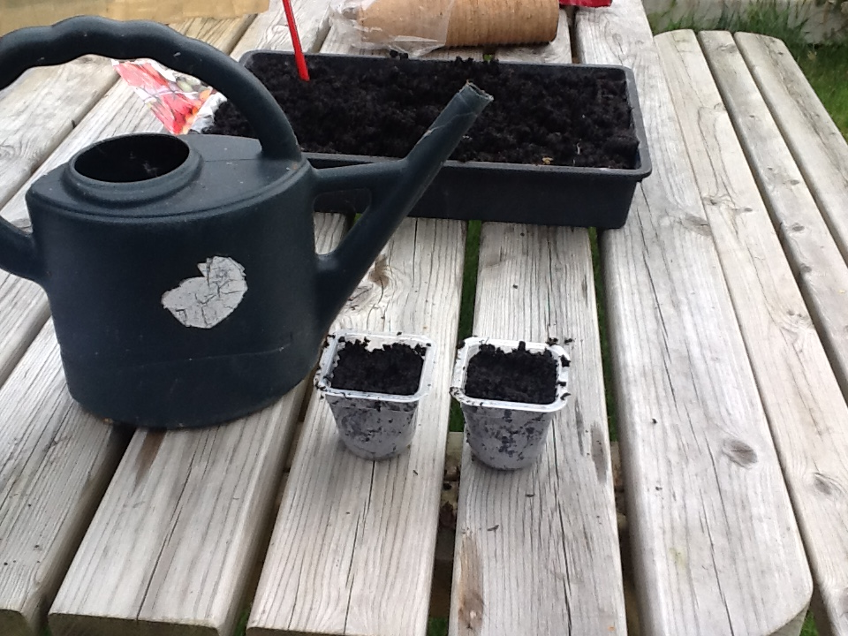
Water your seeds.

Slide 10
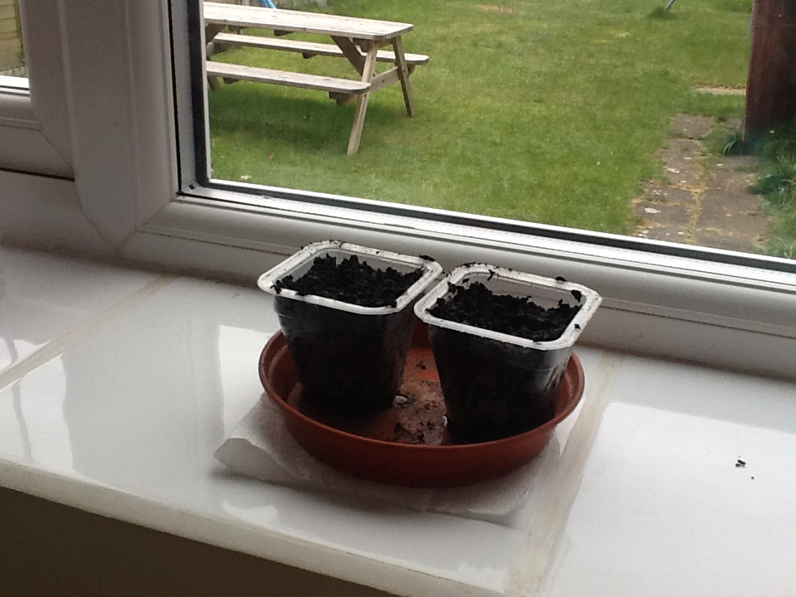
Put the pots on a warm window sill.

Slide 11

Wait and see what grows!

