Slide 1
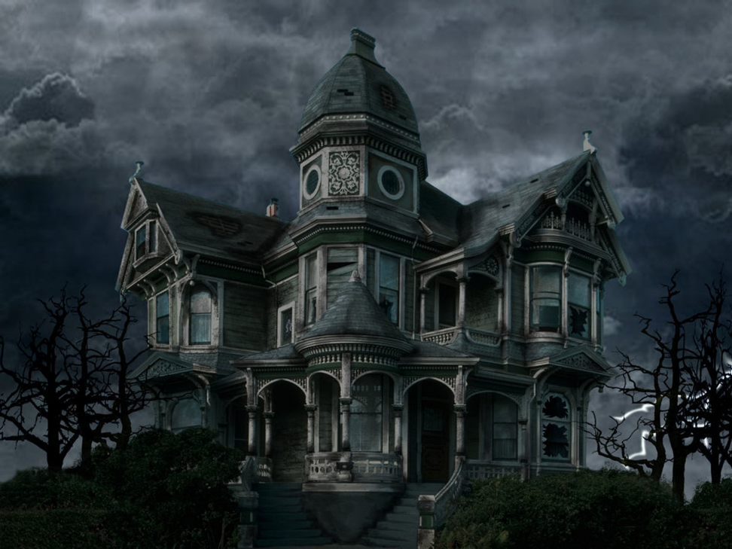
Horror
Success Criteria:
You must:
Create atmosphere
Use a range of sentence constructions
You should attempt:
Select verbs forms for meaning and effect

Slide 2
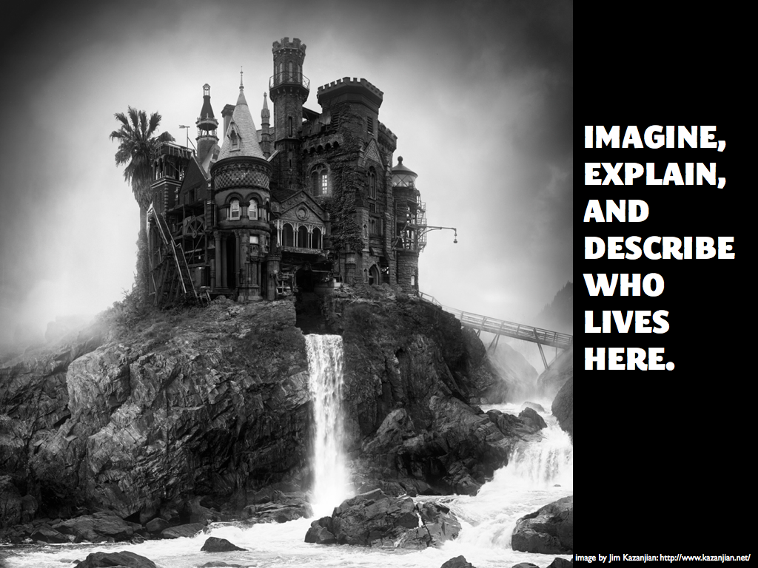

Slide 3
In The Attic…
The attic door creaked open. Something rustled in the darkness. I stared, but could see nothing beyond the vague shapes of old suitcases and trunks piled high. I struggled up into the attic and wedged the door open. Light poured into darkness. I balanced carefully upon the floor beams. I knew that if I stepped onto plaster I could fall straight through into the room below. A cobweb brushed my face and I felt a spider crawl across my cheek. As I made my way forwards, it grew darker and colder. I was blocking the light from the attic door. There were piles of old newspapers, brown bags tied with string cardboard boxes and ancient, moth eaten rugs. Thick dust powdered every surface. I kept thinking that I could slip and put my foot through the floor. Underneath a pile of camping equipment, I saw a hand. It was quite still and white, like a marble. But then it moved!

Slide 4
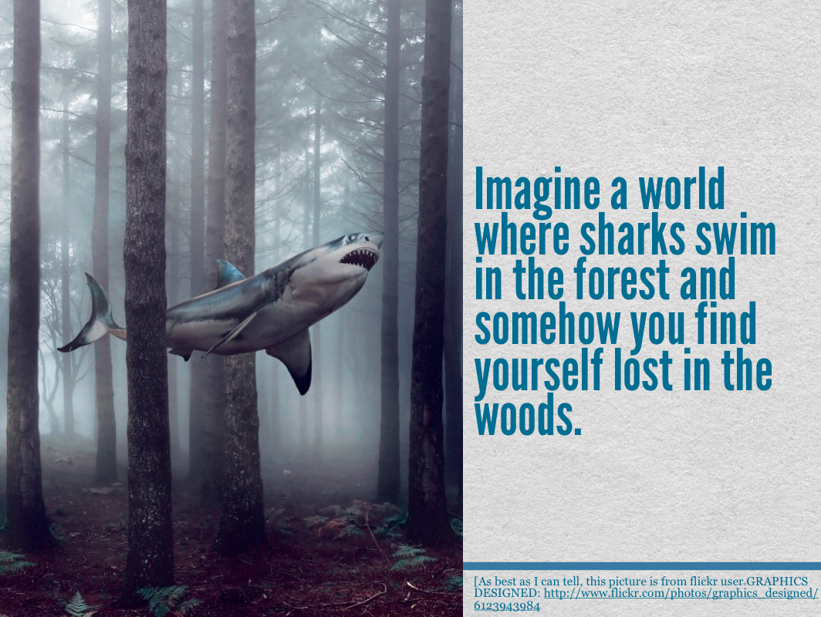

Slide 5
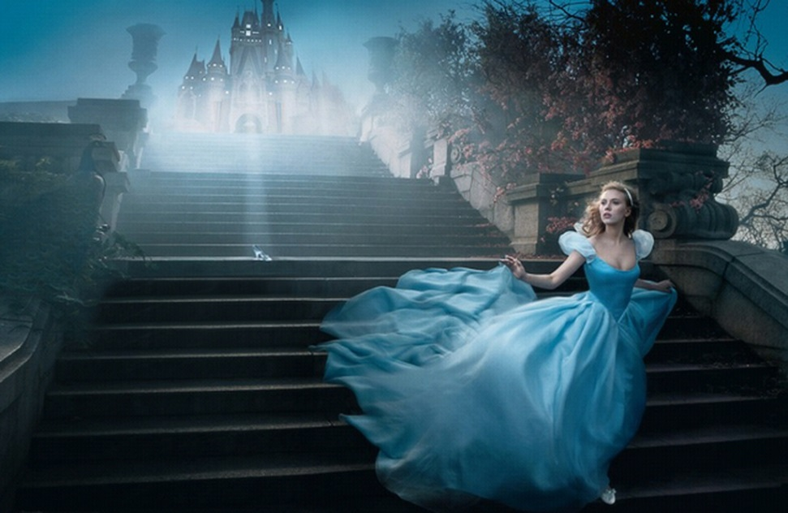
Fairy Tale
Success Criteria:
You must:
Use adverbs, prepositions and extended noun phrases to add detail
Carefully select vocabulary for characterisation
You should attempt:
Select verbs forms for meaning and effect

Slide 6
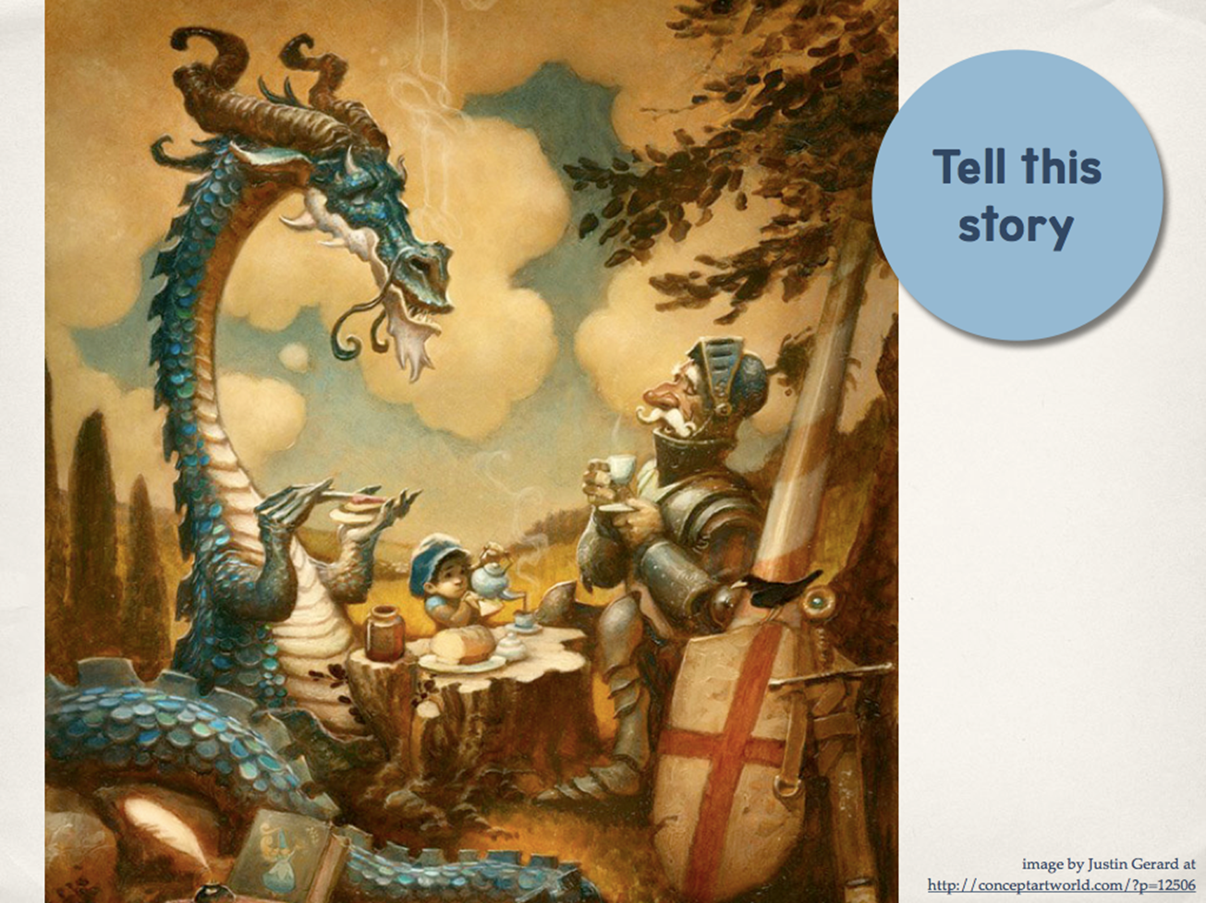

Slide 7
The Knight & The Dragon
Carefully sipping from his tiny china cup, the gigantic turquoise dragon smiled happily at the ancient knight. Thankfully, they had put their differences aside and so there was no need for battle. Trembling, the young boy tried desperately to keep the tea-pot upright as he poured the scalding tea into the spare cup. As loud as a trumpet, the old knight let out a huge belch and returned the smile of his former foe before reaching over for a slice of toast.

Slide 8
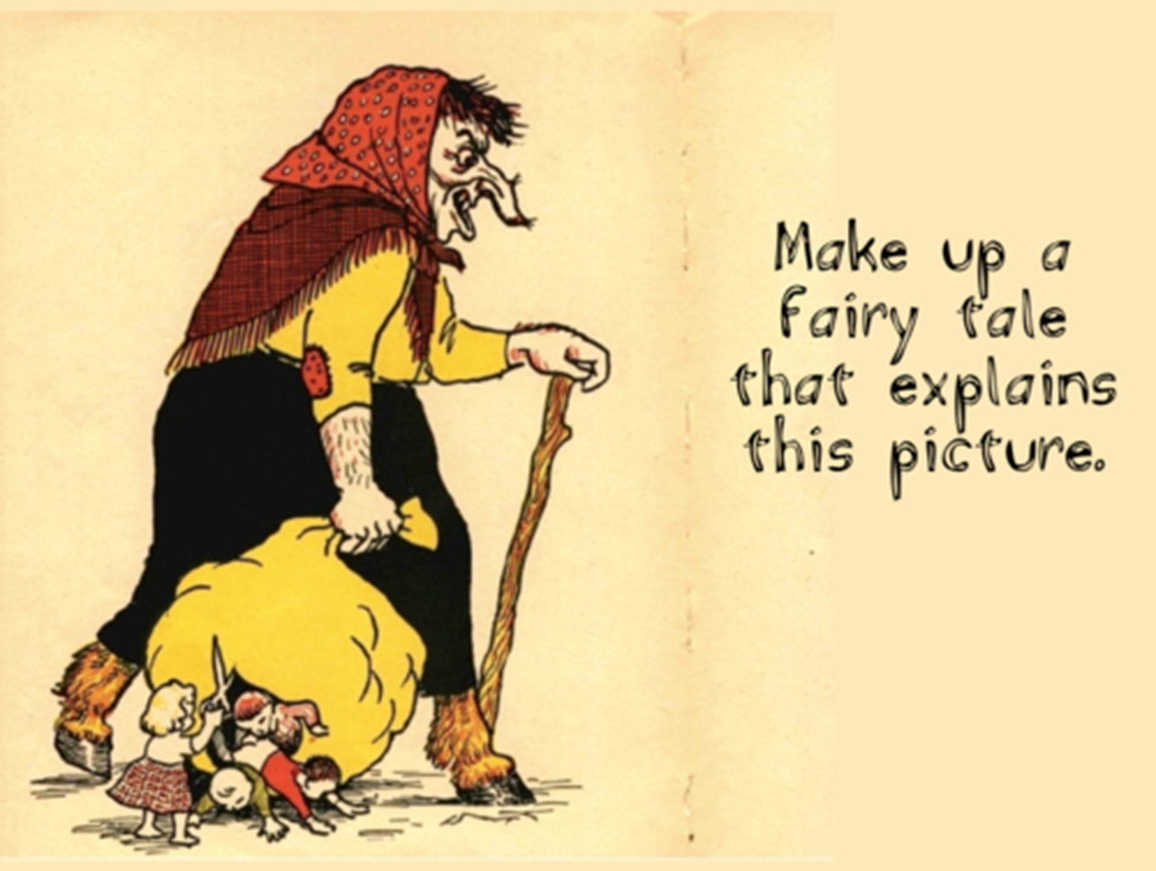

Slide 9

Extraordinary Characters
Success Criteria:
You must:
Use vocabulary to reflect the level of formality
Use dialogue for characterisation
You should attempt:
Shift between levels of formality

Slide 10
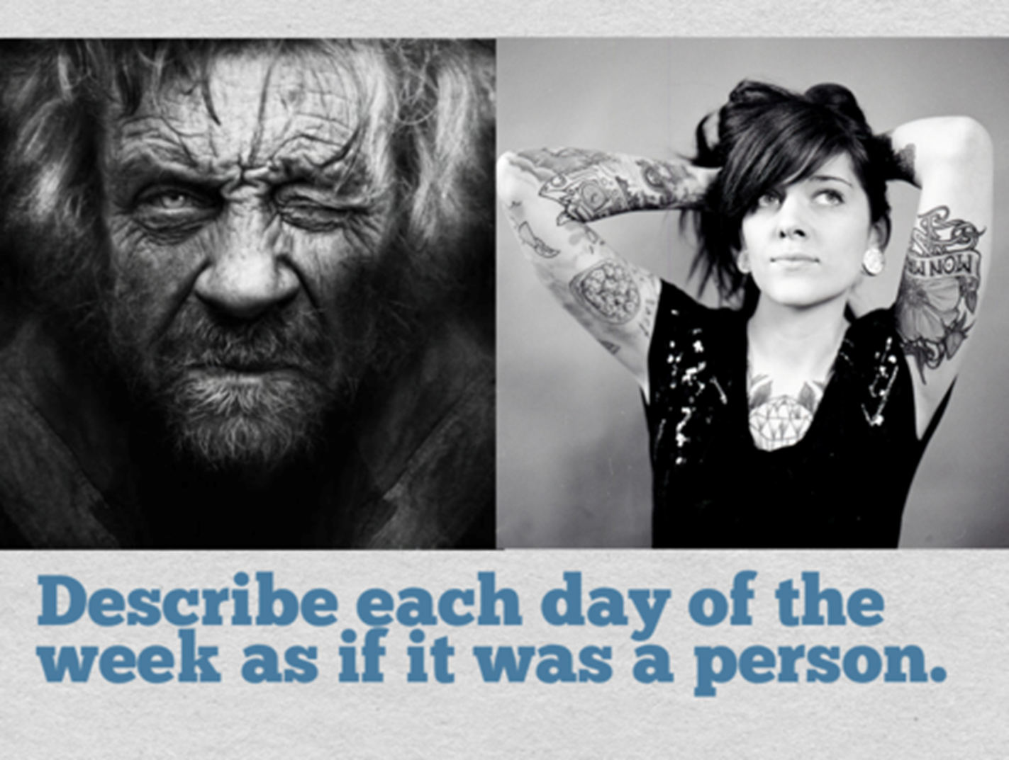

Slide 11
Friday meets Monday
Grumpily, Monday shuffled into the kitchen and slowly poured himself a cup of thick, black coffee. At the back of his head, the migraine was already beginning to throb. He furrowed his brow and began to grind his teeth.
“Good morning!” chirped Friday, as she bounded into the room, sunglasses resting on her glossy hair.
“Keep it down, you toe-rag! I’m not in the mood,” replied Monday.
“But it’s a beautiful day,” pointed out Friday.
“I’ve got a tonne of work and I didn’t sleep last night…”
“You should take it easy,” replied Friday, “Come and join me for yoga in the park.”
“Out! Get out! You silly girl! I’ve had enough of your prattling!” exploded Friday.

Slide 12
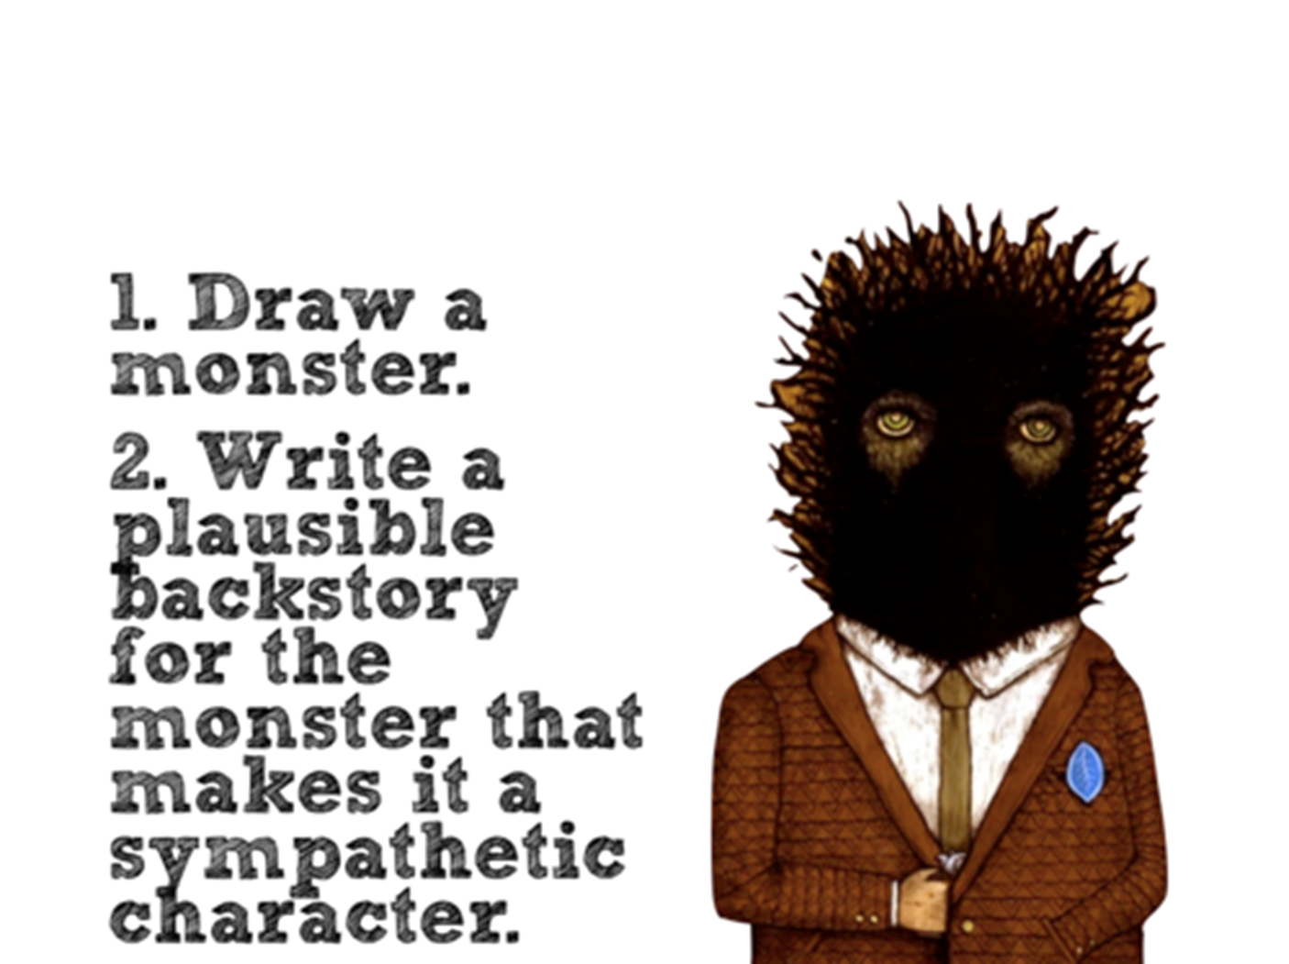

Slide 13
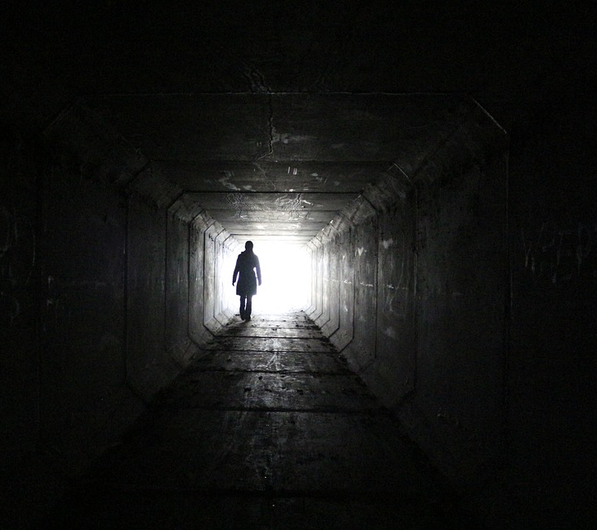
Mystery
Success Criteria:
You must:
Use a range of cohesive devices, including adverbials
Use some punctuation for clarity and to create meaning
You should attempt:
Use a full range of punctuation

Slide 14
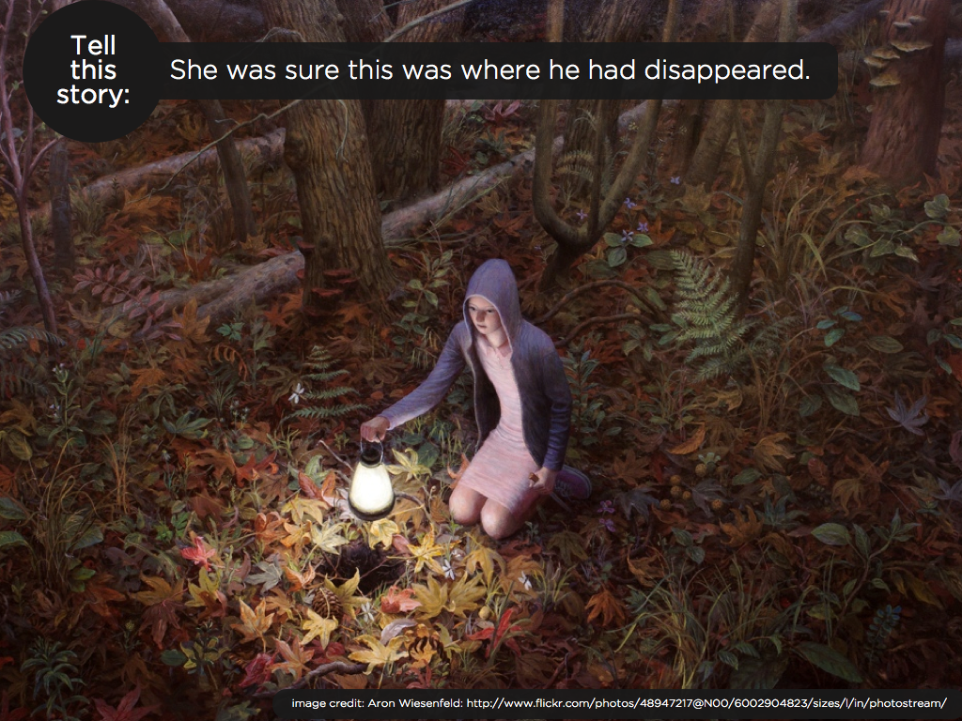

Slide 15
Searching By Lantern-Light
She was sure this was where he disappeared. But it was hard to tell: the lantern’s power was already beginning to fade and the shadows were gathering around her. A soft breeze brushed against her face and sent the autumn leaves rustling; they seemed to whisper “leave this place…”
The fear tasted bitter in her mouth, but she couldn’t turn back (who else would search for her brother?) With trembling hands, she lowered the lantern and spotted a hole half-buried next to an ancient oak tree. She moved closer…

Slide 16
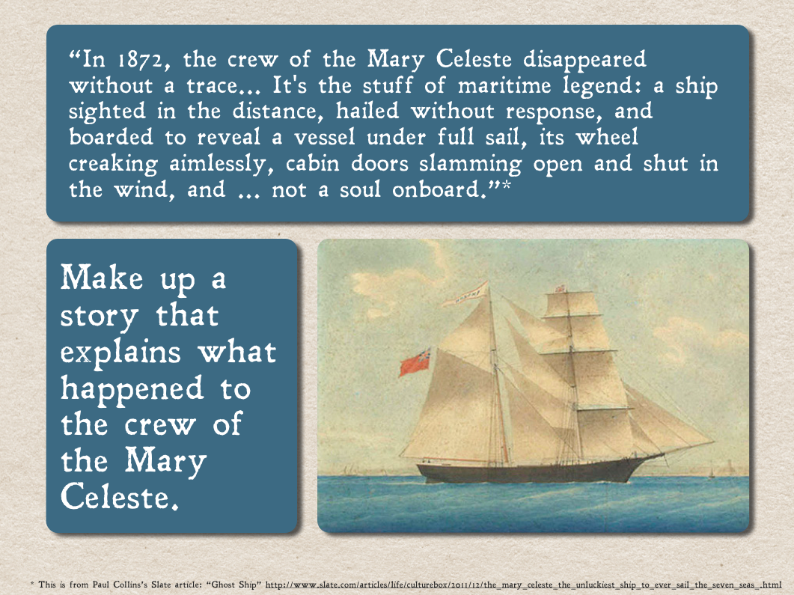

Slide 17

Monologues
Success Criteria:
You must:
Use adverbs, prepositions and extended nouns phrases to add detail
Use passive and modal verbs
You should attempt:
Select verbs for effect and meaning

Slide 18
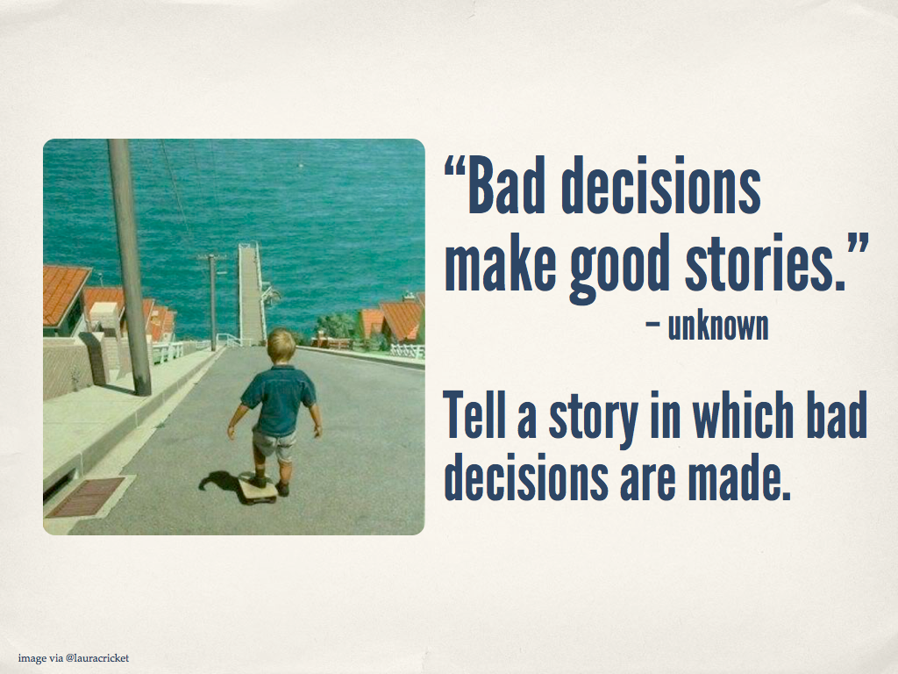

Slide 19
The Executioner’s Office
Standing outside the deputy headmaster’s office seemed to last forever. Ross was already inside. I stared glumly at the turquoise carpet, purposely avoiding the desperate gaze of Carl. So this is how it was going to end. Stories of Mr Burton’s cruelty were legendary, even to lowly Year Seven pupils like us. Every pupil who passed us on the corridor shot us sympathetic glances. Even the Year Elevens, who rarely acknowledged the existence of the ‘little ones’, offered compassionate looks. Eventually, the door of the executioner’s office opened and revealed the wide frame of Mr Burton. He advanced upon us slowly, to make the torture all the worse, revealing his savage face. He had deep lines on his forehead and around his mouth (no doubt earned from years of frowning at disobedient child), a pointed nose with enormous flared nostrils and a thick neck leading to a gaping mouth, designed purely for bellowing. “Inside,” he gestured with a long, fat finger.
Forlornly, we trudged into Mr Burton’s lair...

Slide 20


