Slide 1
Addition

Slide 2
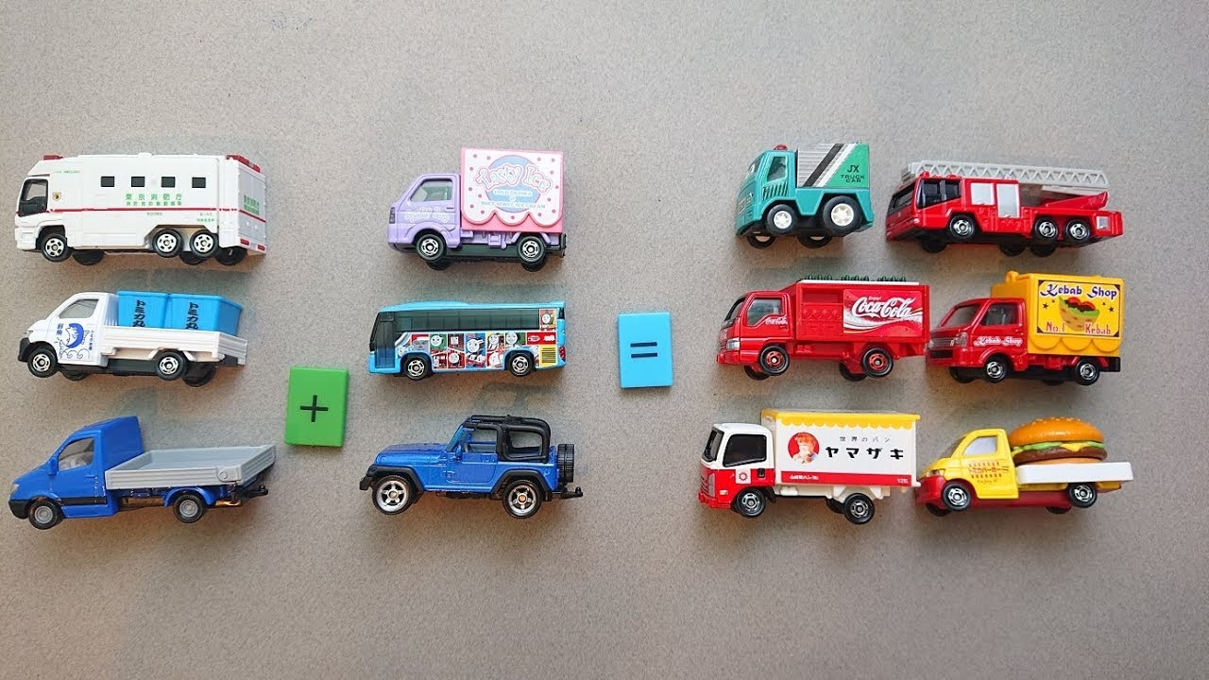
Can you find some toys to add?

Slide 3
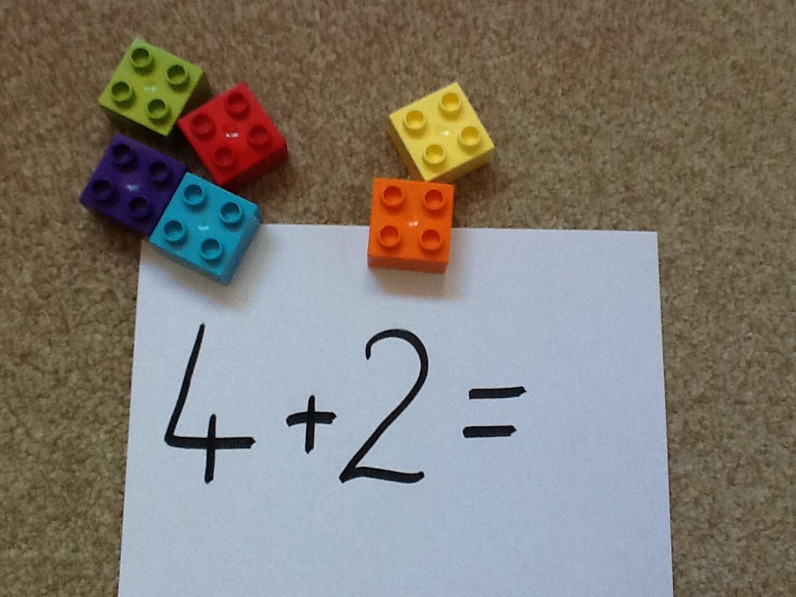
Can you count how many bricks I have all together?

Slide 4
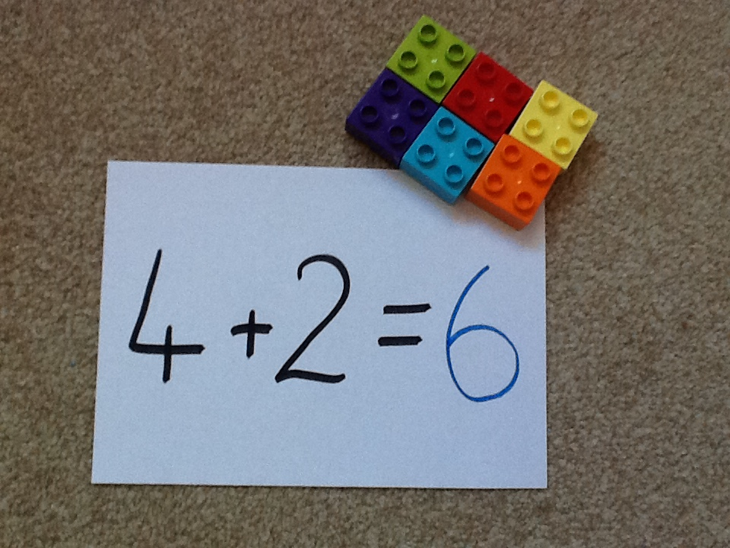

Slide 5


Were you right?
Have a go at some more:

Slide 6
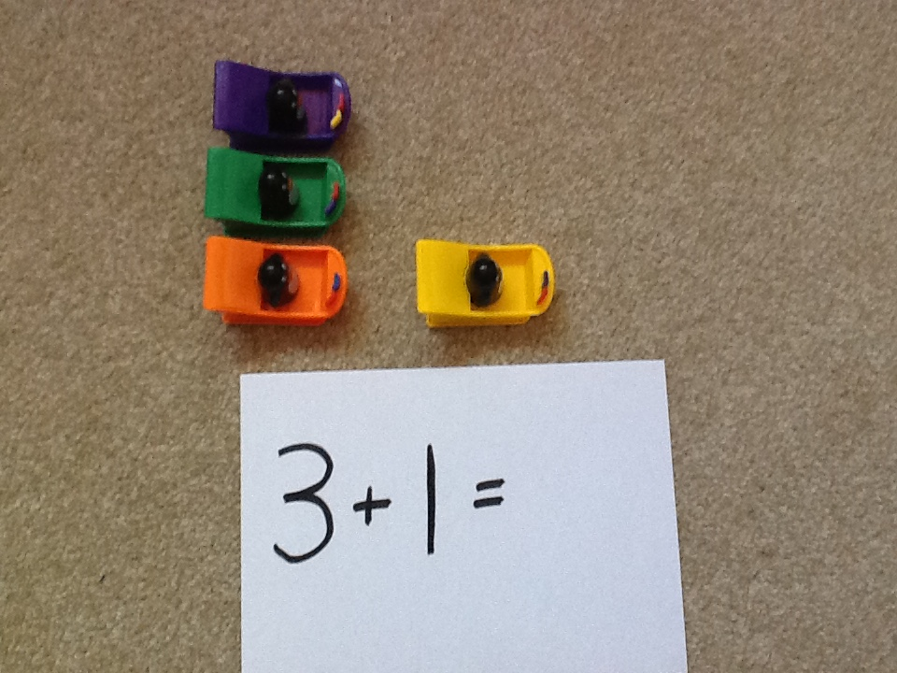
Can you count how many penguins I have all together?

Slide 7
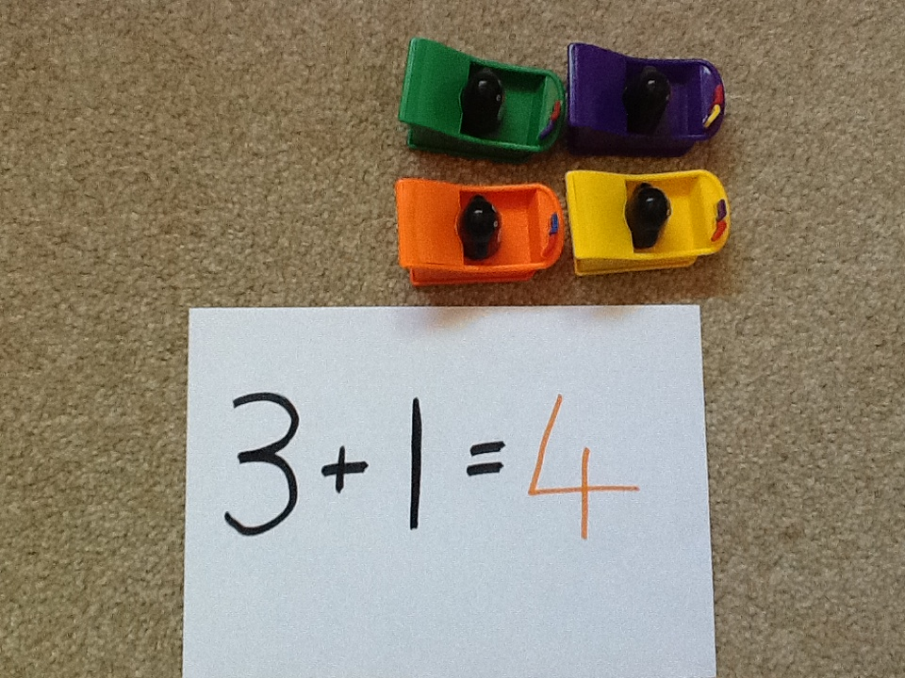

Slide 8
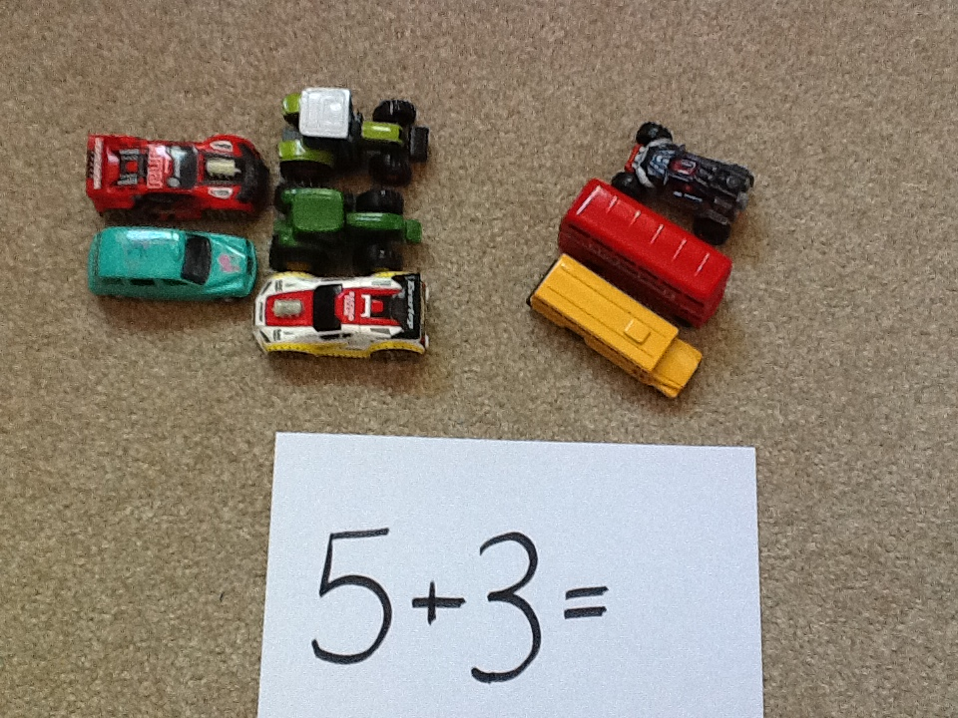
Can you count how many toy cars I have all together?

Slide 9
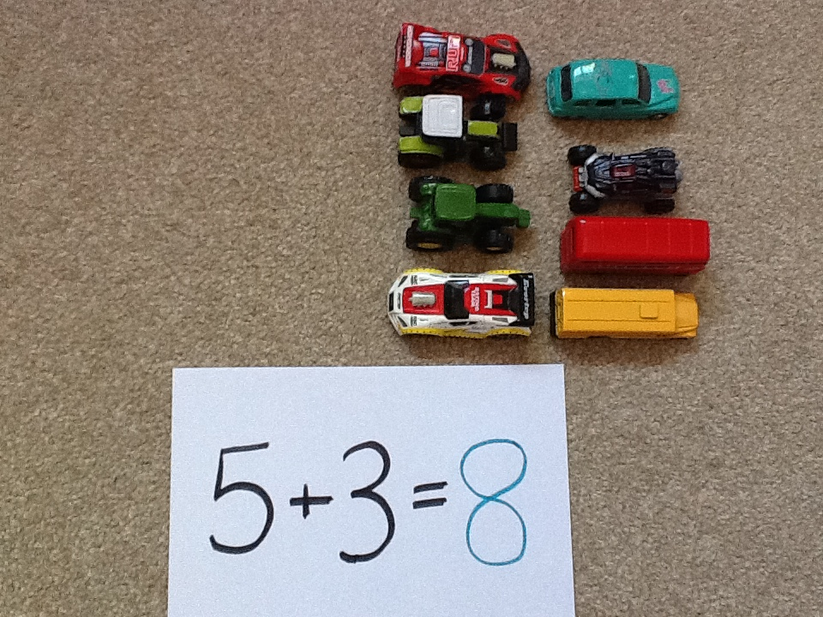

Slide 10
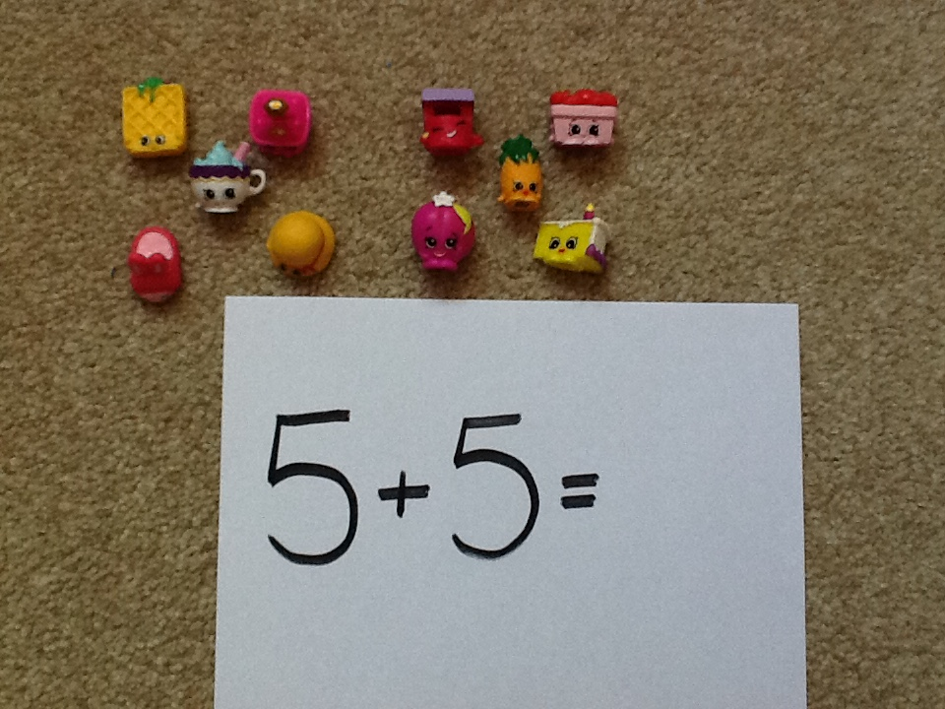
Can you count how many shopkins I have all together?

Slide 11
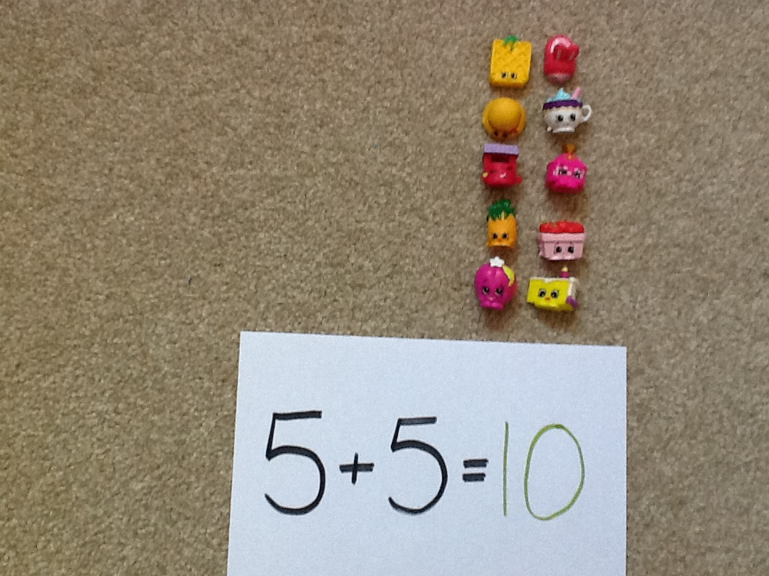

Slide 12
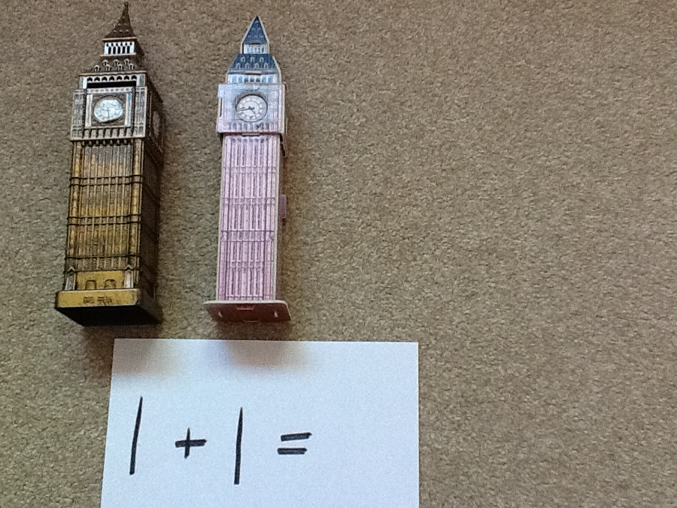
Can you count how many Big Bens I have all together?

Slide 13
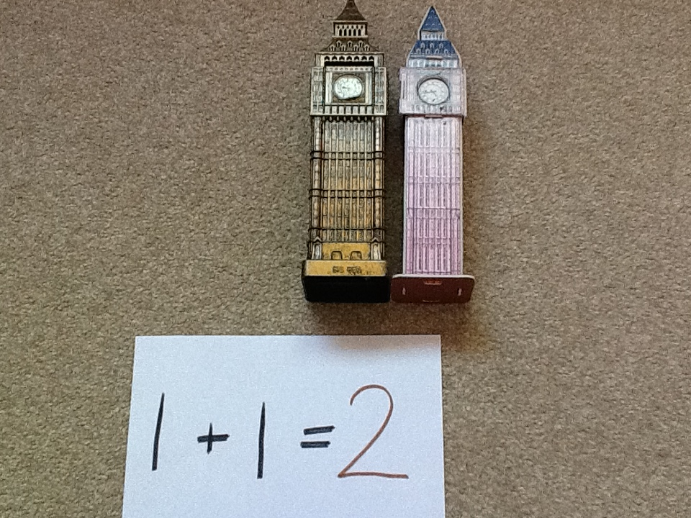

Slide 14
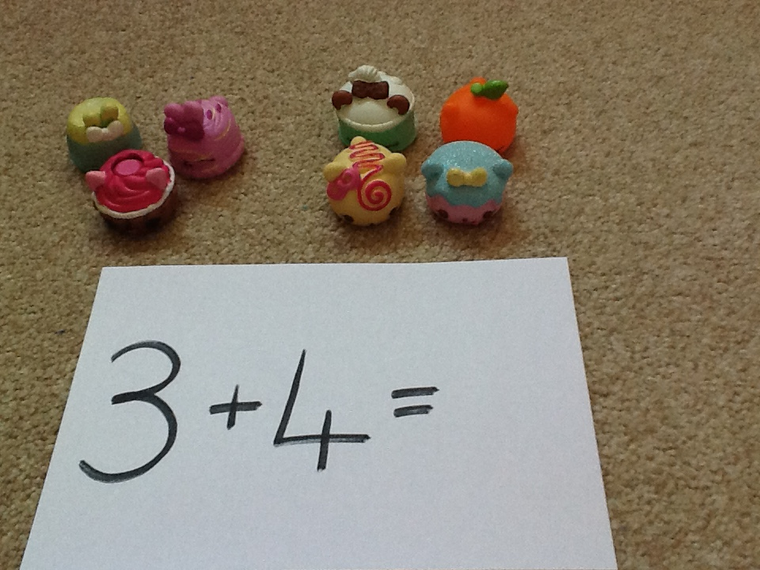
Can you count how many num noms I have all together?

Slide 15
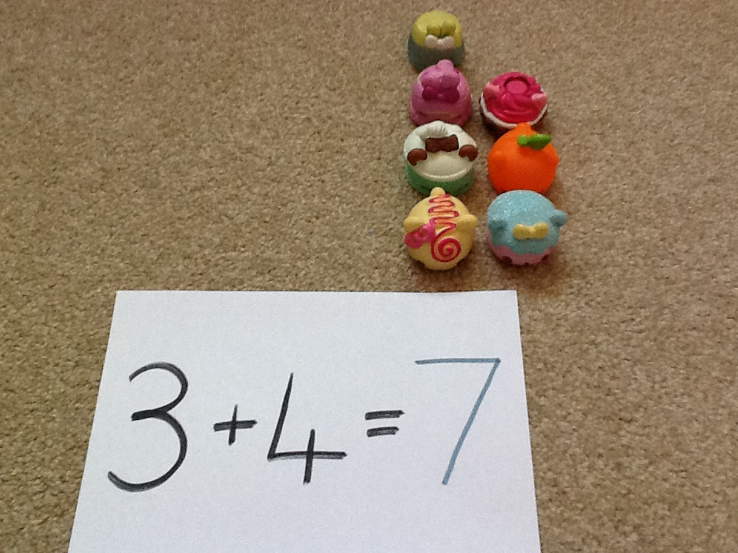

Slide 16
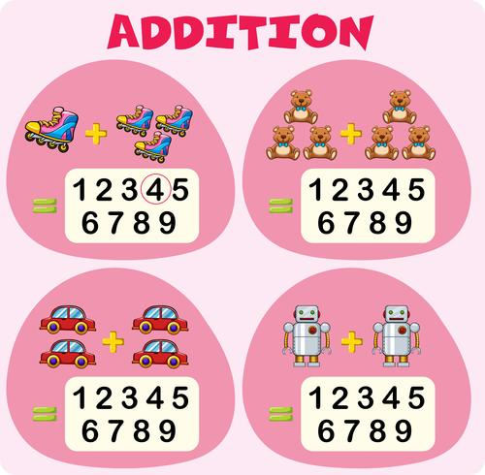
Now have a go using your toys.
Have fun!

