Slide 1
Subtraction

Slide 2
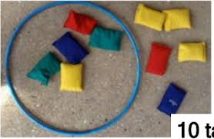
Can you find some toys to take away?

Slide 3
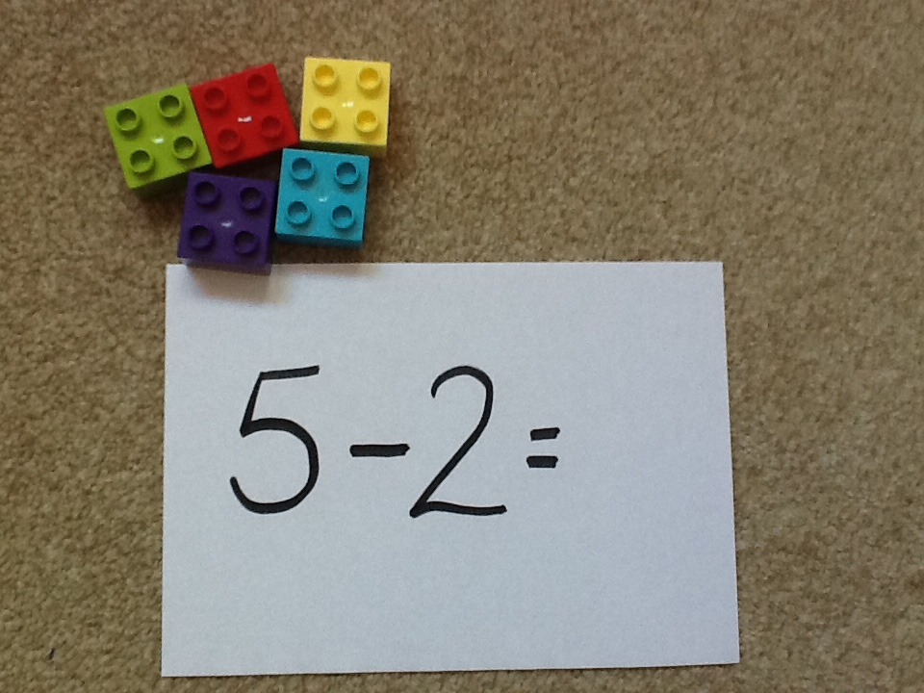
How many bricks will I have left if I take 2 away?

Slide 4
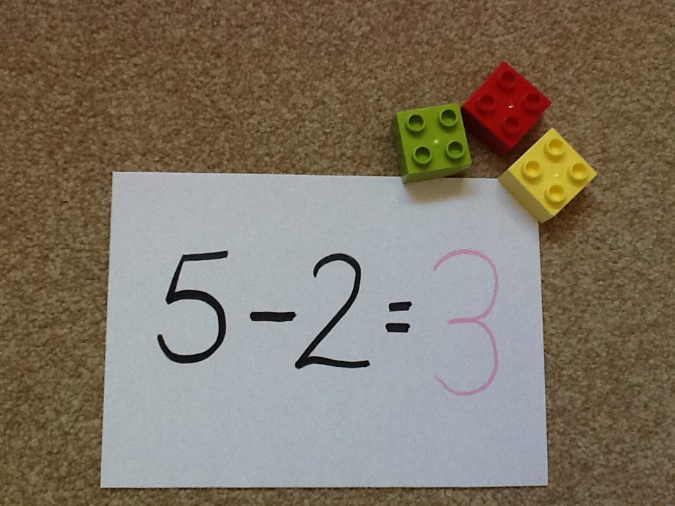

Slide 5


Were you right?
Have a go at some more:

Slide 6
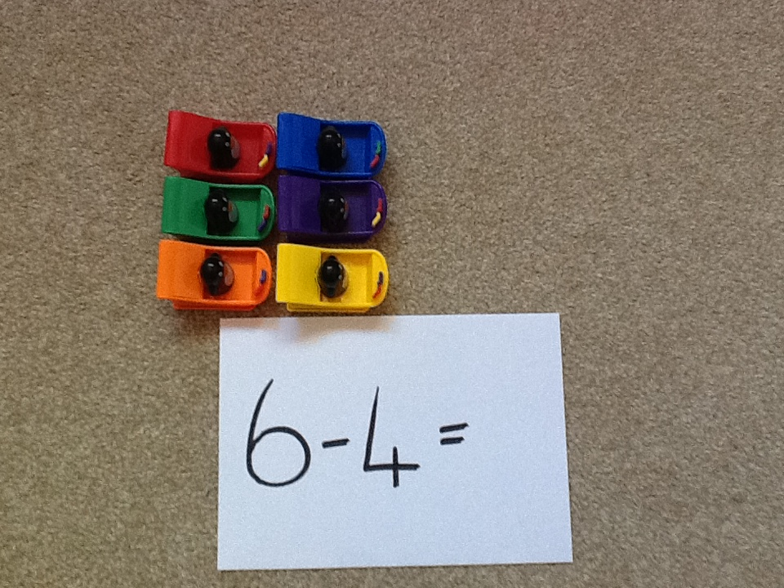
How many penguins will I have left if I take 4 away?

Slide 7
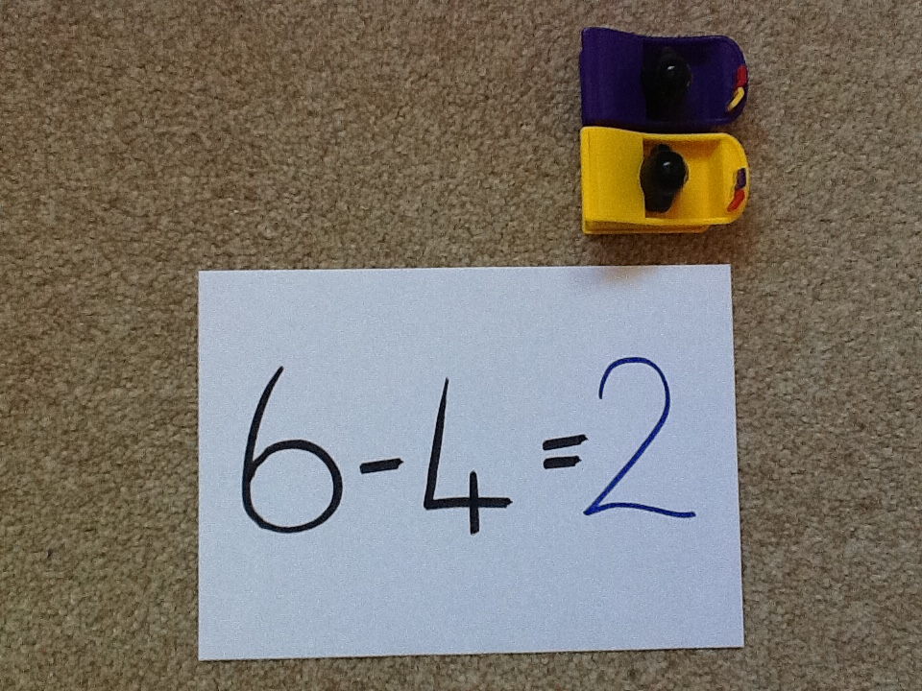

Slide 8
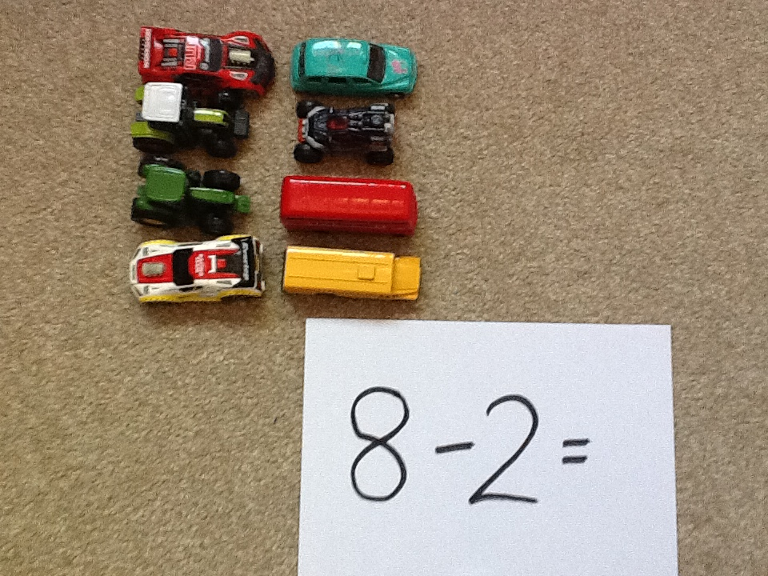
How many toy cars will I have left if I take 2 away?

Slide 9
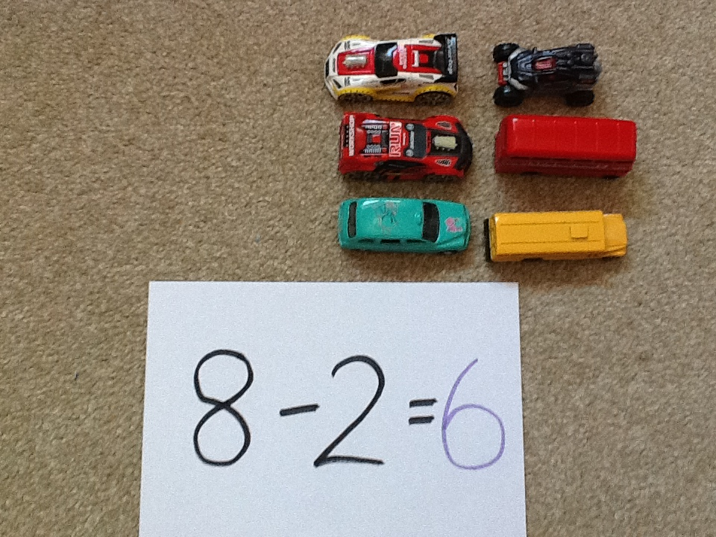

Slide 10
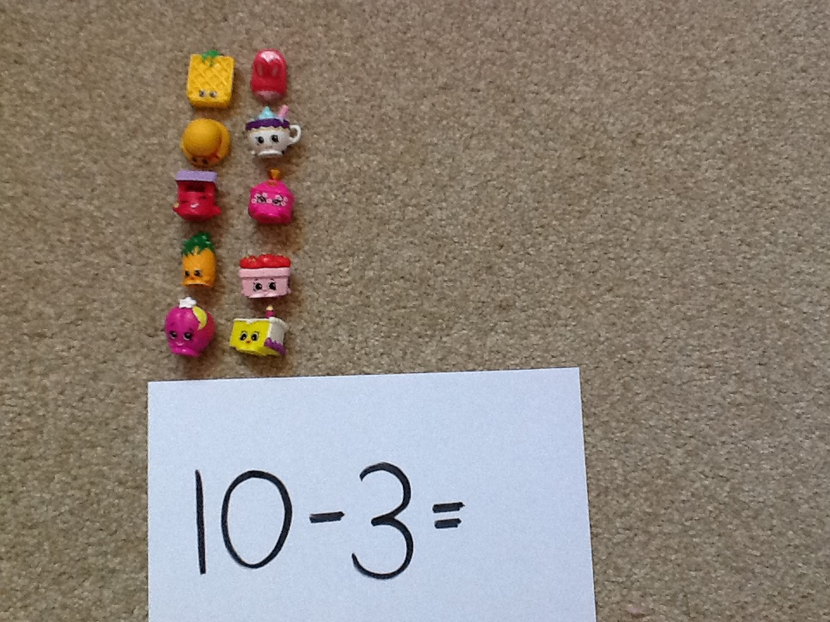
How many shopkins will I have left if I take 3 away?

Slide 11
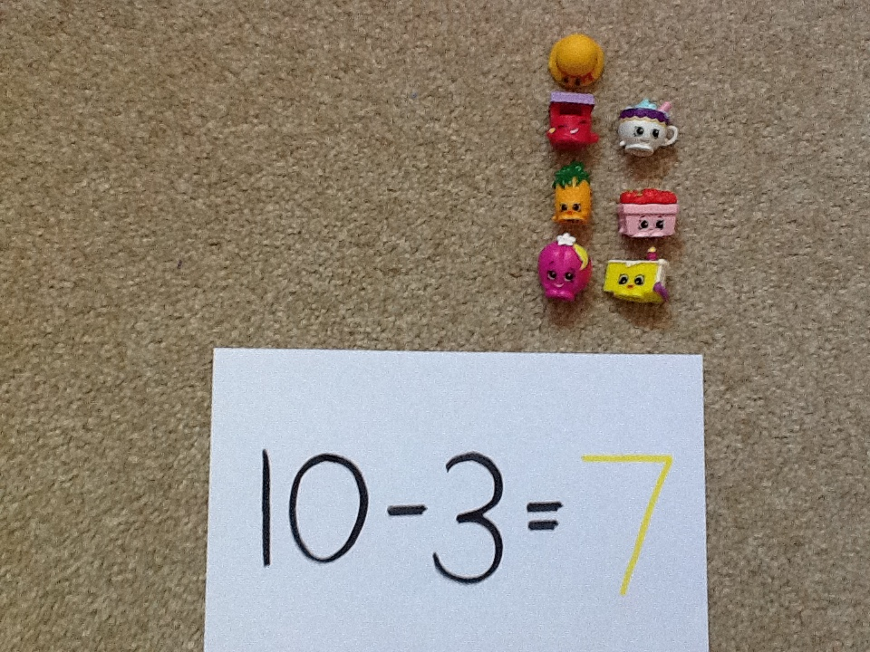

Slide 12
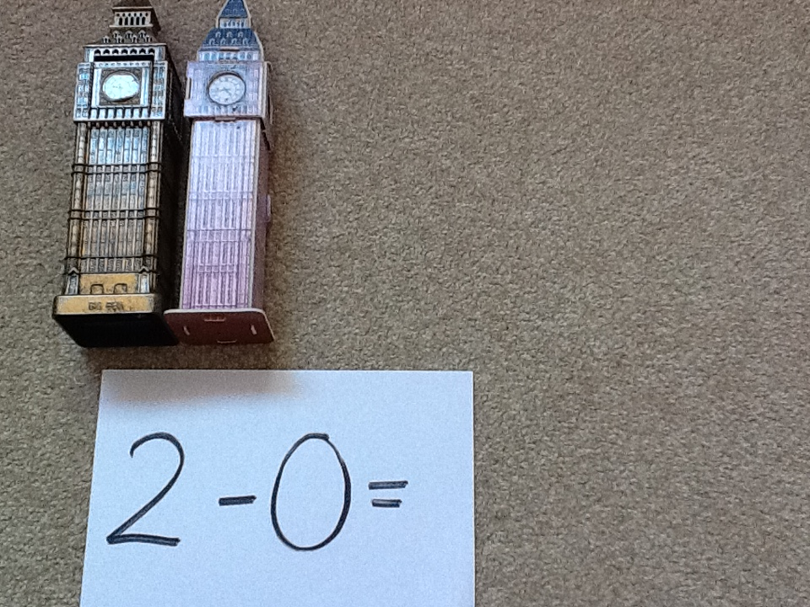
How many Big Bens will I have left if I take 0 away?

Slide 13
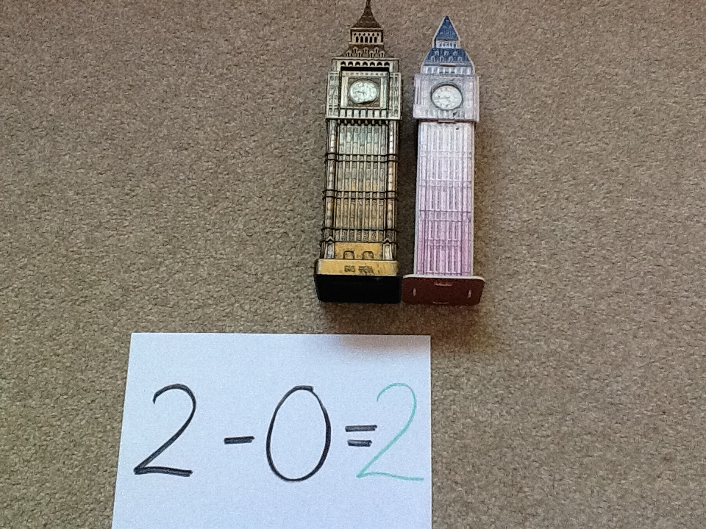

Slide 14
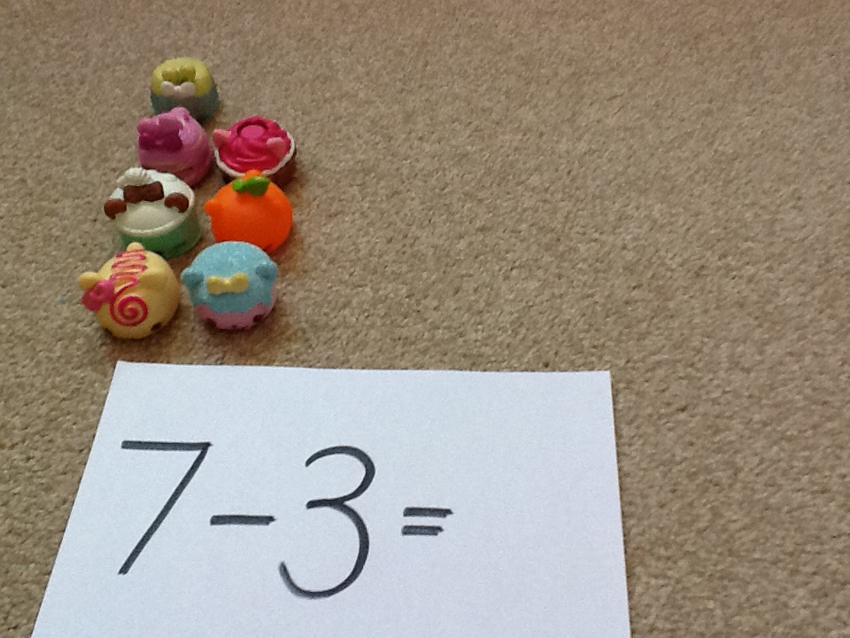
How many num noms will I have left if I take 3 away?

Slide 15
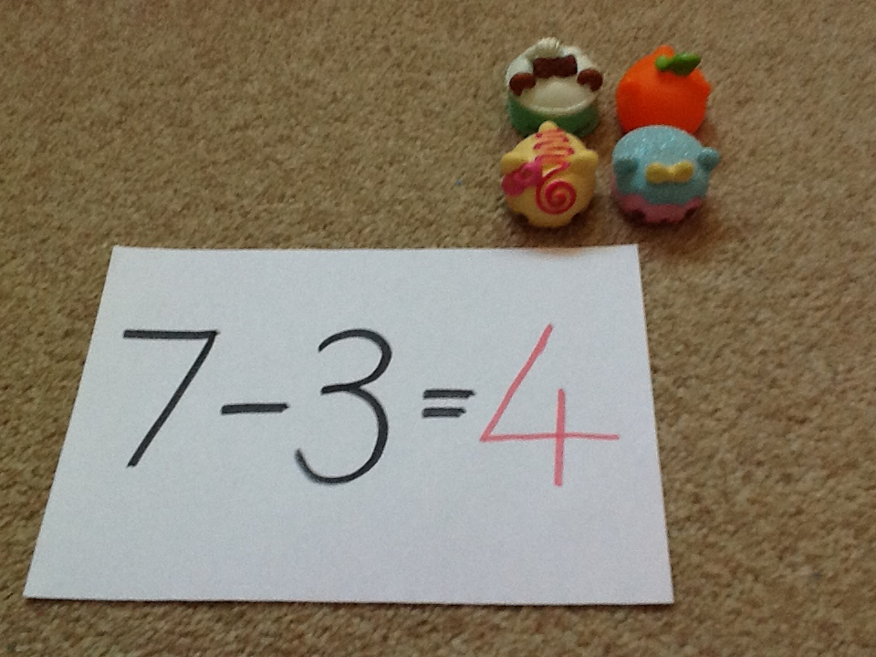

Slide 16
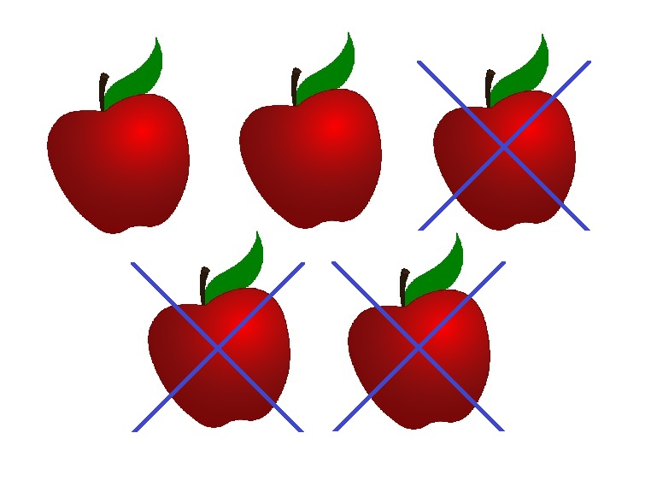
Now have a go using your toys.
Have fun!

