Slide 1
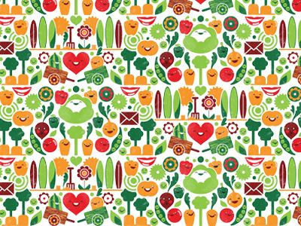
Giuseppe Acrimboldo
1527-1593

Slide 2
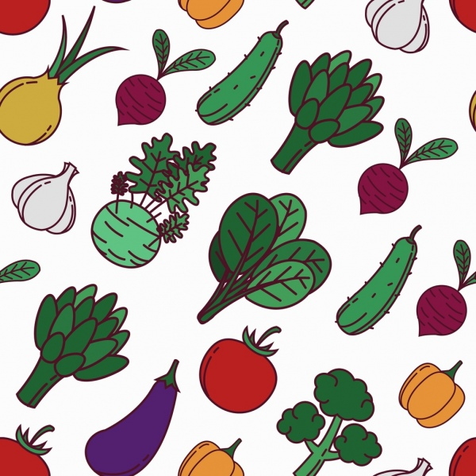

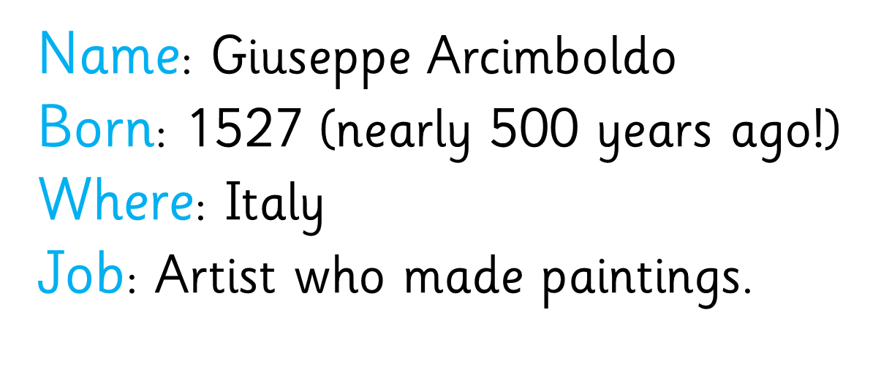

Slide 3
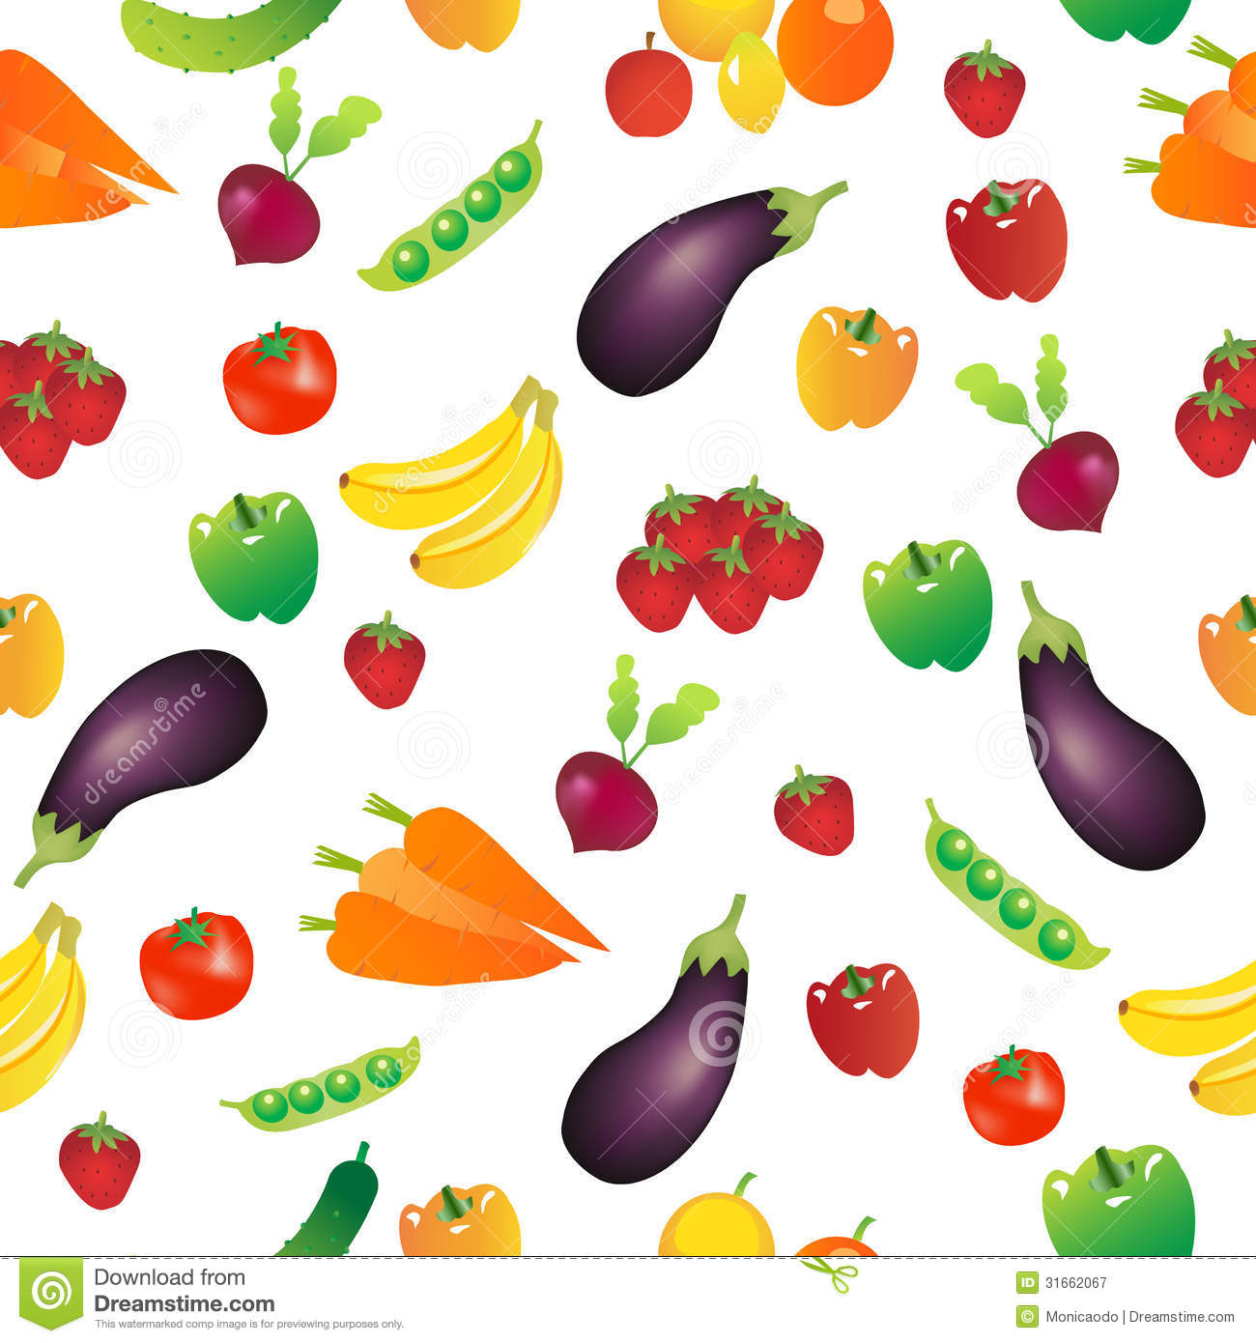

Giuseppe Arcimboldo is well known today for painting portraits of people made out of different types of fruits, vegetables, meat and fish.
He would pick food that had a connection to whatever he was painting. For example, when creating a picture of autumn he used fruits and vegetables that grew in autumn.

Slide 4
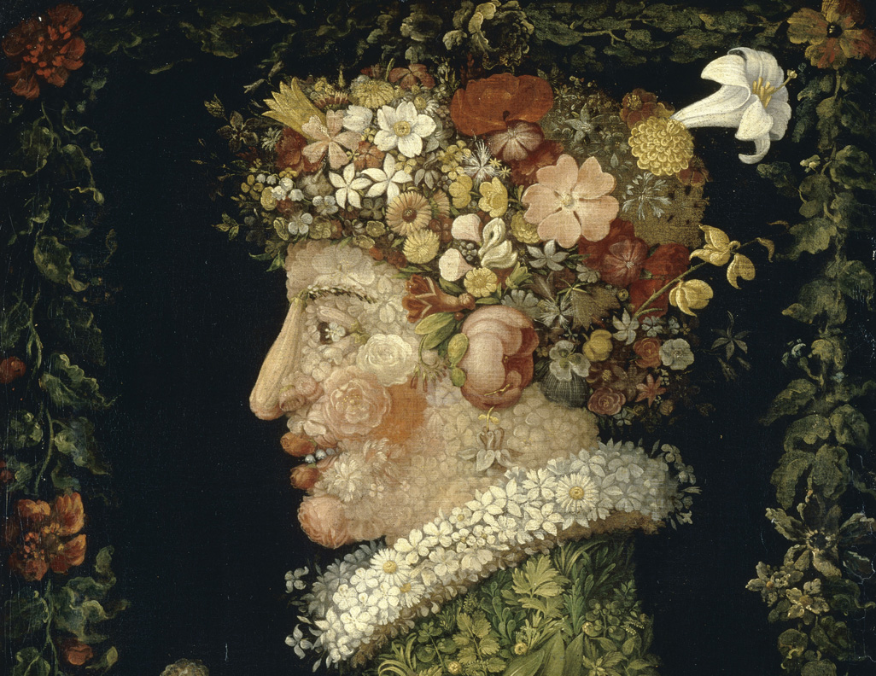

Spring

Slide 5
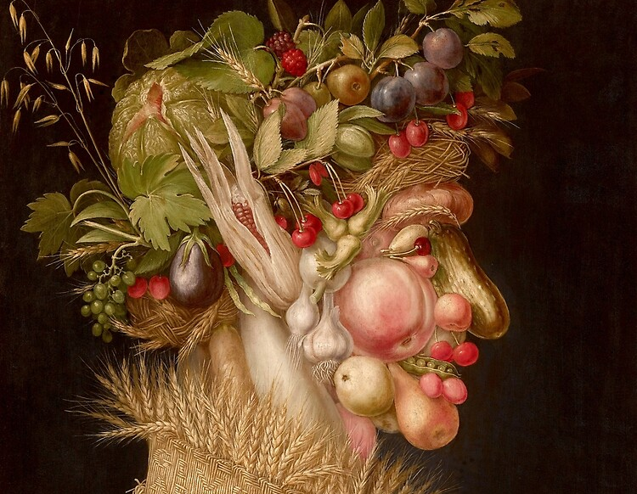

summer

Slide 6
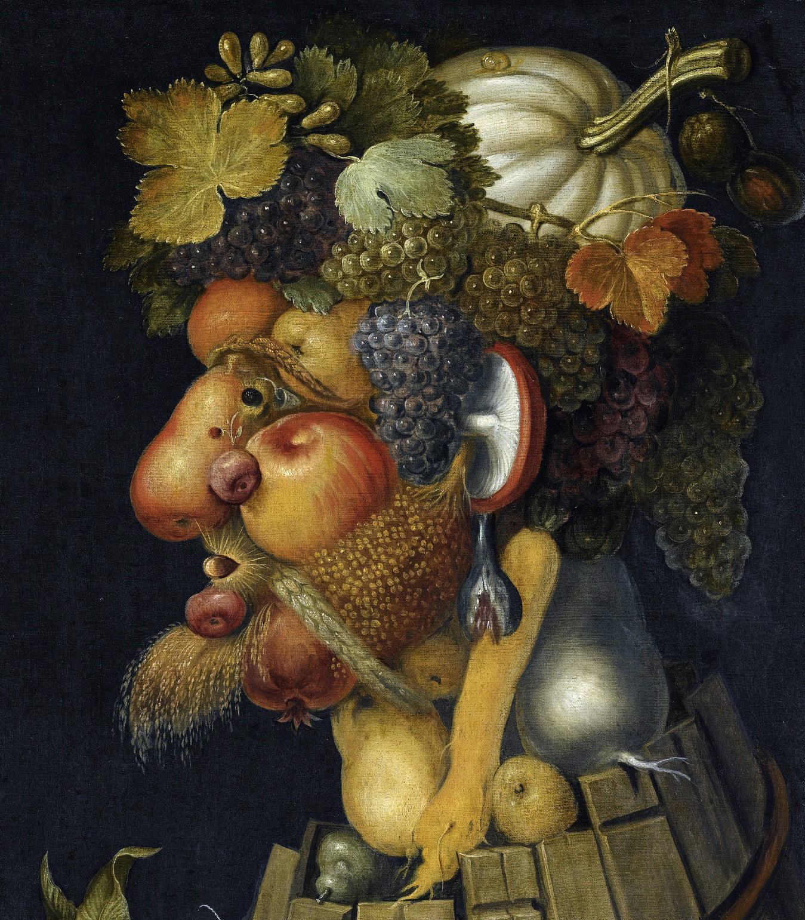

autumn

Slide 7
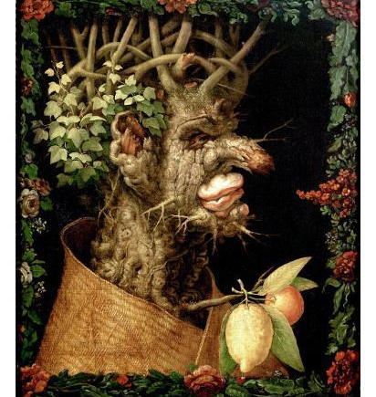

winter

Slide 8


