Slide 1
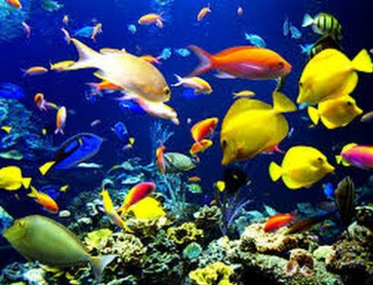
Where do Fish Live?
I _ D_ C _ S

Slide 2
Where do Fish Live?
INDICES

Slide 3
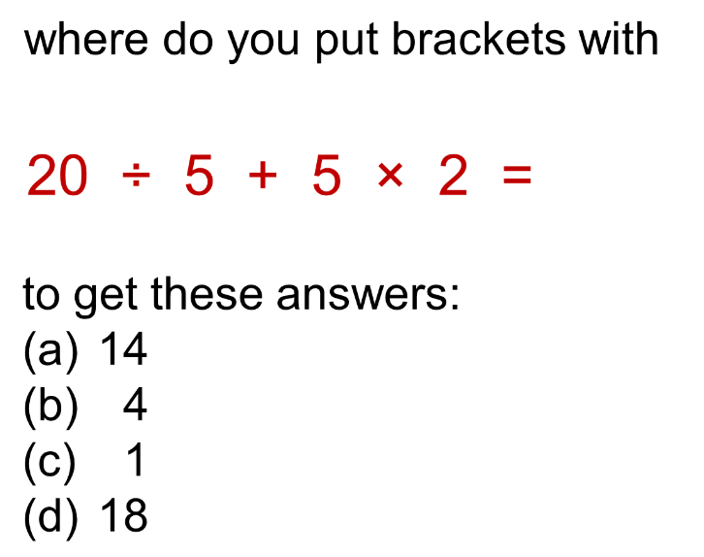
Solution
What is the solution?

Slide 4
BIDMAS
This is the same as BODMAS just using a different name for order. It is the same concept.
B Brackets
I Indices
DM Division/Multiplication
AS Addition/Subtraction

Slide 5
Choose 9 different numbers and place in a BINGO grid
2 | 33 | 30
21 | 67 | -7
2 | 64 | 35
13 | 1 | 45

Slide 6
Question
Solution
7 x 9 + 4
= 67

Slide 7
Question
Solution
9 + 3 x 4
= 21

Slide 8
Question
Solution
1 x 6 ÷ 3
= 2

Slide 9
Question
Solution
(1 + 2²) x 7
= 35

Slide 10
Question
Solution
10 + 24 ÷ 8
= 13

Slide 11
Question
Solution
(6 + 9) x 3
= 45

Slide 12
Question
Solution
9 - 4 x 4
= -7

Slide 13
Question
Solution
7 + 8 x 4 - 6
= 33

Slide 14
Question
Solution
10 x 9 ÷ 3
= 30

Slide 15
Question
Solution
8 x (24 ÷ 3)
= 64

Slide 16
Question
Solution
25 x 4
48 + 2
= 2

Slide 17
Question
Solution
3² - 2 x 1
√(81 – 32)
= 1

Slide 18
No brackets needed

Slide 19

Solution
Fill in the blanks to make correct
x -

Slide 20

Solution
Fill in the blanks to make correct
÷
÷

Slide 21

Solution
Fill in the blanks to make correct
x ÷

Slide 22
Which is correct?
Solution
6 - 1 + 4
1
9
LEFT HAND
RIGHT HAND

Slide 23
Is Jimmy Correct?
Solution
The sum below can be done in any order:
6 x 4 ÷ 2
TRUE
FALSE
LEFT HAND
RIGHT HAND

Slide 24
Is Jimmy Correct?
Solution
The sum below can be done in any order:
6 ÷ 3 x 2
TRUE
FALSE
LEFT HAND
RIGHT HAND

Slide 25
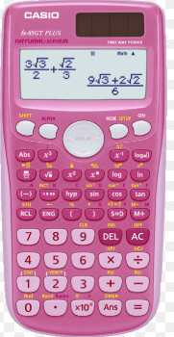
Is Jimmy Correct?
Solution
-5²
Calculators don’t know how to square negative numbers?
-25
TRUE
FALSE
LEFT HAND
RIGHT HAND

Slide 26
Solution
Which is the odd one out? Why?
(2 + 2 x 2)²
(-6)²
(-72 ÷ -2)
-36

Slide 27
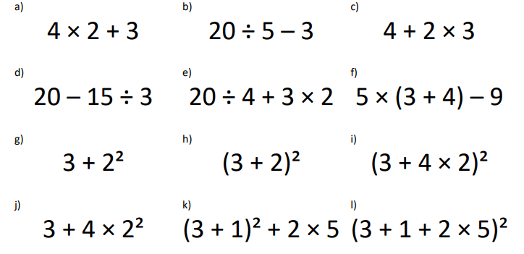




Slide 28
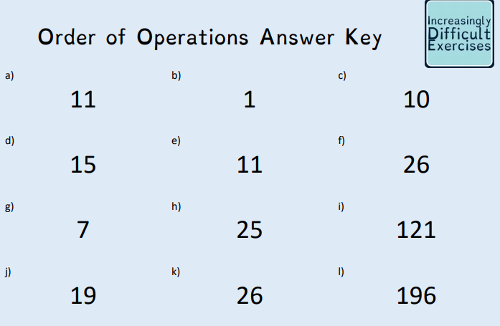
x ÷ ÷ x
+ x - -

Slide 30
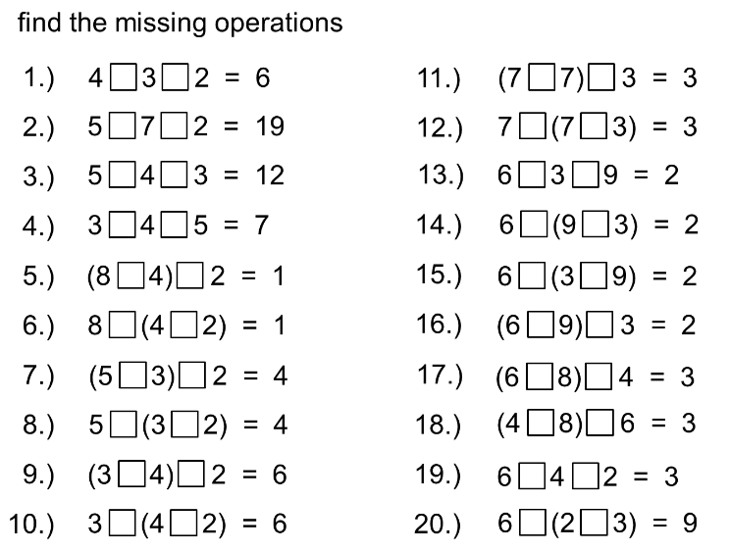

Slide 31


