Slide 1


Keep Calm and
Make Music
Weekly Wonder
Discovering the
Musical Dimensions KS1

Slide 2


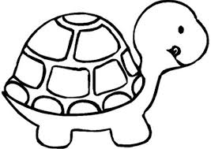



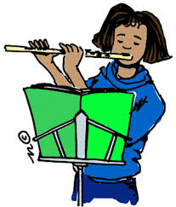

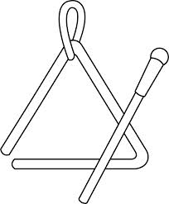

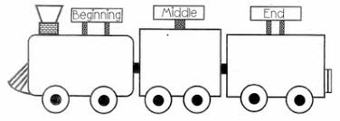
Discovering the
Musical Dimensions
Pitch
Duration
Dynamics
Tempo
(there are seven altogether)
Texture
Structure
Timbre

Slide 3


Contents – homepage
Click on the to return to this page
There are seven musical dimensions – one for every day of the week!
Which one will you discover today? Click on one and off you go
Pitch – what it means and fun pitch activities
Duration – what it means and fun duration activities
Dynamics – what it means and fun dynamic activities
Tempo – what it means and fun tempo activities
Structure – what it means and fun structure activities
Texture - what it means and fun texture activities
Timbre – what it means and fun timbre activities
Quiz time
Don’t try and do them all in one go it could be a bit

Slide 4
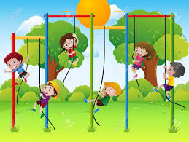
PITCH is all about how high or low sounds are
Key words
High, middle and low
Higher and lower
Click here
to find out about high, middle and low sounds and sing a fun song about those sounds

Slide 5
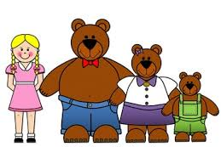
Fun pitch activities
Listen to the story of
Golidlocks and the three bears
and enjoy using low, middle and high voices for daddy, mummy and baby bear
Join in with this fun high and low game
Have fun moving to this version of Teddy Bear’s Picnic. Walk in time to the low sounding footsteps and wave your arms in the air every time you hear a high sound

Slide 6
DURATION is all about how long and short sounds are and beat and rhythm
Key words
Long
Short
Steady beat
Rhythm pattern xx xx x x
Click here
to find out about the steady beat
Click here
to find out about rhythm

Slide 7
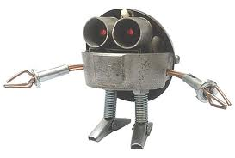


Fun duration activities
Listen to Only time will tell by Mike Oldfield
Tap along to the steady beat (beep) on your thighs
Can you move like a robot to this music?
Create a 4 item beet and cherry rhythm pattern to tap along to the music e.g.
or

Slide 8


DYNAMICS is all about how loud or quiet sounds are
Key words
Loud and quiet
Louder and quieter
Click here
to find out about loud and quiet sounds

Slide 9


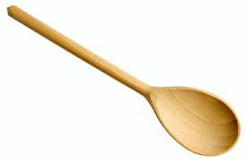
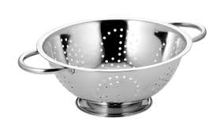
Fun dynamic activities
Make someone jump
Creep up quietly then shout
Listen the March Past of the Kitchen Utensils
Tiptoe around the room when the music is quiet
Clap loudly on the cymbal crash
Once you have got to know the music find something you can make a loud clashing sound with and join in with the cymbal

Slide 10
TEMPO is all about how fast and slow the music is
Key words
Fast and slow
Faster and slower
Click here
to find out about fast and slow sounds
Presto means fast and largo mean slow

Slide 11

Fun tempo activities
Listen to Slowly, slowly walks my grandad
Enjoy walking like grandad, mother and the child singer
Join in with Baby Shark
How fast can you sing? Can you keep up?

Slide 12

STRUCTURE is all about the order sounds happen in
Key words
Beginning, middle, ending
Call and echo, Call and response
Verse, chorus
ABA
Click here
to find out about call and echo
Click here
To join in with a call and response song
The lady sings the call, join in singing the response with the man

Slide 13
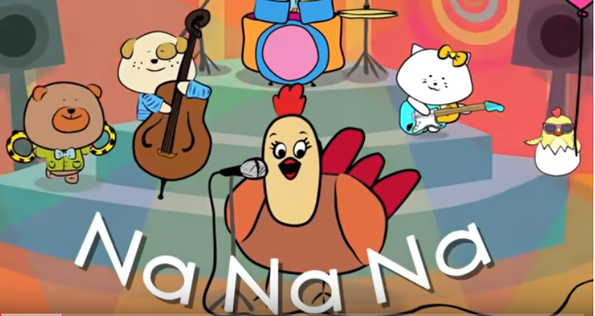
Fun structure activities
Listen to this song
Learn to sing the chorus
Na na na
I’m so happy
I’m so happy sing with me
x 2
Count how many times you sing the chorus
What other songs do you know that have a chorus?

Slide 14
TEXTURE is all about how many sounds can be heard at the same time
Key words
Solo
Unison
Layers
Click here
to watch how layers can slowly be added to a piece of music

Slide 15
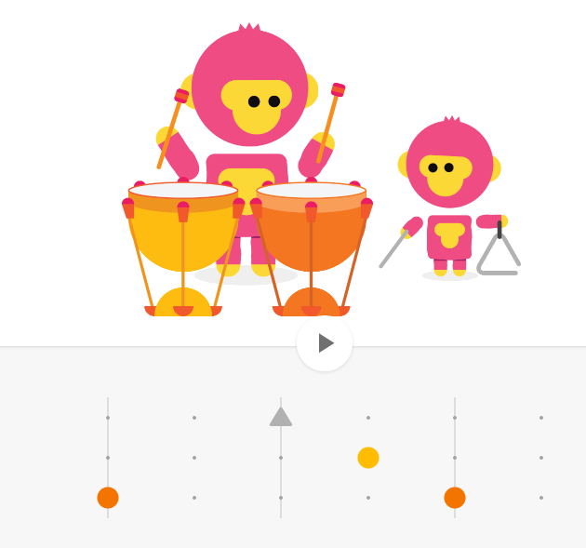
Fun texture activity
Click here
and enjoy adding layers by clicking on the dots to activate 1 2 or 3 sounds at the same time

Slide 16



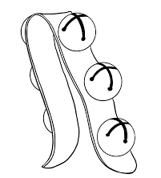
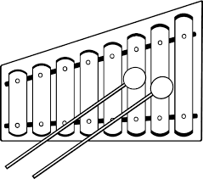
TIMBRE is all about what the sounds are like
Key words
Wood
Metal
Skinned
Shake
Tap
Scrape
Instrument names
Click here
to join in with the song and mime playing
Lots of different instruments

Slide 17
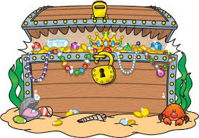

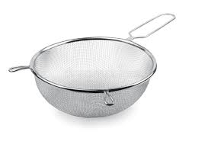

Fun timbre activities
Go on a treasure hunt for sound makers
Can you find a wooden sound to play?
Can you find a metal sound to play?
Can you find a skinned sound to play?
Can you find something to tap?
Can you find something to shake?
Can you find something to scrape?
Draw a treasure chest with all your sound makers around it
Make a list of all the wooden, metal and skinned instruments you can think of – which list is the longest?

Slide 18

Name the dimension quiz
Look at the slides below
Can you work out
which dimension each is about?

Slide 19

?
High
Low
Middle
Higher
Lower
Notes:
Pitch

Slide 20
?
Long
Short
Steady beat
Rhythm pattern xx xx x x
Notes:
Duration

Slide 21
?
Loud
Quiet
Louder
Quieter
Notes:
Dynamics

Slide 22
?
Fast
Slow
Faster
Slower
Notes:
Tempo

Slide 23
?
Beginning
Ending
Beginning, middle, ending
Call and echo, Call and response
Verse, chorus
ABA
Notes:
Structure

Slide 24

?
Solo
Unison
Layers
Notes:
Texture

Slide 25
?
Wood
Metal
Skinned
Shake
Tap
Scrape
Notes:
Timbre

