Slide 1
Propoganda
Propaganda is the spreading of misleading information in order to influence the public and serve the interests of the messenger.
Propaganda can take many forms, including text, images, videos and more.
Propaganda is most commonly used to spread a particular political message and has been used historically during times of conflict.

Slide 2
Types of propaganda
Bandwagon - this aims to encourage people to do something simply because a lot of other people are doing it.
Testimonial - this relies on experts and respected sources to promote a particular idea.
Transfer - this associates the traits of a well-known person with a product to promote or demote it. Linking an item to a respected person is positive transfer. Creating an analogy between a disliked person and a product is negative transfer.
Repetition - repeating a message helps it stick in the mind of the audience.
Emotive language - this gives a message an emotional weight and appeals to the audience

Slide 3
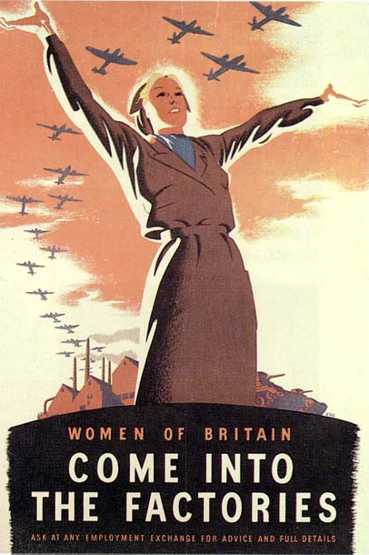
Why is this woman standing so proud and tall?

Slide 4
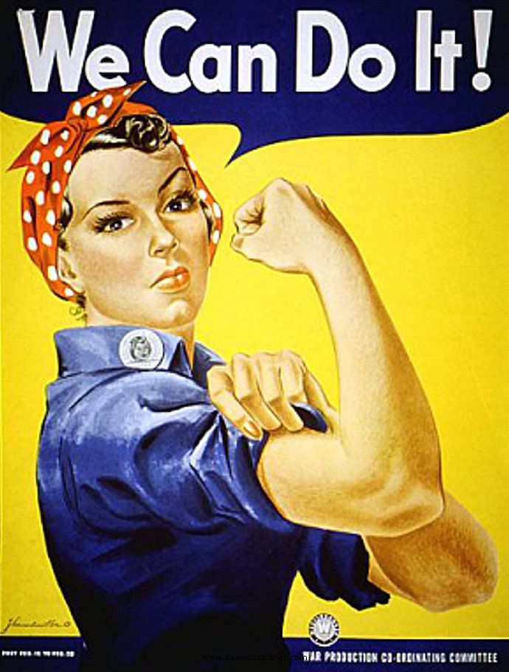
What does ‘we can do it’ mean?

Slide 5
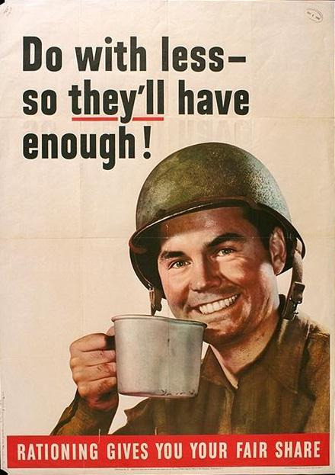
Do with less of what?
Who does it help?

Slide 6
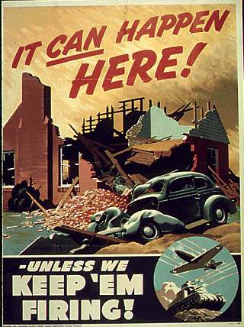
What do we
need to keep firing?
For what reason?

Slide 7

How can food be
a weapon?

Slide 8

This poster
uses a rhyme,
what does it mean?

Slide 9
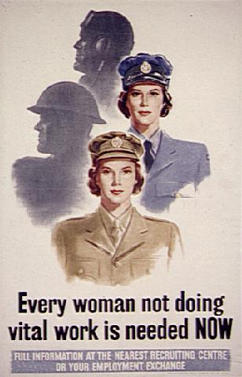
What do you think
The women were
needed for?

Slide 10
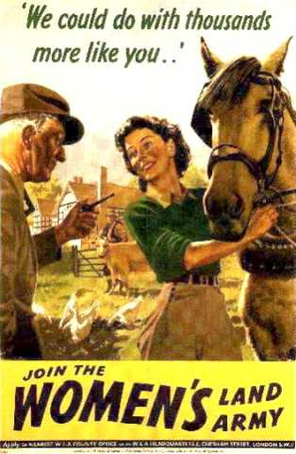
Thousands more
of what?

Slide 11


