Slide 2
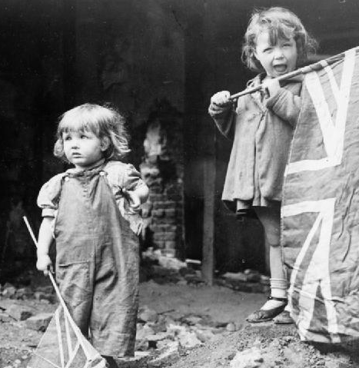
Victory in Europe
Victory in Europe Day/VE Day took place on May 8th 1945. It was a public holiday and day of celebration to mark the defeat of Germany by the Allied forces in Second World War.
VE Day marked the formal conclusion of the war with Germany and brought to an end six years of suffering, courage and endurance across the world.

Slide 3
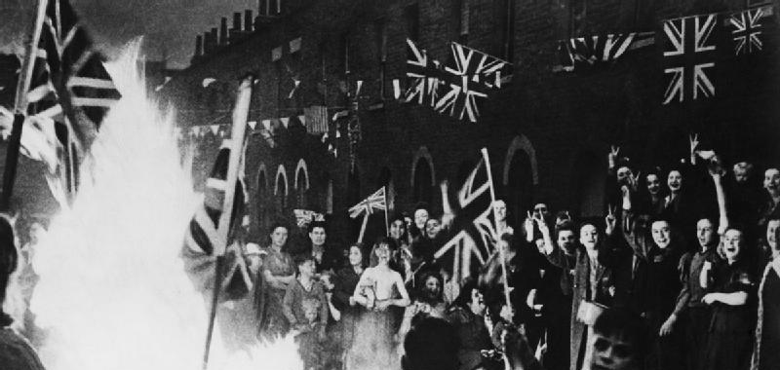
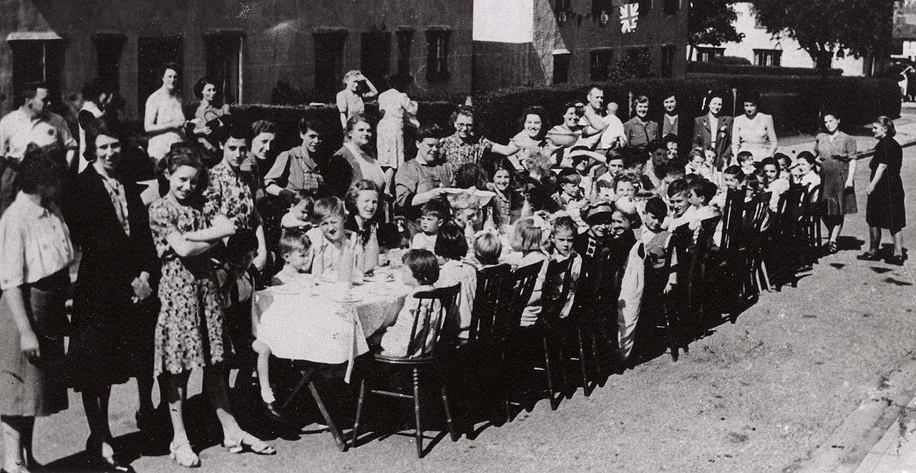
Time to Celebrate
People ran out on to the streets, hanging bunting and banners and dancing.
Church bells pealed across the country to share the news: peace in Europe!
Everyone brought out food to share at street parties.
Tuesday May 8th was to be a national day of celebration: Victory in Europe Day.

Slide 4


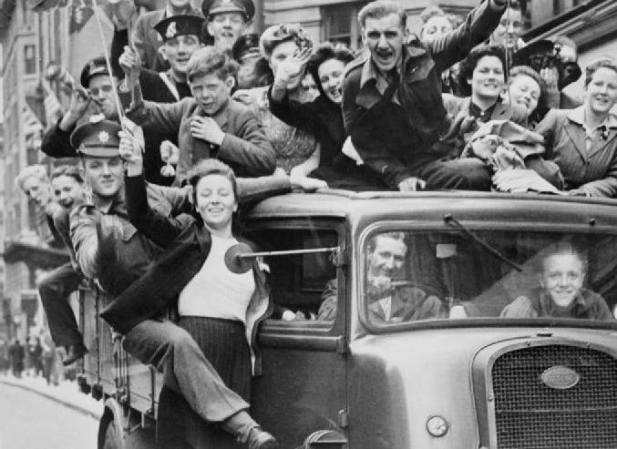
Time to Celebrate
The capital city, London, was the place to be on VE Day.
Anyone who could reach the city did so.
The centre of London was full of people wearing red, white and blue, waving flags, dancing and singing.
Fireworks filled the sky with flashes of light.

Slide 5
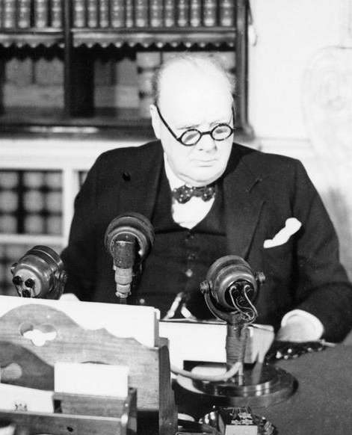
“The German war is therefore at an end.”
On VE Day, everyone, both in London and at home sitting by their wireless sets, wanted to hear just one man: Winston Churchill.
At 3pm the Prime Minister broadcast to the nation: the war was over.

Slide 6
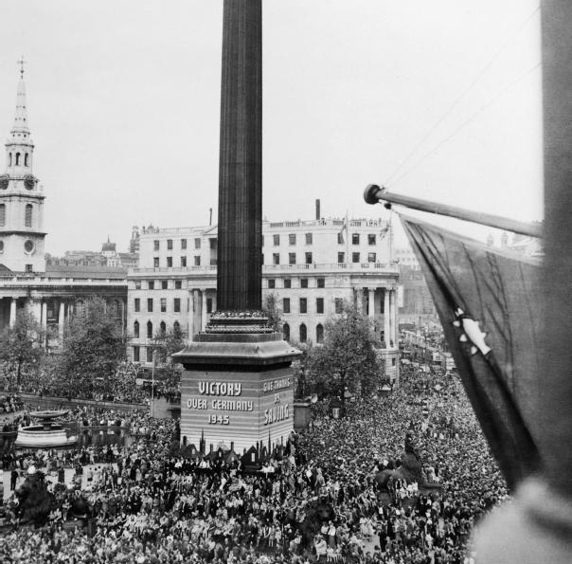
“The German war is therefore at an end.”
Crowds gathered in Trafalgar Square and up The Mall.
They were waiting for Winston Churchill and King George VI to make an appearance on the balcony of Buckingham Palace.

Slide 7
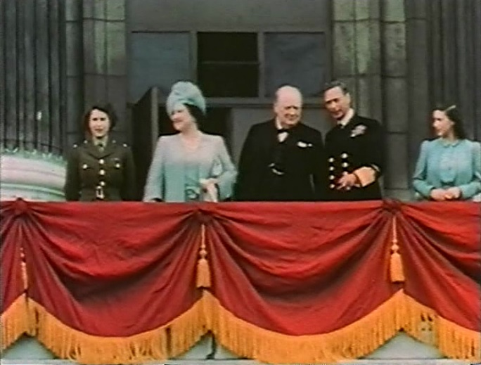
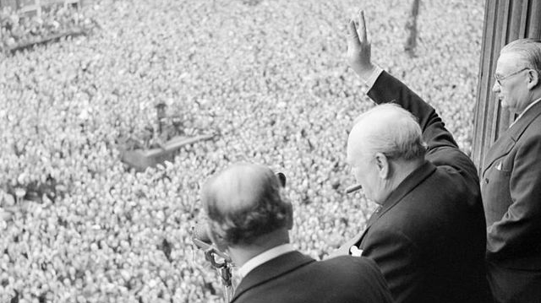
“This is your victory!”
Shortly after Churchill's speech, King George VI, Queen Elizabeth and the two princesses came out onto the balcony at Buckingham Palace.
Churchill told the crowds: “This is your victory!”
It was to be the first of eight appearances by the King and Queen on VE Day.

