Slide 1


LIFE/work balance
We have started a #LIFEworkbalance campaign and we need your help to complete our LIFE/work balance survey.
We hope to publish the results soon, so please give 15 minutes of your time to help us get a true picture of school life.
Want to be a part of this campaign? Take the survey on our website and share it with your colleagues!
© Classroom Secrets Limited 2019

Slide 2
Year 3 – Summer Block 1 – Nouns – Using Abstract Nouns
About This Resource:
This PowerPoint has been designed to support your teaching of this small step. It includes a starter activity and an example of each question from the Varied Fluency and Application and Reasoning resources also provided in this pack. You can choose to work through all examples provided or a selection of them depending on the needs of your class.
National Curriculum Objectives:
No formal objective. However, these words are taken from the Year 3/4 non-statutory spelling list and the focus is given to vocabulary of abstract concepts in line with the Spoken Language Guidance.
Spell words from the word list – Years 3 and 4.
More resources from our Grammar, Punctuation and Spelling scheme of work.
Did you like this resource? Don’t forget to review it on our website.
© Classroom Secrets Limited 2019

Slide 3
Year 3 – Summer Block 1 – Nouns – Using Abstract Nouns
Notes and Guidance:
Once children are able to recognise abstract nouns, they can begin to use them. In this step children will focus upon building their own sentences using abstract nouns.
Focused Questions
Change this sentence to include an abstract noun.
Have you used an abstract noun? How do you know?
© Classroom Secrets Limited 2019

Slide 4
Year 3 – Summer Block 1 – Nouns
Step 3: Using Abstract Nouns
© Classroom Secrets Limited 2019

Slide 5
Introduction
Complete the table by sorting the nouns.
Concrete nouns | Abstract nouns
football
dream
spoon
today
birthday
rabbit
happiness
pancake
clown
© Classroom Secrets Limited 2019

Slide 6
Introduction
Complete the table by sorting the nouns.
Concrete nouns | Abstract nouns
football
dream
spoon
today
rabbit
birthday
pancake
clown
happiness
© Classroom Secrets Limited 2019

Slide 7
Varied Fluency 1
Which abstract noun would make sense in the sentence below?
The pupil was filled with ______________ when she saw the clear night sky full of stars.
cold
evening
wonder
© Classroom Secrets Limited 2019

Slide 8
Varied Fluency 1
Which abstract noun would make sense in the sentence below?
The pupil was filled with ______________ when she saw the clear night sky full of stars.
wonder
cold
evening
wonder
© Classroom Secrets Limited 2019

Slide 9
Varied Fluency 2
Complete the sentence below using an abstract noun.
I felt a lot of _________________ toward the elderly man whose dog was ill.
© Classroom Secrets Limited 2019

Slide 10
Varied Fluency 2
Complete the sentence below using an abstract noun.
Example answer:
I felt a lot of _________________ toward the elderly man whose dog was ill.
sympathy
© Classroom Secrets Limited 2019

Slide 11
Varied Fluency 3
Change one concrete noun and one abstract noun in the sentence below to change the meaning.
How did the doctor keep up her level of dedication?
© Classroom Secrets Limited 2019

Slide 12
Varied Fluency 3
Change one concrete noun and one abstract noun in the sentence below to change the meaning.
How did the doctor keep up her level of dedication?
Example answer: How did the teacher keep up her level of knowledge?
© Classroom Secrets Limited 2019

Slide 13
Varied Fluency 4
Use an abstract noun from the word bank to complete the sentence below.
“Your _____________ makes me smile every day,” said Maggie.
memory | truth | kindness
© Classroom Secrets Limited 2019

Slide 14
Varied Fluency 4
Use an abstract noun from the word bank to complete the sentence below.
“Your _____________ makes me smile every day,” said Maggie.
memory | truth | kindness
kindness
© Classroom Secrets Limited 2019

Slide 15
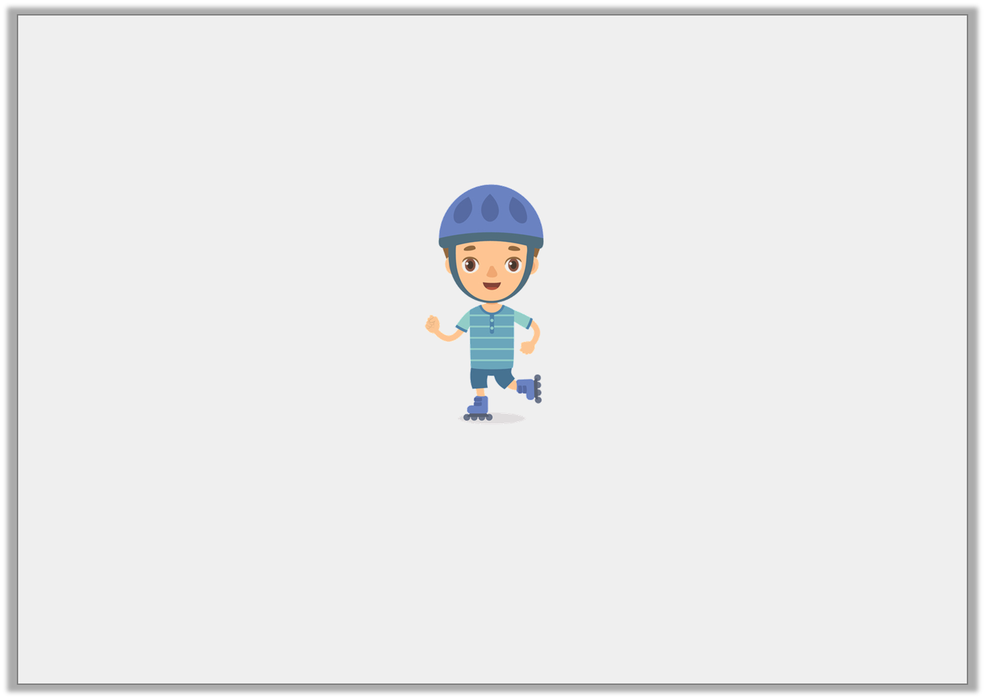
Application 1
Write a sentence about the image below which includes one abstract noun from the word bank.
luxury | victory | opportunity
© Classroom Secrets Limited 2019

Slide 16
Application 1
Write a sentence about the image below which includes one abstract noun from the word bank.
Example answer: Samuel took the school holidays as an opportunity to use his new roller-skates.
luxury | victory | opportunity
© Classroom Secrets Limited 2019

Slide 17
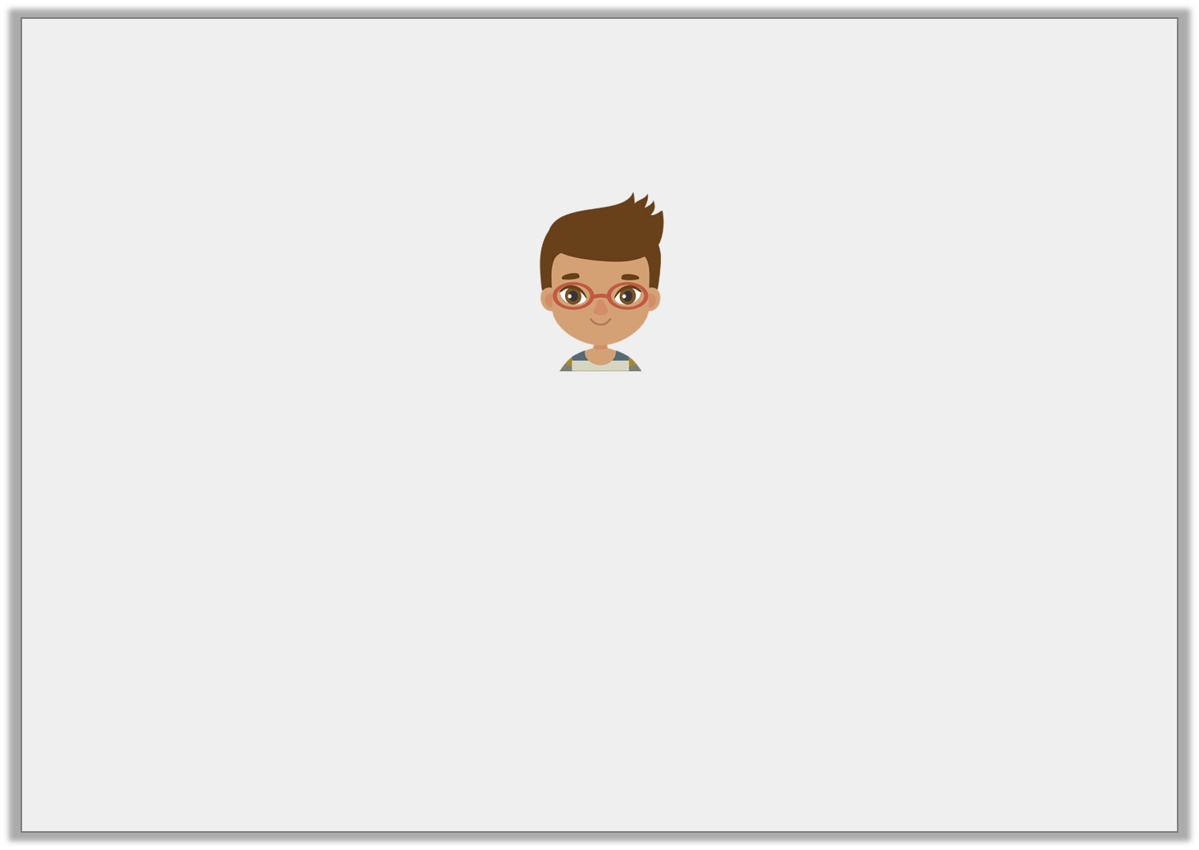
Reasoning 1
Thomas wrote a sentence. Has he used an abstract noun? How do you know?
Whether my friend would arrive on time was a worry.
© Classroom Secrets Limited 2019

Slide 18
Reasoning 1
Thomas wrote a sentence. Has he used an abstract noun? How do you know?
Thomas has used an abstract noun because…
Whether my friend would arrive on time was a worry.
© Classroom Secrets Limited 2019

Slide 19
Reasoning 1
Thomas wrote a sentence. Has he used an abstract noun? How do you know?
Thomas has used an abstract noun because he has used the word ‘worry’, which cannot be seen, heard or touched.
Whether my friend would arrive on time was a worry.
© Classroom Secrets Limited 2019

Slide 20
Application 2
Darla wrote a sentence with an abstract noun but it doesn’t make sense.
It was a need when Gran came to pick me up from the park.
Write the sentence again with a different abstract noun that makes sense.
© Classroom Secrets Limited 2019

Slide 21
Application 2
Darla wrote a sentence with an abstract noun but it doesn’t make sense.
It was a need when Gran came to pick me up from the park.
Write the sentence again with a different abstract noun that makes sense.
Various answers, for example: It was a surprise when Gran came to pick me up from the park.
© Classroom Secrets Limited 2019

