Slide 1

Year 3 – Summer Block 1 – Nouns – Using Different Types of Nouns
About This Resource:
This PowerPoint has been designed to support your teaching of this small step. It includes a starter activity and an example of each question from the Varied Fluency and Application and Reasoning resources also provided in this pack. You can choose to work through all examples provided or a selection of them depending on the needs of your class.
National Curriculum Objectives:
No formal objective. However, these words are taken from the year 3/4 non-statutory spelling list and the focus is given to vocabulary of abstract concepts in line with the Spoken Language Guidance.
Spell words from the word list – years 3 and 4.
More resources from our Grammar, Punctuation and Spelling scheme of work.
Did you like this resource? Don’t forget to review it on our website.
© Classroom Secrets Limited 2018

Slide 2
Year 3 – Summer Block 1 – Nouns
Step 4: Using Different Types of Nouns
© Classroom Secrets Limited 2018

Slide 3
Introduction
What type of word is underlined in the sentence below?
We watched the aeroplane take off from the runway.
 |  | Tick one
determiner
noun
adverb
conjunction
© Classroom Secrets Limited 2018

Slide 4
Introduction
What type of word is underlined in the sentence below?
We watched the aeroplane take off from the runway.
 |  | Tick one
determiner
noun |  |  | 
adverb
conjunction
© Classroom Secrets Limited 2018

Slide 5
Varied Fluency 1
Tick to show which types of nouns are used in the sentences below.
A. I live in a small house in London.
B. A flock of birds swooped down.
C. She showed patience while waiting for the train.
Collective
Proper
Abstract
Common
© Classroom Secrets Limited 2018

Slide 6
Varied Fluency 1
Tick to show which types of nouns are used in the sentences below.
A. I live in a small house in London. |  |  |  | 
B. A flock of birds swooped down. |  |  |  | 
C. She showed patience while waiting for the train. |  |  |  | 
Collective
Proper
Abstract
Common
© Classroom Secrets Limited 2018

Slide 7
Varied Fluency 2
Identify the different types of noun in the sentence below.
I ran to the park with Shelly and we disturbed a flock of birds.
A
B
C
© Classroom Secrets Limited 2018

Slide 8
Varied Fluency 2
Identify the different types of noun in the sentence below.
I ran to the park with Shelly and we disturbed a flock of birds.
A: common, B: proper, C: collective
A
B
C
© Classroom Secrets Limited 2018

Slide 9
Varied Fluency 3
True or false? The underlined noun is a common noun.
Steph showed pride in her writing and received a certificate for her work.
© Classroom Secrets Limited 2018

Slide 10
Varied Fluency 3
True or false? The underlined noun is a common noun.
Steph showed pride in her writing and received a certificate for her work.
False. It is an abstract noun.
© Classroom Secrets Limited 2018

Slide 11
Varied Fluency 4
Underline all the common nouns in the sentence below.
I had a sandwich, an apple and two yoghurts in my lunch-box.
© Classroom Secrets Limited 2018

Slide 12
Varied Fluency 4
Underline all the common nouns in the sentence below.
I had a sandwich, an apple and two yoghurts in my lunch-box.
© Classroom Secrets Limited 2018

Slide 13
Application 1
Write a sentence using the following noun which also includes a:
Collective noun
Proper noun
birds
Remember to punctuate your sentence correctly.
© Classroom Secrets Limited 2018

Slide 14
Application 1
Write a sentence using the following noun which also includes a:
Collective noun
Proper noun
birds
Remember to punctuate your sentence correctly.
Example answer: The flock of birds swooped down towards Adil.
© Classroom Secrets Limited 2018

Slide 15
Application 2
Tick the noun type which is not included in the sentence below.
The gaggle of geese waddled through the busy town with heaps of confidence.
Rewrite the sentence to include the missing word type.
proper |  |  | collective
common |  |  | abstract
© Classroom Secrets Limited 2018

Slide 16
Application 2
Tick the noun type which is not included in the sentence below.
The gaggle of geese waddled through the busy town with heaps of confidence.
Rewrite the sentence to include the missing word type.
Example answer: The gaggle of geese waddled through Sowerby Bridge with heaps of confidence.
proper |  |  | collective
common |  |  | abstract
© Classroom Secrets Limited 2018

Slide 17
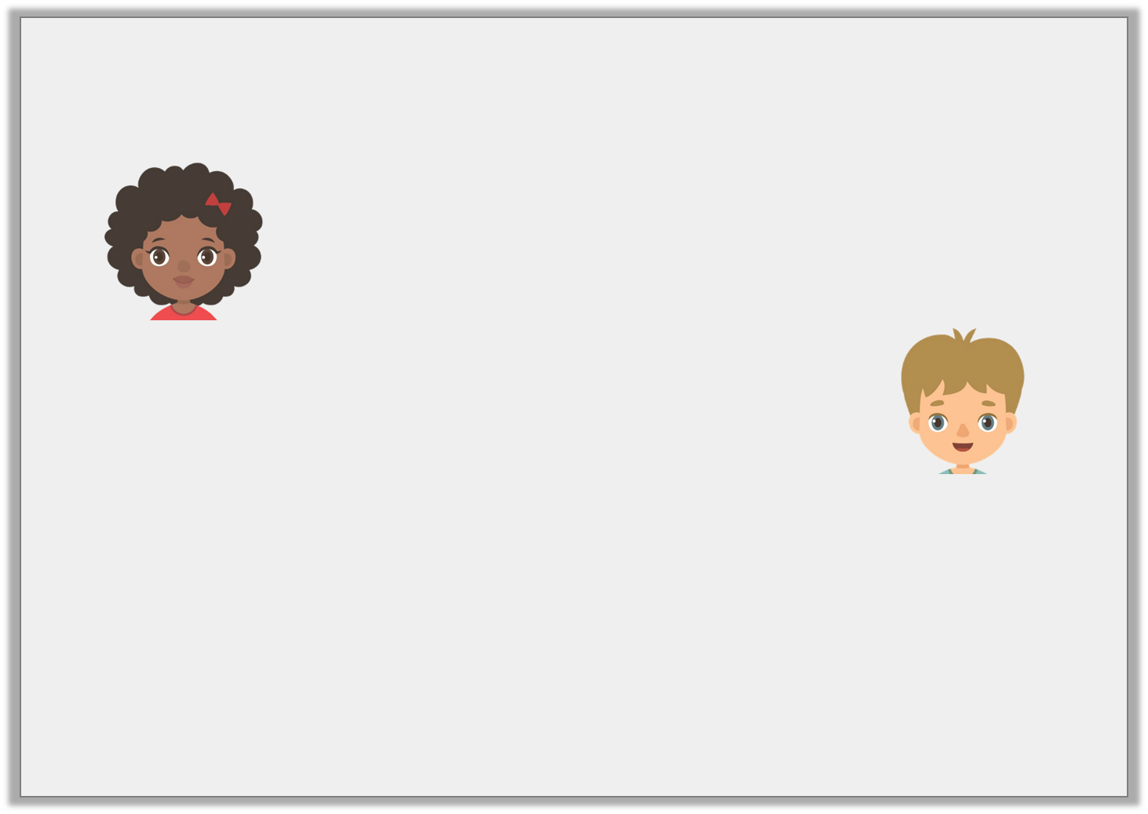
Reasoning 1
Holly and Sean are writing sentences.
Who has used an abstract noun correctly?
Explain how you know.
She laughed happily at the joke she had just heard.
Holly
She showed real happiness when she laughed at her friend’s joke.
Sean
© Classroom Secrets Limited 2018

Slide 18
Reasoning 1
Holly and Sean are writing sentences.
Who has used an abstract noun correctly?
Explain how you know.
Sean is correct because…
She laughed happily at the joke she had just heard.
Holly
She showed real happiness when she laughed at her friend’s joke.
Sean
© Classroom Secrets Limited 2018

Slide 19
Reasoning 1
Holly and Sean are writing sentences.
Who has used an abstract noun correctly?
Explain how you know.
Sean is correct because ‘happiness’ is an abstract noun. Holly has used ‘happily’ as an adverb.
She laughed happily at the joke she had just heard.
Holly
She showed real happiness when she laughed at her friend’s joke.
Sean
© Classroom Secrets Limited 2018

