Slide 1
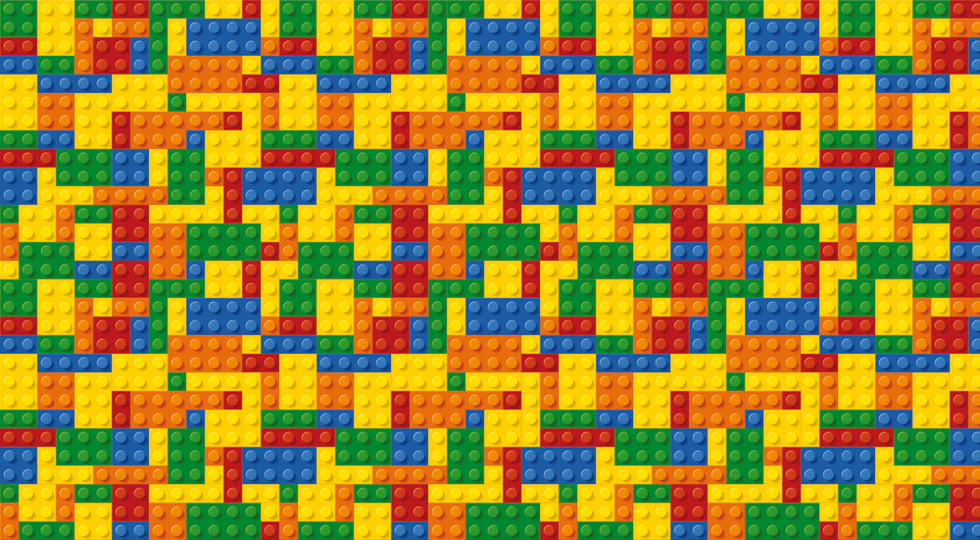
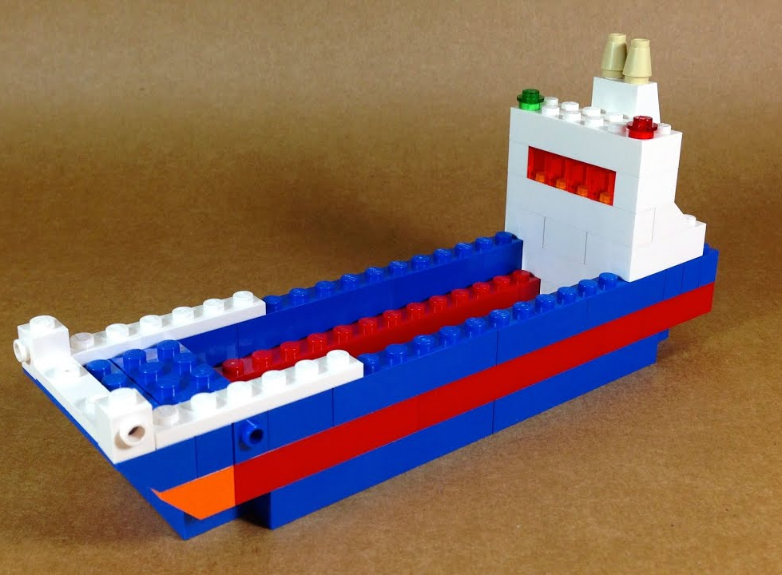
Lego Challenge: Boat Building
Your Challenge!
This challenge is to construct unsinkable ships. Fill a sink with a tub of water, and ask students to create ships that must endure the "ocean" waves and lots of heavy cargo. The students should be given multiple trials to see if their ship kept the passengers in, and water out.
Engineering Goals:
Types of boat
Fishing boats in different sizes are used on both salt and freshwater bodies. The immediate qualities of these boats include stability, strength, and durability to survive the fishing ventures across various kinds of waterways.
Learn about buoyancy and how to design objects that will float
Have various weights to add to your boat. Start with the lighter weights, and see how much can be added to each design.
A dinghy can be a small inflatable boat usually made of rubber and comprises of cross thwarts and rowlocks that act as seats and oars, respectively
Deck Boats come with an open deck area that provides plenty of seating arrangements for a small group of people
Reflection Questions
What should I do first?
Catamaran is a multi-hulled watercraft that features two parallel hulls of equal size. Compared to vessels with a single hull, Catamaran Boats features less hull volume, shallower draft and higher displacement.
Is something confusing me?
Could I explain this to someone else?
Where can I look for help?
Pontoon boats are flattish in shape and that relies on tubes (pontoons) to float on the water.
How can I do it better?

