Slide 1


LIFE/work balance
We have started a #LIFEworkbalance campaign and we need your help to complete our LIFE/work balance survey.
We hope to publish the results soon, so please give 15 minutes of your time to help us get a true picture of school life.
Want to be a part of this campaign? Take the survey on our website and share it with your colleagues!
© Classroom Secrets Limited 2019

Slide 2
Year 3 – Summer Block 2 – Paragraphs – What is a Paragraph? – Fiction
About This Resource:
This PowerPoint has been designed to support your teaching of this small step. It includes a starter activity and an example of each question from the Varied Fluency and Application and Reasoning resources also provided in this pack. You can choose to work through all examples provided or a selection of them depending on the needs of your class.
National Curriculum Objectives:
  English Year 3: Introduction to paragraphs as a way to group related material
More resources from our Grammar, Punctuation and Spelling scheme of work.
Did you like this resource? Don’t forget to review it on our website.
© Classroom Secrets Limited 2019

Slide 3
Year 3 – Summer Block 2 – Paragraphs – What is a Paragraph? – Fiction
Notes and Guidance:
Children should now have an understanding of how to group sentences together so that ideas linked to the same theme flow.
In this step, children will be introduced to the idea of a paragraph as a group of sentences. Paragraphs are used to structure a long piece of writing, breaking it up into separate points to make it easier to read.
Children will use what they have learnt by grouping sentences on a related theme to begin to recognise where to start new paragraphs in their writing.
Children will also learn some features of paragraphs such as indenting the first few words of the text or inserting a line break; using headings and subheadings to introduce new paragraphs and starting a new line for any speech that is included.
Focused Questions
Identify the paragraphs in the text by writing the first word of each.
What is the subject of the second paragraph?
Why are the paragraphs here separate?
© Classroom Secrets Limited 2019

Slide 4
Year 3 – Summer Block 2 – Paragraphs
Step 2: What is a Paragraph? – Fiction
© Classroom Secrets Limited 2019

Slide 5
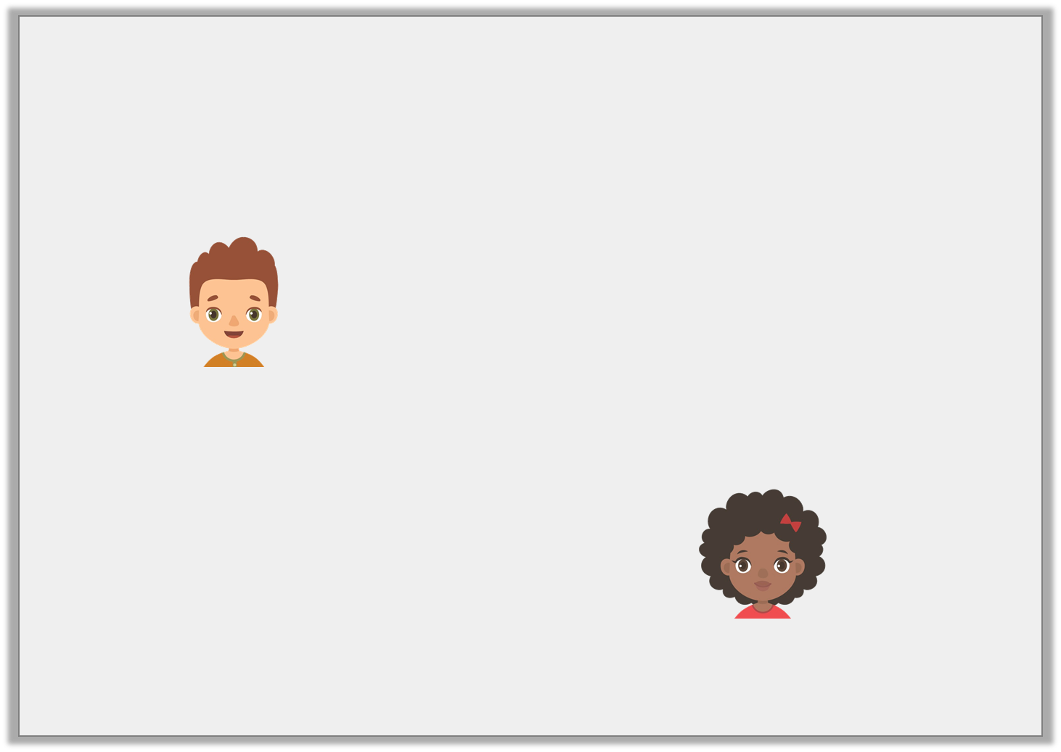
Introduction
Marcus and Anita have shared the same sentences.
Who has put them in the most logical order?
The tunes erupted around the stadium. Thousands of fans sang the words back to the band. They waved their arms in the air to the rhythm of the music.
Marcus
They waved their arms in the air to the rhythm of the music. Thousands of fans sang the words back to the band. The tunes erupted around the stadium.
Anita
© Classroom Secrets Limited 2019

Slide 6
Introduction
Marcus and Anita have shared the same sentences.
Who has put them in the most logical order?
The tunes erupted around the stadium. Thousands of fans sang the words back to the band. They waved their arms in the air to the rhythm of the music.
Marcus
They waved their arms in the air to the rhythm of the music. Thousands of fans sang the words back to the band. The tunes erupted around the stadium.
Anita
© Classroom Secrets Limited 2019

Slide 7
Varied Fluency 1
Write down the first word of each paragraph.
Stepping out of the time machine, Freya looked around in amazement. Her home town looked so different. She could hardly believe her eyes. Suddenly, she heard voices. She ran across the garden and crouched down behind a hedge. Holding her breath, she listened carefully. Two men, who were dressed in the most unusual clothes she had ever seen, came into view. One of them sounded very angry. “You fool!” he shouted. “How will we ever explain this?” “I’m so sorry,” the second man replied. “I promise I can fix this but you have to give me one last chance. We have to go back!” The men stopped right in front of Freya’s hiding place. They stared at each other for a long time. The angry man turned and marched back in the direction they had come from. The other man sighed with relief and ran to catch up with him. Silently, Freya crept out from behind the hedge. Curiously and carefully, she followed behind them.
© Classroom Secrets Limited 2019

Slide 8
Varied Fluency 1
Write down the first word of each paragraph.
Stepping, Suddenly, Two, You, I’m, The, Silently
Stepping out of the time machine, Freya looked around in amazement. Her home town looked so different. She could hardly believe her eyes. Suddenly, she heard voices. She ran across the garden and crouched down behind a hedge. Holding her breath, she listened carefully. Two men, who were dressed in the most unusual clothes she had ever seen, came into view. One of them sounded very angry. “You fool!” he shouted. “How will we ever explain this?” “I’m so sorry,” the second man replied. “I promise I can fix this but you have to give me one last chance. We have to go back!” The men stopped right in front of Freya’s hiding place. They stared at each other for a long time. The angry man turned and marched back in the direction they had come from. The other man sighed with relief and ran to catch up with him. Silently, Freya crept out from behind the hedge. Curiously and carefully, she followed behind them.
© Classroom Secrets Limited 2019

Slide 9
Varied Fluency 2
True or false? A new paragraph would be needed if the words, ‘One of them sounded very angry’ were changed to ‘They were arguing loudly.’
Stepping out of the time machine, Freya looked around in amazement. Her home town looked so different. She could hardly believe her eyes. Suddenly, she heard voices. She ran across the garden and crouched down behind a hedge. Holding her breath, she listened carefully. Two men, who were dressed in the most unusual clothes she had ever seen, came into view. One of them sounded very angry. “You fool!” he shouted. “How will we ever explain this?” “I’m so sorry,” the second man replied. “I promise I can fix this but you have to give me one last chance. We have to go back!” The men stopped right in front of Freya’s hiding place. They stared at each other for a long time. The angry man turned and marched back in the direction they had come from. The other man sighed with relief and ran to catch up with him. Silently, Freya crept out from behind the hedge. Curiously and carefully, she followed behind them.
© Classroom Secrets Limited 2019

Slide 10
Varied Fluency 2
True or false? A new paragraph would be needed if the words, ‘One of them sounded very angry’ were changed to ‘They were arguing loudly.’
False, the sentence would continue in the previous paragraph as it links to the two men who had appeared.
Stepping out of the time machine, Freya looked around in amazement. Her home town looked so different. She could hardly believe her eyes. Suddenly, she heard voices. She ran across the garden and crouched down behind a hedge. Holding her breath, she listened carefully. Two men, who were dressed in the most unusual clothes she had ever seen, came into view. One of them sounded very angry. “You fool!” he shouted. “How will we ever explain this?” “I’m so sorry,” the second man replied. “I promise I can fix this but you have to give me one last chance. We have to go back!” The men stopped right in front of Freya’s hiding place. They stared at each other for a long time. The angry man turned and marched back in the direction they had come from. The other man sighed with relief and ran to catch up with him. Silently, Freya crept out from behind the hedge. Curiously and carefully, she followed behind them.
© Classroom Secrets Limited 2019

Slide 11
Varied Fluency 3
Which paragraph introduces the first people Freya sees?
Stepping out of the time machine, Freya looked around in amazement. Her home town looked so different. She could hardly believe her eyes. Suddenly, she heard voices. She ran across the garden and crouched down behind a hedge. Holding her breath, she listened carefully. Two men, who were dressed in the most unusual clothes she had ever seen, came into view. One of them sounded very angry. “You fool!” he shouted. “How will we ever explain this?” “I’m so sorry,” the second man replied. “I promise I can fix this but you have to give me one last chance. We have to go back!” The men stopped right in front of Freya’s hiding place. They stared at each other for a long time. The angry man turned and marched back in the direction they had come from. The other man sighed with relief and ran to catch up with him. Silently, Freya crept out from behind the hedge. Curiously and carefully, she followed behind them.
© Classroom Secrets Limited 2019

Slide 12
Varied Fluency 3
Which paragraph introduces the first people Freya sees?
Paragraph three
Stepping out of the time machine, Freya looked around in amazement. Her home town looked so different. She could hardly believe her eyes. Suddenly, she heard voices. She ran across the garden and crouched down behind a hedge. Holding her breath, she listened carefully. Two men, who were dressed in the most unusual clothes she had ever seen, came into view. One of them sounded very angry. “You fool!” he shouted. “How will we ever explain this?” “I’m so sorry,” the second man replied. “I promise I can fix this but you have to give me one last chance. We have to go back!” The men stopped right in front of Freya’s hiding place. They stared at each other for a long time. The angry man turned and marched back in the direction they had come from. The other man sighed with relief and ran to catch up with him. Silently, Freya crept out from behind the hedge. Curiously and carefully, she followed behind them.
© Classroom Secrets Limited 2019

Slide 13
Varied Fluency 4
Why did the second paragraph have to be started?
Stepping out of the time machine, Freya looked around in amazement. Her home town looked so different. She could hardly believe her eyes. Suddenly, she heard voices. She ran across the garden and crouched down behind a hedge. Holding her breath, she listened carefully. Two men, who were dressed in the most unusual clothes she had ever seen, came into view. One of them sounded very angry. “You fool!” he shouted. “How will we ever explain this?” “I’m so sorry,” the second man replied. “I promise I can fix this but you have to give me one last chance. We have to go back!” The men stopped right in front of Freya’s hiding place. They stared at each other for a long time. The angry man turned and marched back in the direction they had come from. The other man sighed with relief and ran to catch up with him. Silently, Freya crept out from behind the hedge. Curiously and carefully, she followed behind them.
to introduce a
new character
to introduce a
new speaker
to introduce a new event or action
© Classroom Secrets Limited 2019

Slide 14
Varied Fluency 4
Why did the second paragraph have to be started?
Stepping out of the time machine, Freya looked around in amazement. Her home town looked so different. She could hardly believe her eyes. Suddenly, she heard voices. She ran across the garden and crouched down behind a hedge. Holding her breath, she listened carefully. Two men, who were dressed in the most unusual clothes she had ever seen, came into view. One of them sounded very angry. “You fool!” he shouted. “How will we ever explain this?” “I’m so sorry,” the second man replied. “I promise I can fix this but you have to give me one last chance. We have to go back!” The men stopped right in front of Freya’s hiding place. They stared at each other for a long time. The angry man turned and marched back in the direction they had come from. The other man sighed with relief and ran to catch up with him. Silently, Freya crept out from behind the hedge. Curiously and carefully, she followed behind them.
to introduce a
new character
to introduce a
new speaker
to introduce a new event or action
© Classroom Secrets Limited 2019

Slide 15
Reasoning 1
Alfie has written the sentence below.
“There’s no way out!”
He wants to put it at the end of the second paragraph.
Is he correct? Explain how you know.
The red, hot flames flew from the dragon’s enormous, cruel mouth. The fire spread in a circle around the field. There was no escape. They were trapped. “I guess this is it!” Jason screamed. “It’s all over now!” Desperately, Carla searched for a way out. She wasn’t going to give up without a fight. There had to be another way. The heat was closing in on them as the dragon circled above. The clouds of smoke were making it hard to breathe and they both cried tears of frustration. That’s when she saw it.
© Classroom Secrets Limited 2019

Slide 16
Reasoning 1
Alfie has written the sentence below.
“There’s no way out!”
He wants to put it at the end of the second paragraph.
Is he correct? Explain how you know.
He will not need to start a new paragraph because…
The red, hot flames flew from the dragon’s enormous, cruel mouth. The fire spread in a circle around the field. There was no escape. They were trapped. “I guess this is it!” Jason screamed. “It’s all over now!” Desperately, Carla searched for a way out. She wasn’t going to give up without a fight. There had to be another way. The heat was closing in on them as the dragon circled above. The clouds of smoke were making it hard to breathe and they both cried tears of frustration. That’s when she saw it.
© Classroom Secrets Limited 2019

Slide 17
Reasoning 1
Alfie has written the sentence below.
“There’s no way out!”
He wants to put it at the end of the second paragraph.
Is he correct? Explain how you know.
He will not need to start a new paragraph because his sentence follows on from Jason’s speech so it can be grouped with the sentences in paragraph two.
The red, hot flames flew from the dragon’s enormous, cruel mouth. The fire spread in a circle around the field. There was no escape. They were trapped. “I guess this is it!” Jason screamed. “It’s all over now!” Desperately, Carla searched for a way out. She wasn’t going to give up without a fight. There had to be another way. The heat was closing in on them as the dragon circled above. The clouds of smoke were making it hard to breathe and they both cried tears of frustration. That’s when she saw it.
© Classroom Secrets Limited 2019

Slide 18
Reasoning 2
Here is a new sentence to add to the text:
The dragon shot another blast of fire, lighting up the night sky.
Which paragraph would it fit into best? Convince me.
The red, hot flames flew from the dragon’s enormous, cruel mouth. The fire spread in a circle around the field. There was no escape. They were trapped. “I guess this is it!” Jason screamed. “It’s all over now!” Desperately, Carla searched for a way out. She wasn’t going to give up without a fight. There had to be another way. The heat was closing in on them as the dragon circled above. The clouds of smoke were making it hard to breathe and they both cried tears of frustration. That’s when she saw it.
© Classroom Secrets Limited 2019

Slide 19
Reasoning 2
Here is a new sentence to add to the text:
The dragon shot another blast of fire, lighting up the night sky.
Which paragraph would it fit into best? Convince me.
Various possible answers, for example: Paragraph four because…
The red, hot flames flew from the dragon’s enormous, cruel mouth. The fire spread in a circle around the field. There was no escape. They were trapped. “I guess this is it!” Jason screamed. “It’s all over now!” Desperately, Carla searched for a way out. She wasn’t going to give up without a fight. There had to be another way. The heat was closing in on them as the dragon circled above. The clouds of smoke were making it hard to breathe and they both cried tears of frustration. That’s when she saw it.
© Classroom Secrets Limited 2019

Slide 20
Reasoning 2
Here is a new sentence to add to the text:
The dragon shot another blast of fire, lighting up the night sky.
Which paragraph would it fit into best? Convince me.
Various possible answers, for example: Paragraph four because it follows on from the dragon circling above them.
The red, hot flames flew from the dragon’s enormous, cruel mouth. The fire spread in a circle around the field. There was no escape. They were trapped. “I guess this is it!” Jason screamed. “It’s all over now!” Desperately, Carla searched for a way out. She wasn’t going to give up without a fight. There had to be another way. The heat was closing in on them as the dragon circled above. The clouds of smoke were making it hard to breathe and they both cried tears of frustration. That’s when she saw it.
© Classroom Secrets Limited 2019

Slide 21
Application 1
Write one more sentence that could be added to the final paragraph.
Then write a sentence that could start the next paragraph.
The red, hot flames flew from the dragon’s enormous, cruel mouth. The fire spread in a circle around the field. There was no escape. They were trapped. “I guess this is it!” Jason screamed. “It’s all over now!” Desperately, Carla searched for a way out. She wasn’t going to give up without a fight. There had to be another way. The heat was closing in on them as the dragon circled above. The clouds of smoke were making it hard to breathe and they both cried tears of frustration. That’s when she saw it.
© Classroom Secrets Limited 2019

Slide 22
Application 1
Write one more sentence that could be added to the final paragraph.
Various possible answers, for example: It was the answer she had been hoping for.
Then write a sentence that could start the next paragraph.
Various possible answers, for example: As quick as a flash, Carla grabbed Jason’s hand and pulled him to his feet.
The red, hot flames flew from the dragon’s enormous, cruel mouth. The fire spread in a circle around the field. There was no escape. They were trapped. “I guess this is it!” Jason screamed. “It’s all over now!” Desperately, Carla searched for a way out. She wasn’t going to give up without a fight. There had to be another way. The heat was closing in on them as the dragon circled above. The clouds of smoke were making it hard to breathe and they both cried tears of frustration. That’s when she saw it.
© Classroom Secrets Limited 2019

