Slide 1

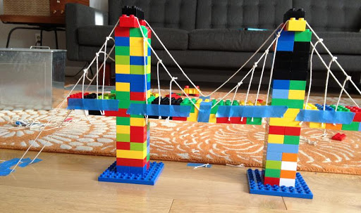
Lego Challenge: Bridge Building
Introduction
A bridge is a structure built to span a physical obstacle, such as a body of water, valley, or road, without closing the way underneath. It is constructed for the purpose of providing passage over the obstacle, usually something that can be detrimental to cross otherwise.
Engineering Goals:
Your Challenge!
Look at how bridges are constructed and how they distribute weight. Discuss how to make supports for the bridges using trusses and arcs.
A LEGO person who lives in the United States wants to visit his LEGO friend in England. To get across the ocean that separates the U.S. and England, the LEGO person can only drive. Challenge students to build a bridge that is strong and sturdy so no LEGO people fall into the ocean.
Types of bridge
Beam bridge
The most simple and common type of bridge used in the real world. This type can be quite effective, even if it isn’t very beautiful. Most highway bridges fall under this category, made from I Beams and reinforced concrete.
Reflection Questions
A suspension bridge is a type of bridge in which the deck is hung below suspension cables on vertical suspenders. The basic structural components of a suspension bridge system include stiffening girders/trusses, the main suspension cables, main towers, and the anchorages for the cables at each end of the bridge.
What should I do first?
Is something confusing me?
Could I explain this to someone else?
An arch bridge is a bridge with abutments at each end shaped as a curved arch. Arch bridges work by transferring the weight of the bridge and its loads partially into a horizontal thrust restrained by the abutments at either side.
Where can I look for help?
How can I do it better?

