Slide 2

Divide 2 Digits by 1 Digit (1)
Diving
Complete this calculation.
66 ÷ 3 = 156
22
10
10
10
10
10
10
1
1
1
1
1
1
Place Value Counters
Part-Whole Model
T | O
22
66 ÷ 3 =
10
10
1
1
10
10
1
1
6 ÷ 3 =
60 ÷ 3 =
2
10
10
1
1
20

Slide 3
Divide 2 Digits by 1 Digit (1)
Diving
Complete this calculation.
13
52 ÷ 4 =156
Place Value Counters
Part-Whole Model
T | O
52 ÷ 4 =
13
10
1
1
1
10
1
1
1
10
1
1
1
40 ÷ 4 =
10
12 ÷ 4 =
3
10
1
1
1
1
1
1
1
1
1
1
1
10
10
1
1

Slide 4
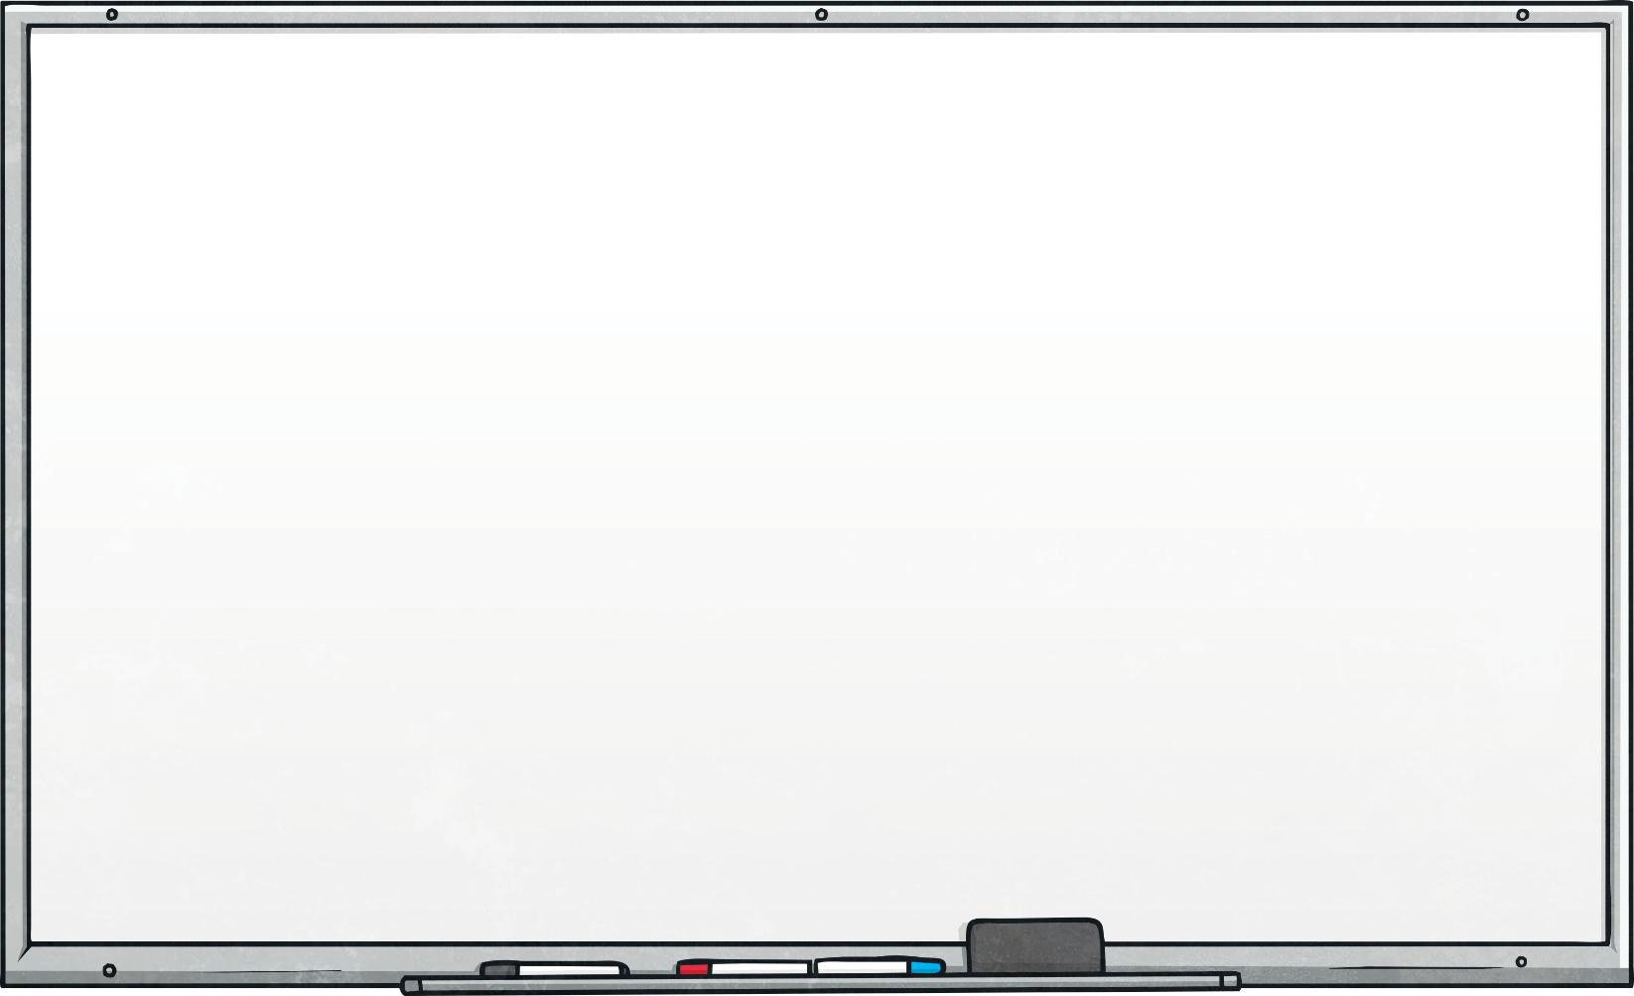
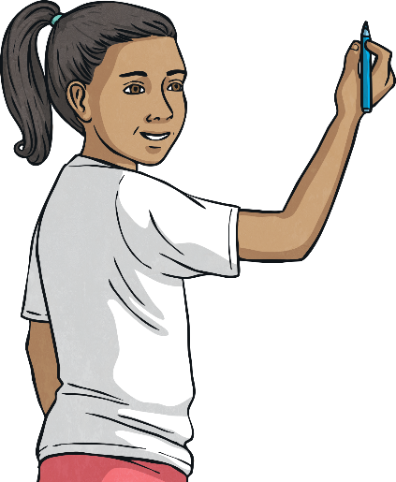
Divide 2 Digits by 1 Digit (1)
Diving
Use the part-whole models to find the missing numbers.
÷ 4 = 18
84 ÷ = 14
72
6
60 ÷ = 10
÷ 6 = 4
÷ 4 = 10
32 ÷ 4 =
6
24
40
8

Slide 5
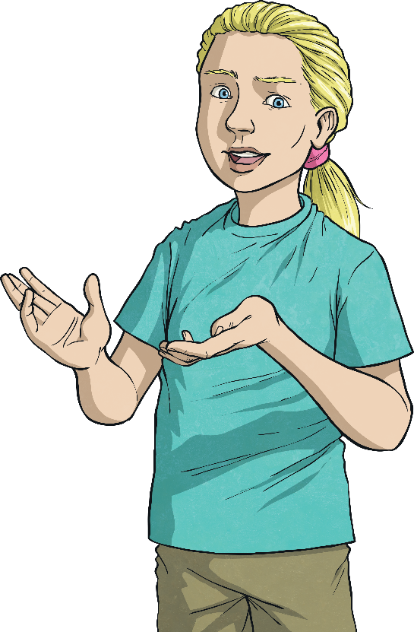
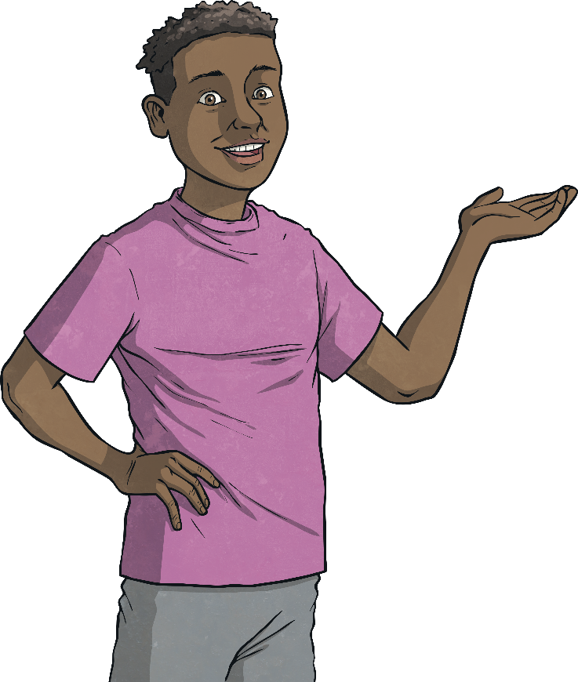
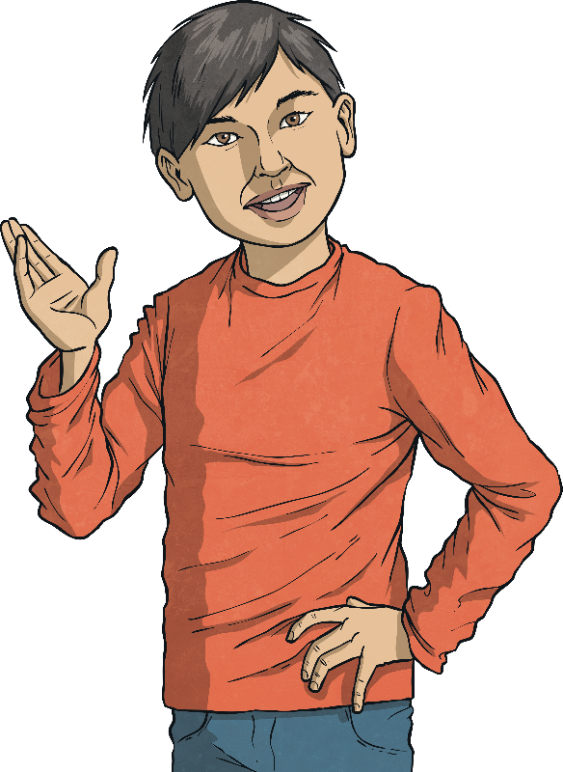


Divide 2 Digits by 1 Digit (1)
Diving
Solve this word problem.
Becky, Jack and Seb are sharing the 54 marbles equally. How many marbles will they each get?
54 ÷ 3 = 18

Slide 6

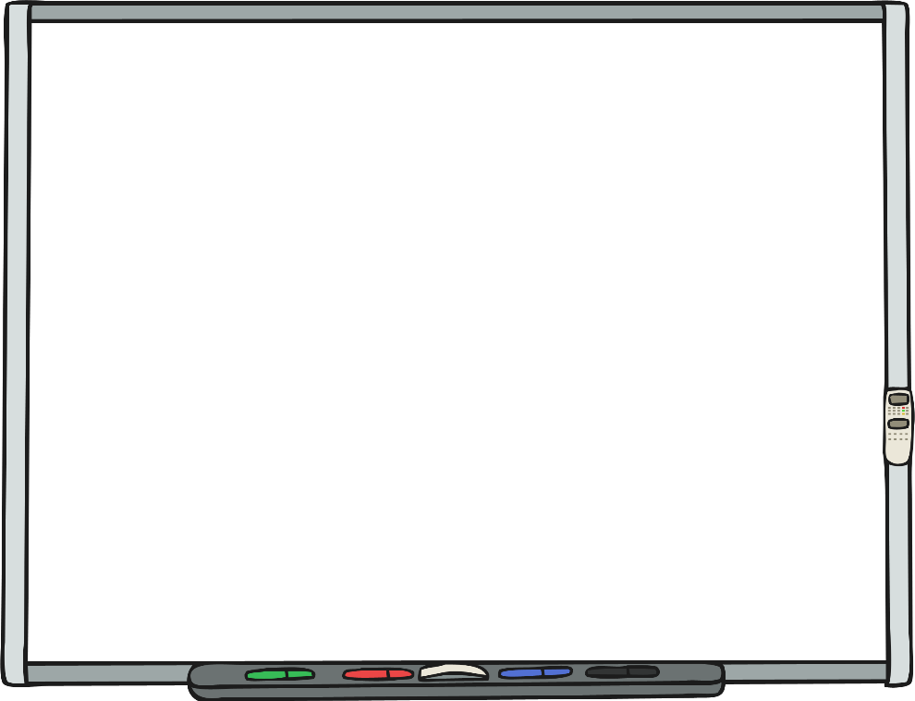
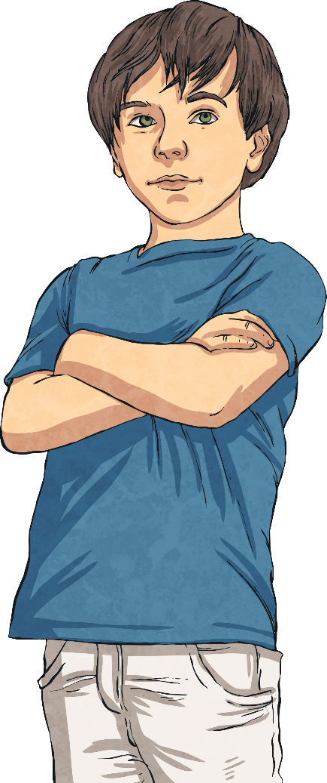
Divide 2 Digits by 1 Digit (1)
Deeper
Identify, correct and explain
the mistake Lyle has made.
56 ÷ 2 = 25
T | O
10
10
1
1
1
1
1
10
10
1
1
1
1
1
10
Lyle has not exchanged correctly. He has made the existing ones total of 6 up to 10, rather than adding an additional 10 counters to the amount that is already there to make 16 ones. The answer should be 28.

Slide 7


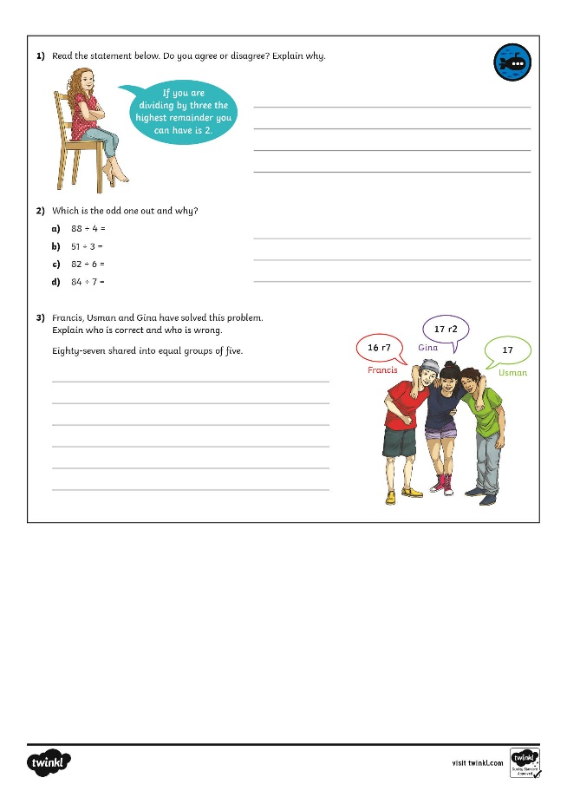
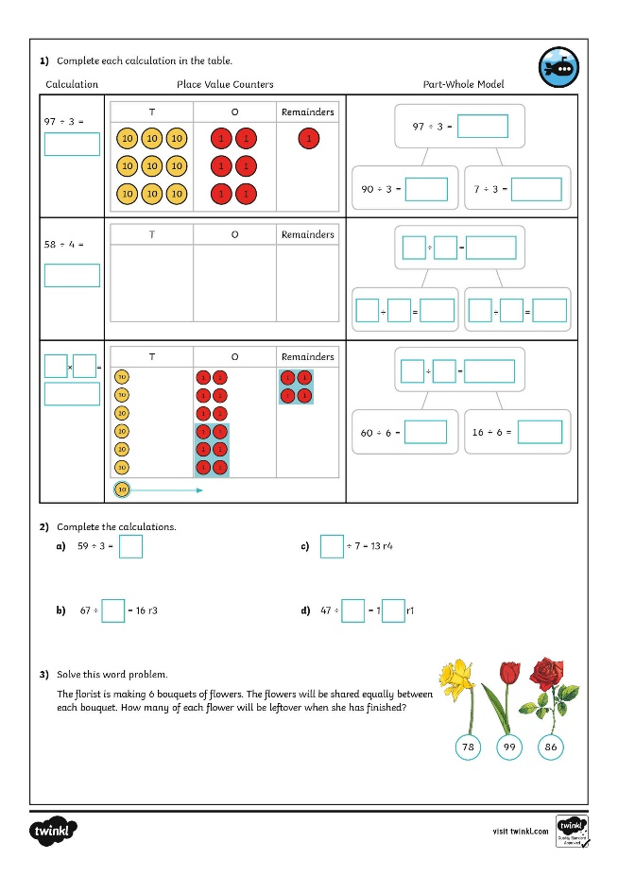
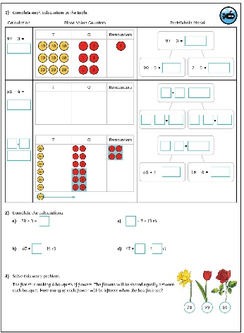
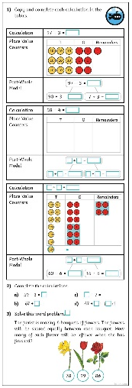
Divide 2 Digits by 1 Digit (1)
Dive in by completing your own activity!

