Slide 1
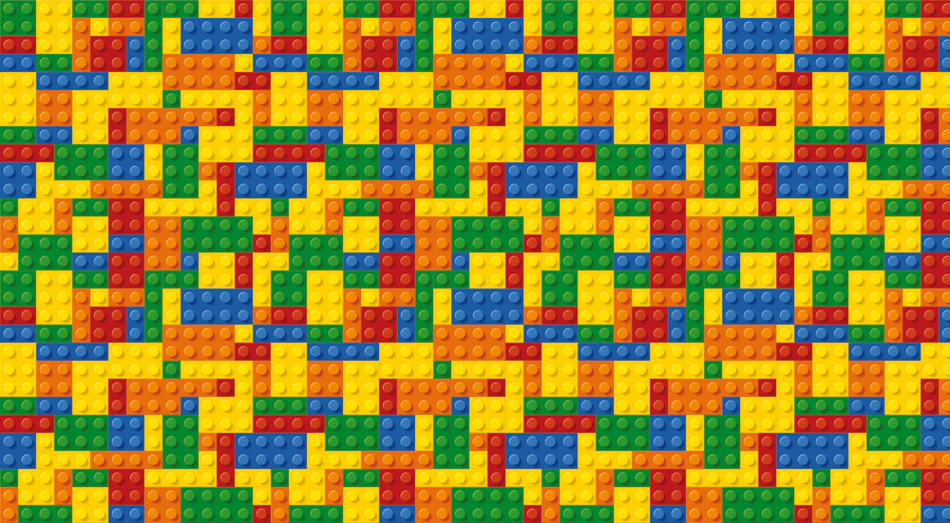
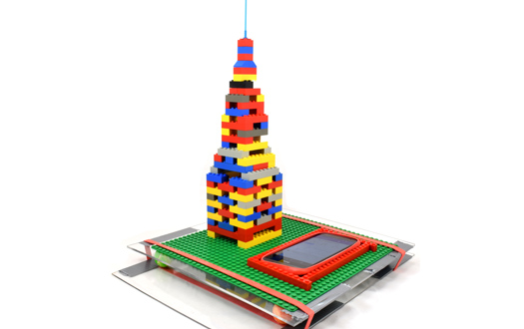
Lego Challenge: Tallest Tower
Your Challenge!
Because of overpopulation in LEGOville, the city has decided that because it has no more land to build on. Therefore, the LEGO people must build up instead of out. The challenge is to help LEGOville solve their problem by constructing the tallest LEGO skyscraper. Keep in mind that there are lots of earthquakes in LEGOville, so the tower must be able to withstand an earthquake (a shake test).
Planning during this challenge
Place a baseplate on a flat, sturdy surface. A LEGO baseplate is a flat piece covered in studs so you have a starting point for your tower.
Use square and rectangular bricks at least 2 studs wide. If the bricks are wider, your tower will be sturdier as it increases in size. 2x2 and 2x4 bricks work perfectly for building exterior walls for your tower, but you can experiment with any size you’d like.
Build 4 walls that are the same length. Attach bricks to the baseplate to form a foundation for your tower. These will be your ground floor exterior walls, so outline how big you want your tower to be
Stagger where the seams meet as you build taller. If you stack the same piece in line with the piece below it, you line up the seams. When the seams are lined up, the tower will be less sturdy and more likely to collapse when you make it taller.
Avoid building interiors to save bricks. While it may be nice to have separate floors inside of your tower, it will only use more bricks in the end and cost more money.
Give your tower some decorations. Once you’ve finished building the basics of your tower, you can get creative by adding your own touches. Make it unique!
Engineering Goals:
Learn about the stability of tall structures and how to engineer tall buildings that are also strong.
Reflection Questions
What should I do first?
Is something confusing me?
Could I explain this to someone else?
Where can I look for help?
How can I do it better?

