Slide 1


Keep Calm and
Make Music
Weekly Wonder
Discovering the
Musical Dimensions KS1

Slide 2










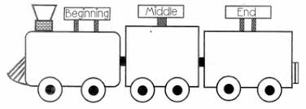
Discovering the
Musical Dimensions
Pitch
Duration
Dynamics
Tempo
(there are seven altogether)
Texture
Structure
Timbre

Slide 3


Contents – homepage
Click on the to return to this page
There are seven musical dimensions – one for every day of the week!
Which one will you discover today? Click on one and off you go
Pitch – what it means and fun pitch activities
Duration – what it means and fun duration activities
Dynamics – what it means and fun dynamic activities
Tempo – what it means and fun tempo activities
Structure – what it means and fun structure activities
Texture - what it means and fun texture activities
Timbre – what it means and fun timbre activities
Quiz time
Don’t try and do them all in one go it could be a bit

Slide 4
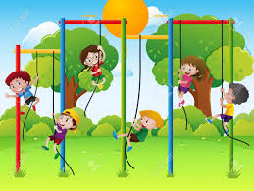
PITCH is all about how high or low sounds are
Key words
High, middle and low
Higher and lower
Click here
to find out about high, middle and low sounds and sing a fun song about those sounds

Slide 5
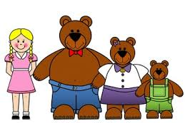
Fun pitch activities
Listen to the story of
Golidlocks and the three bears
and enjoy using low, middle and high voices for daddy, mummy and baby bear
Join in with this fun high and low game
Have fun moving to this version of Teddy Bear’s Picnic. Walk in time to the low sounding footsteps and wave your arms in the air every time you hear a high sound

