Slide 1
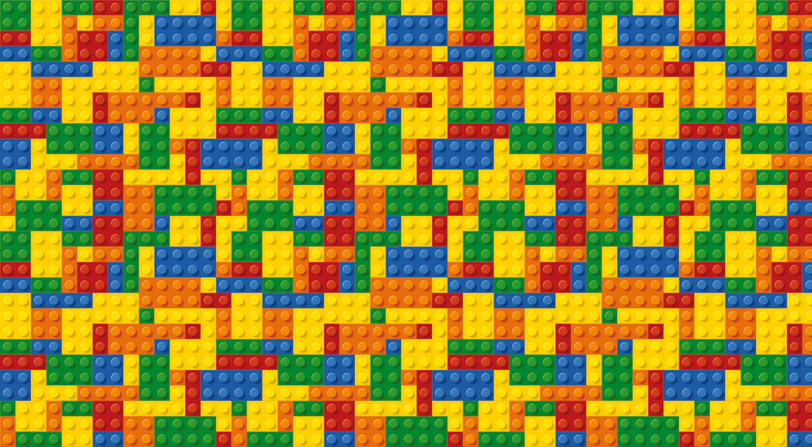
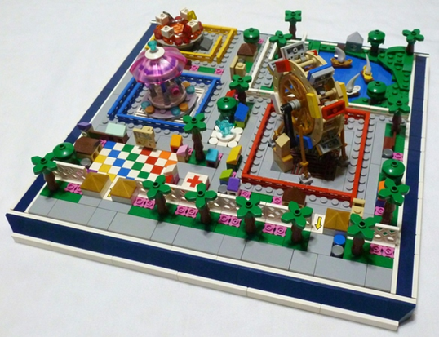
Lego Challenge: Ultimate Amusement Park
Your Challenge!
A theme park is a place with attractions made up of rides, such as roller coasters and water rides. Theme parks can be enjoyed by adults, teenagers and children. Design the ultimate amusement park using your knowledge of simple machines!
Engineering Goals:
Ride examples
Learn about the different simple machines
Apply this knowledge to design awesome amusement park rides
Think both about safety and fun when designing new amusement park rides
Pendulum rides are amusement rides based on the motion of a fixed pendulum. The configuration of the ride consists of a gondola, arm, and an axle. One end of the arm is fitted with a passenger-carrying gondola, while the other is attached to the axle. On some models, the arm extends beyond the axle and is fitted with a heavy counterweight.
Bumper cars or dodgems is the generic name for a type of flat ride consisting of several small electrically powered cars which draw power from the floor and/or ceiling, and which are turned on and off remotely by an operator.
Reflection Questions
What should I do first?
A carousel roundabout or merry-go-round, is a type of amusement ride consisting of a rotating circular platform with seats for riders. The "seats" are traditionally in the form of rows of wooden horses or other animals mounted on posts, many of which are moved up and down by gears to simulate galloping
Is something confusing me?
Could I explain this to someone else?
Where can I look for help?
Water rides are amusement rides that are set over water. For instance, a log flume travels through a channel of water to move along its course.
How can I do it better?

