Slide 1




Year 6 - Spring - Block 3
Algebra

Slide 2
Input
Output
Eva has a one-step function machine.
She puts in the number 6 and the number 18 comes out.
What could the function be?
How many different answers can you find?
6
6

Slide 3
Amir puts some numbers into a function machine.
What is the output from the function when the input is 16?
2
8
3
7
6
4

Slide 4
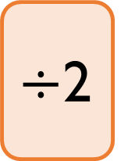
Dora puts a number into the function machine.
Dora’s number is:
A factor of 32
A multiple of 8
A square number
What is Dora’s input?
What is her output?
Can you create your own clues for the numbers you put into a function machine for a partner to solve?
$÷$2
Input
Output

Slide 5

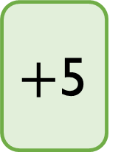
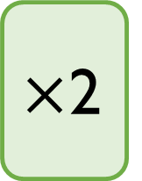
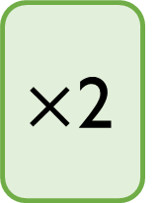
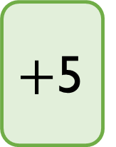
Teddy has two function machines.
He says,
Is Teddy correct?
Is there an input that will give the same output for both machines?
$+$5
$×$2
Input
Output
$×$2
$+$5
Input
Output
The function machines will give the same answer.

Slide 6

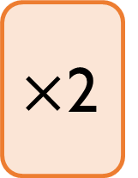

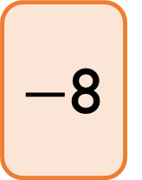
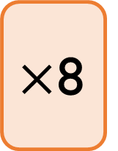
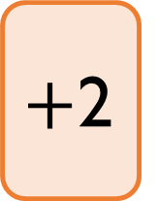
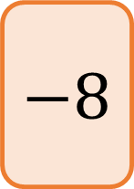
Mo has the following function machines.
Explain which of these can be written as single function machines.
$+$2
$−$8
Input
Output
$×$8
$÷$2
Input
Output
$×$2
$$−8$$
Input
Output

Slide 7





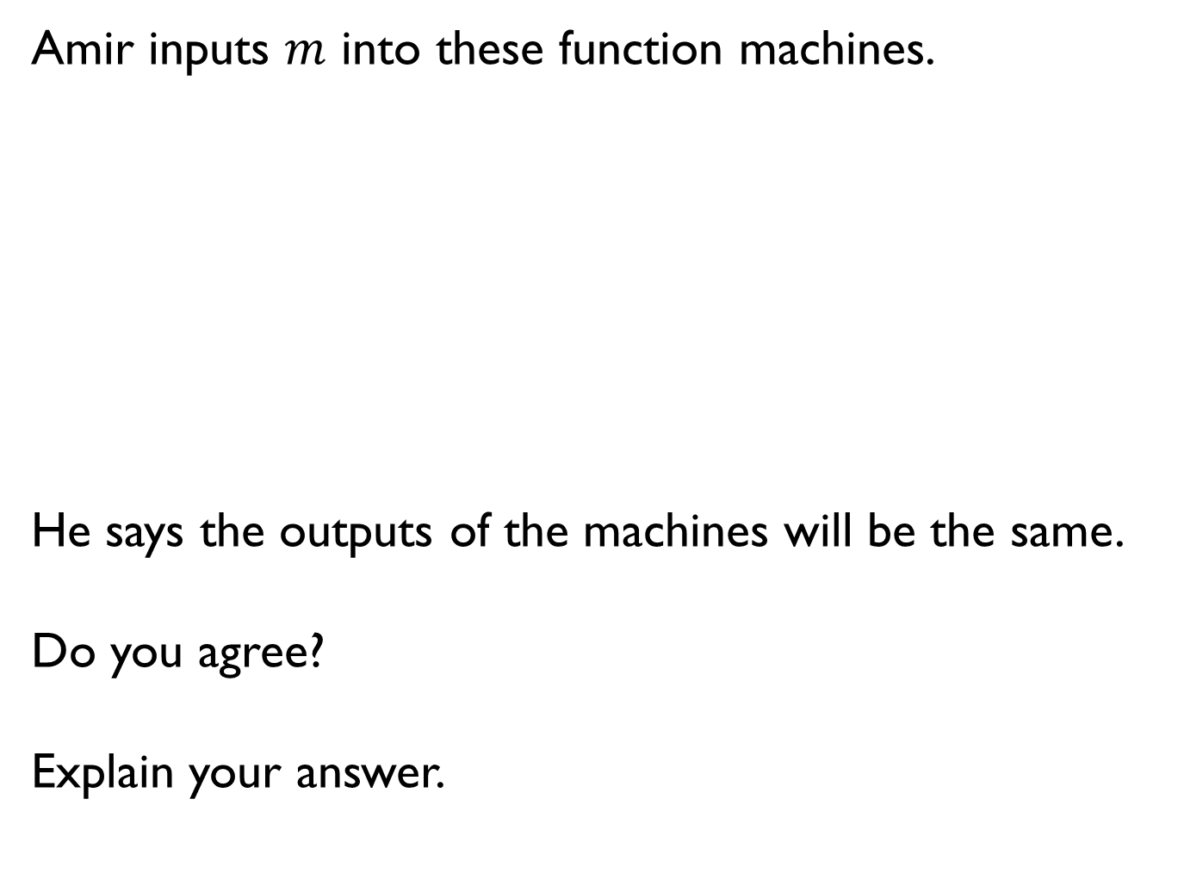

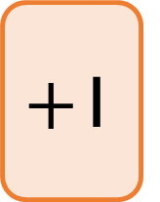
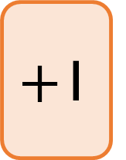

Amir inputs $m$ into these function machines.
He says the outputs of the machines will be the same.
Do you agree?
Explain your answer.
$×$2
$+$1
Input
Output
$+$1
$×$2
Input
Output

Slide 8
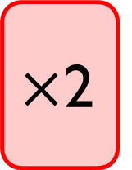
This function machine gives the same output for every input.
For example if the input is 5 then the output is 5 and so on.
What is the missing part of the function?
What other pairs of functions can you think that will do the same?
$×$2
Input
Output

Slide 9
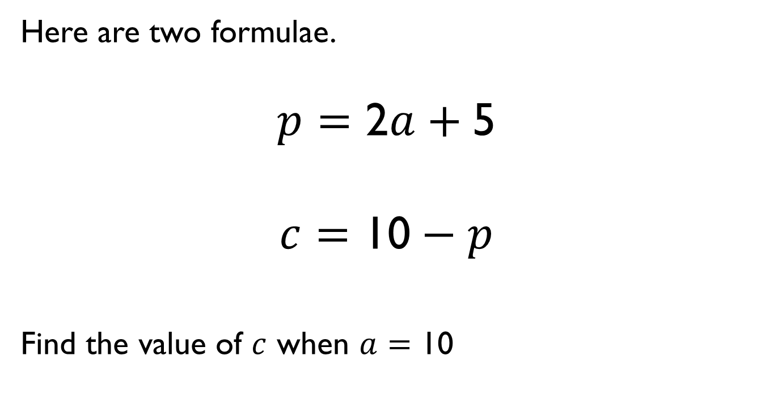
Here are two formulae.
$$p=\text{2}a+\text{5}$$
$$c=\text{10}−p$$
Find the value of $c$ when $a$ $=$ 10

Slide 10


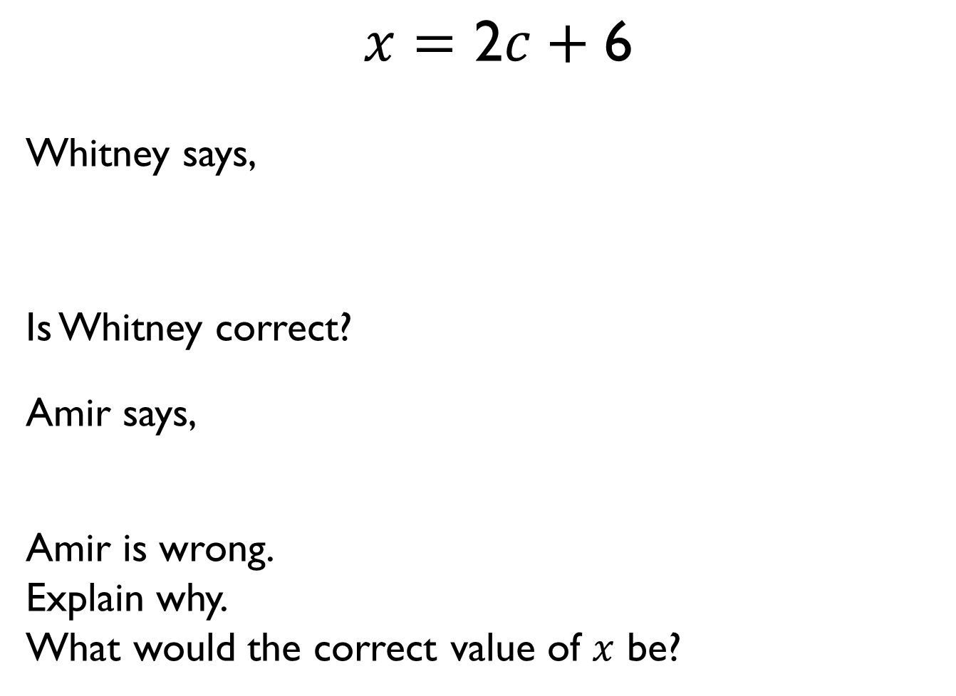

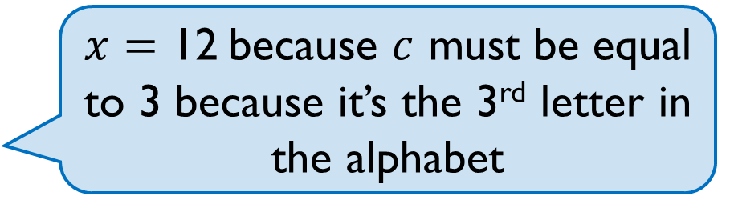
$x=\text{2}c+\text{6}$
Whitney says,
Is Whitney correct?
Amir says,
Amir is wrong.
Explain why.
What would the correct value of $x$ be?
$x=\text{12}$ because $c$ must be equal to 3 because it’s the 3rd letter in the alphabet
When $c=\text{5}$, $x=\text{31}$

Slide 11
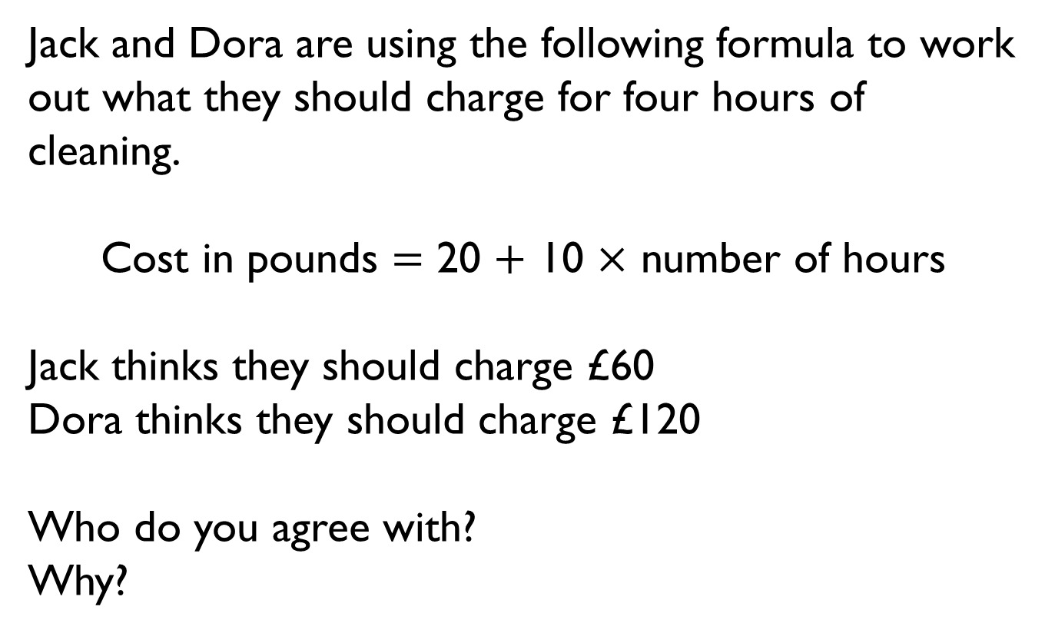
Jack and Dora are using the following formula to work out what they should charge for four hours of cleaning.
Cost in pounds $=$ 20 $+$ 10 $×$ number of hours
Jack thinks they should charge £60
Dora thinks they should charge £120
Who do you agree with?
Why?

Slide 12
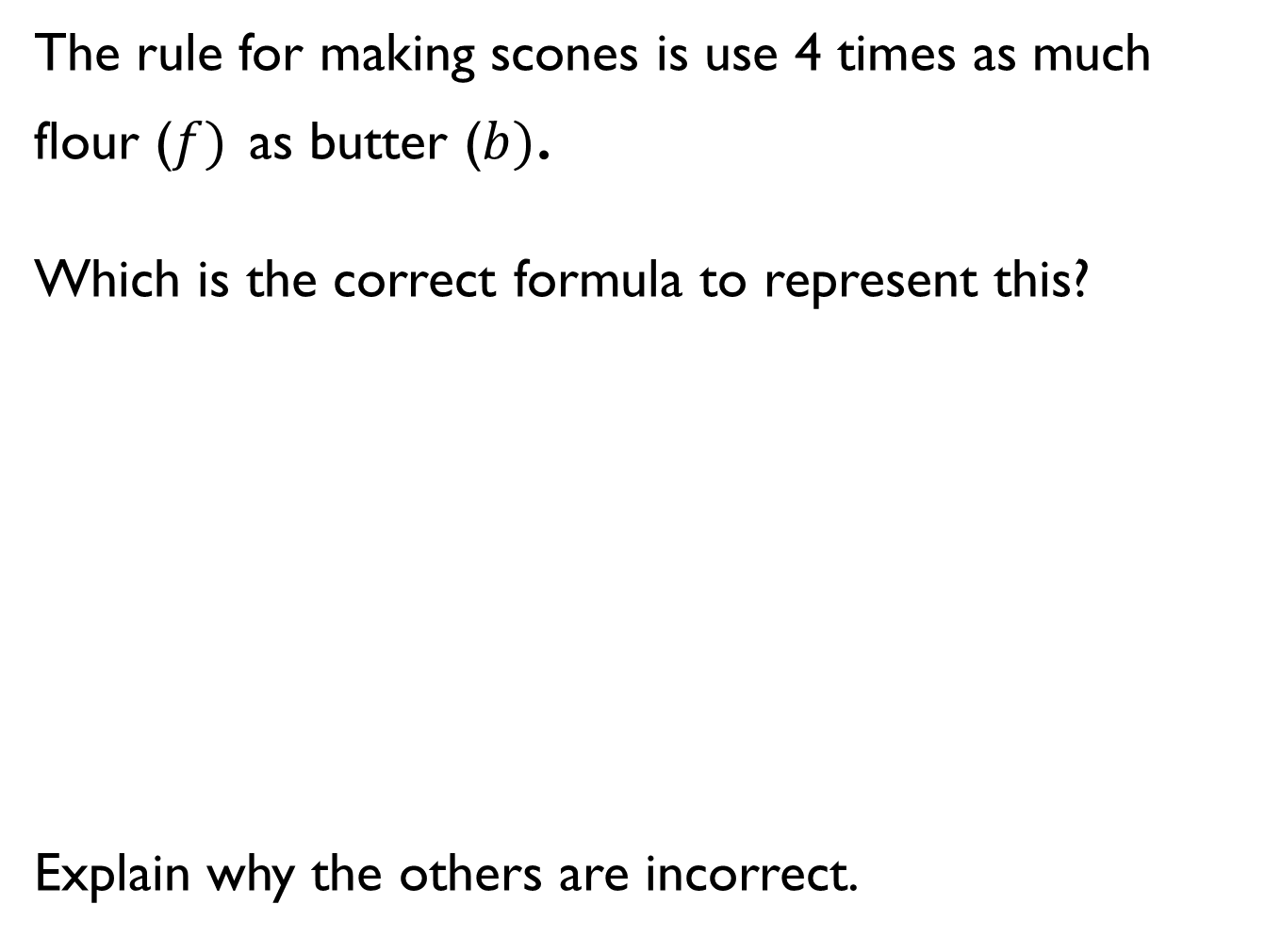



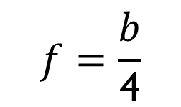
The rule for making scones is use 4 times as much flour ($f)$ as butter ($b)$.
Which is the correct formula to represent this?
Explain why the others are incorrect.
A
B
$$f=\frac{b}{\text{4}}$$
$$f=\text{4}b$$
C
D
$$f=b+\text{4}$$
$$\text{4}f=b$$

Slide 13
Words | Concrete | Algebra
Rosie thinks of a number. She adds 7 and divides her answer by 2
Teddy thinks of a number. He multiples by 3 and subtracts 4
Rosie and Teddy think of the same number.
Rosie’s answer is 9
What is Teddy’s answer?
Rosie and Teddy think of the same number again. This time, they both get the same answer.
Use trial and improvement to find the number they were thinking of.

Slide 14
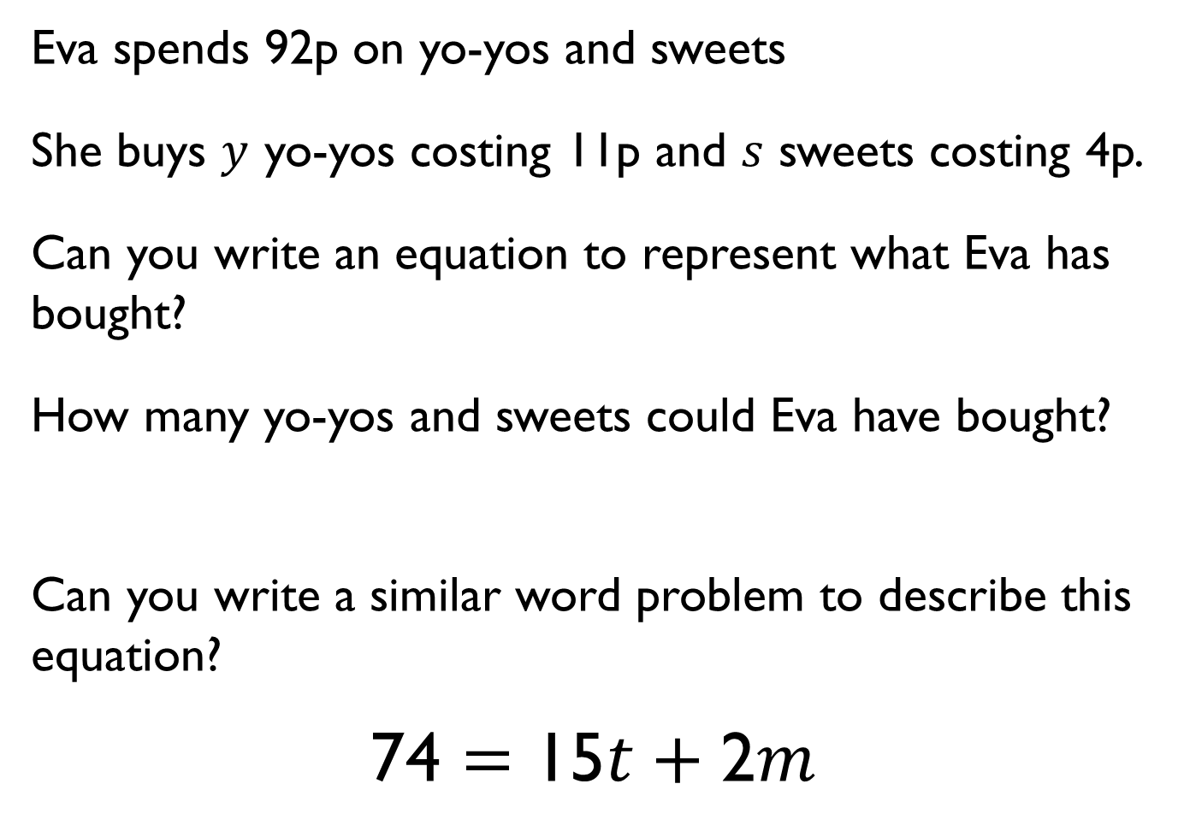
Eva spends 92p on yo-yos and sweets
She buys $y$ yo-yos costing 11p and $s$ sweets costing 4p.
Can you write an equation to represent what Eva has bought?
How many yo-yos and sweets could Eva have bought?
Can you write a similar word problem to describe this equation?
$$\text{74}=\text{15}t+\text{2}m$$

Slide 15
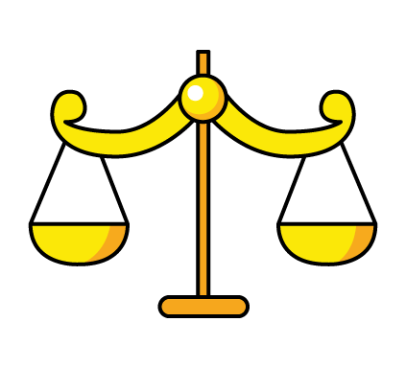

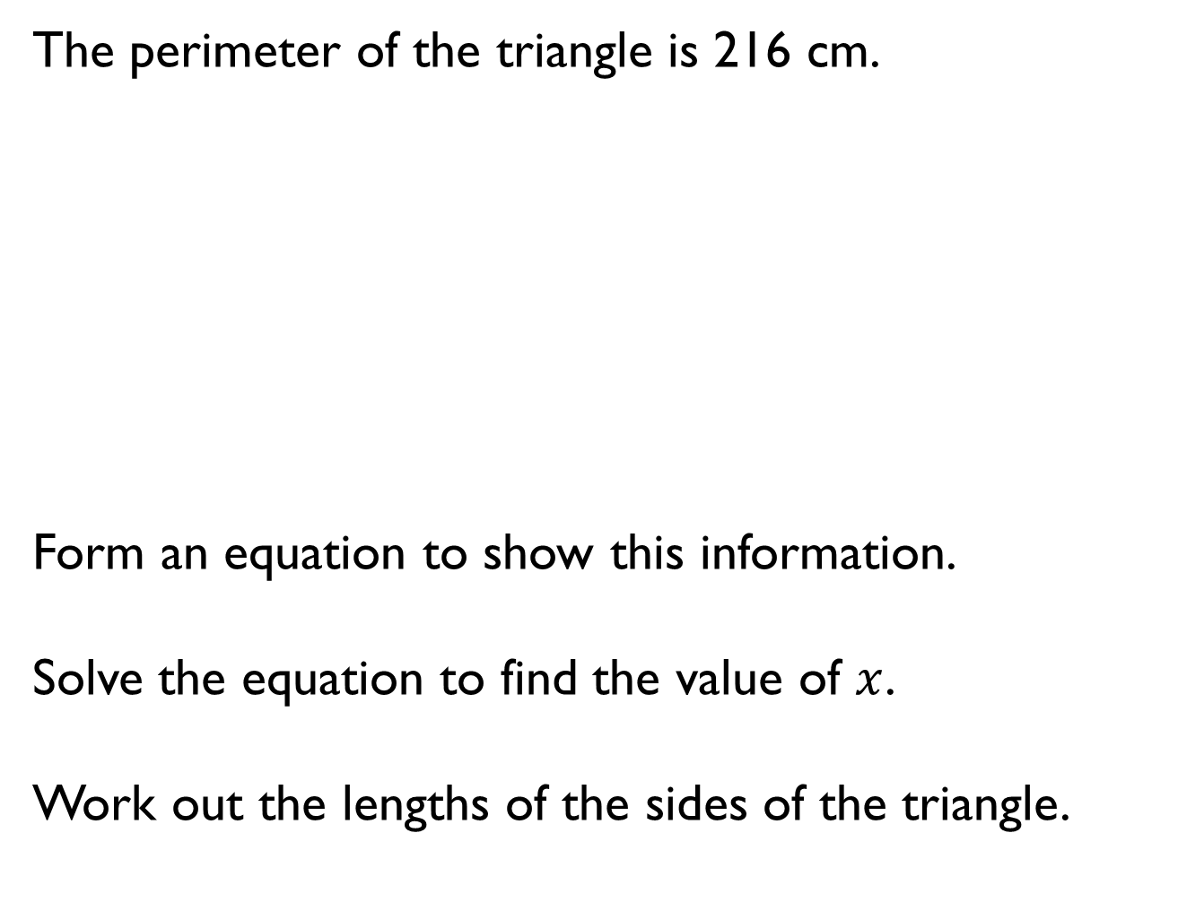



The perimeter of the triangle is 216 cm.
Form an equation to show this information.
Solve the equation to find the value of $x$.
Work out the lengths of the sides of the triangle.
$$\text{5}x$$
$$\text{3}x$$
$$\text{4}x$$

Slide 16
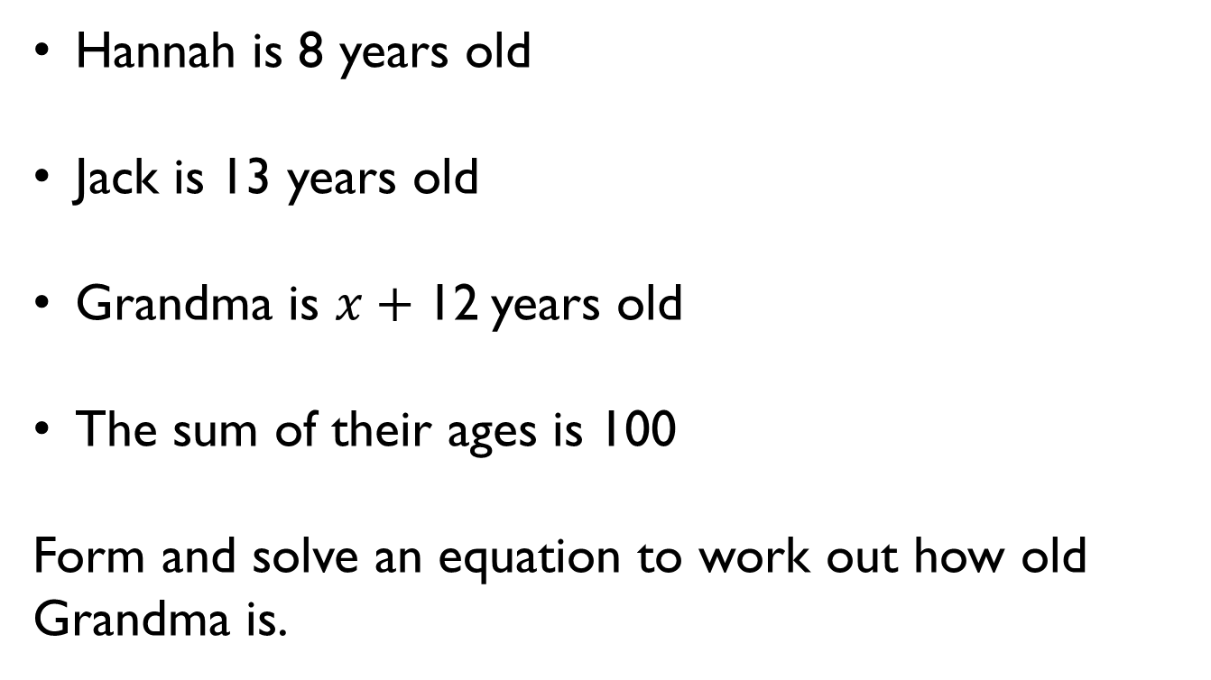
Hannah is 8 years old
Jack is 13 years old
Grandma is $x+\text{12}$years old
The sum of their ages is 100
Form and solve an equation to work out how old Grandma is.

Slide 17


What is the size of the smallest angle in this isosceles triangle?
How can you check your answer?
$$\text{3}\text{y}$$
$$2y$$

Slide 18
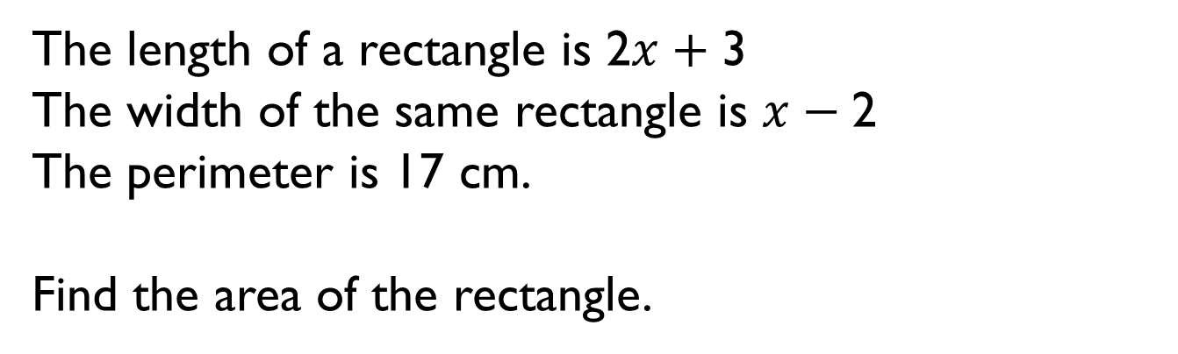
The length of a rectangle is $\text{2}x+\text{3}$
The width of the same rectangle is $x−\text{2}$
The perimeter is 17 cm.
Find the area of the rectangle.

Slide 19


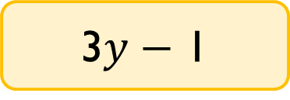

Alex has some algebra expression cards.
The mean of the cards is 19
Work out the value of each card.
$$y+\text{4}$$
$$\text{2}y$$
$\text{3}y−$ 1

Slide 20
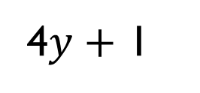
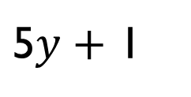
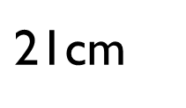
Here is the quadrilateral ABCD.
The perimeter of the quadrilateral is 80 cm.
AB is the same length as BC.
Find the length of CD.
B
$\text{21}$cm
4$y+$ 1
C
A
D
$\text{5}y+$ 1

Slide 21
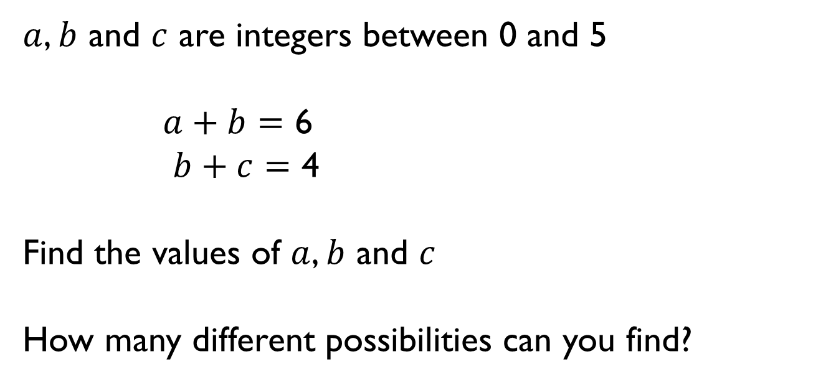
$a$, $b$ and $c$ are integers between 0 and 5
$a+b=$ 6
$b+c=$ 4
Find the values of $a$, $b$ and $c$
How many different possibilities can you find?

Slide 22


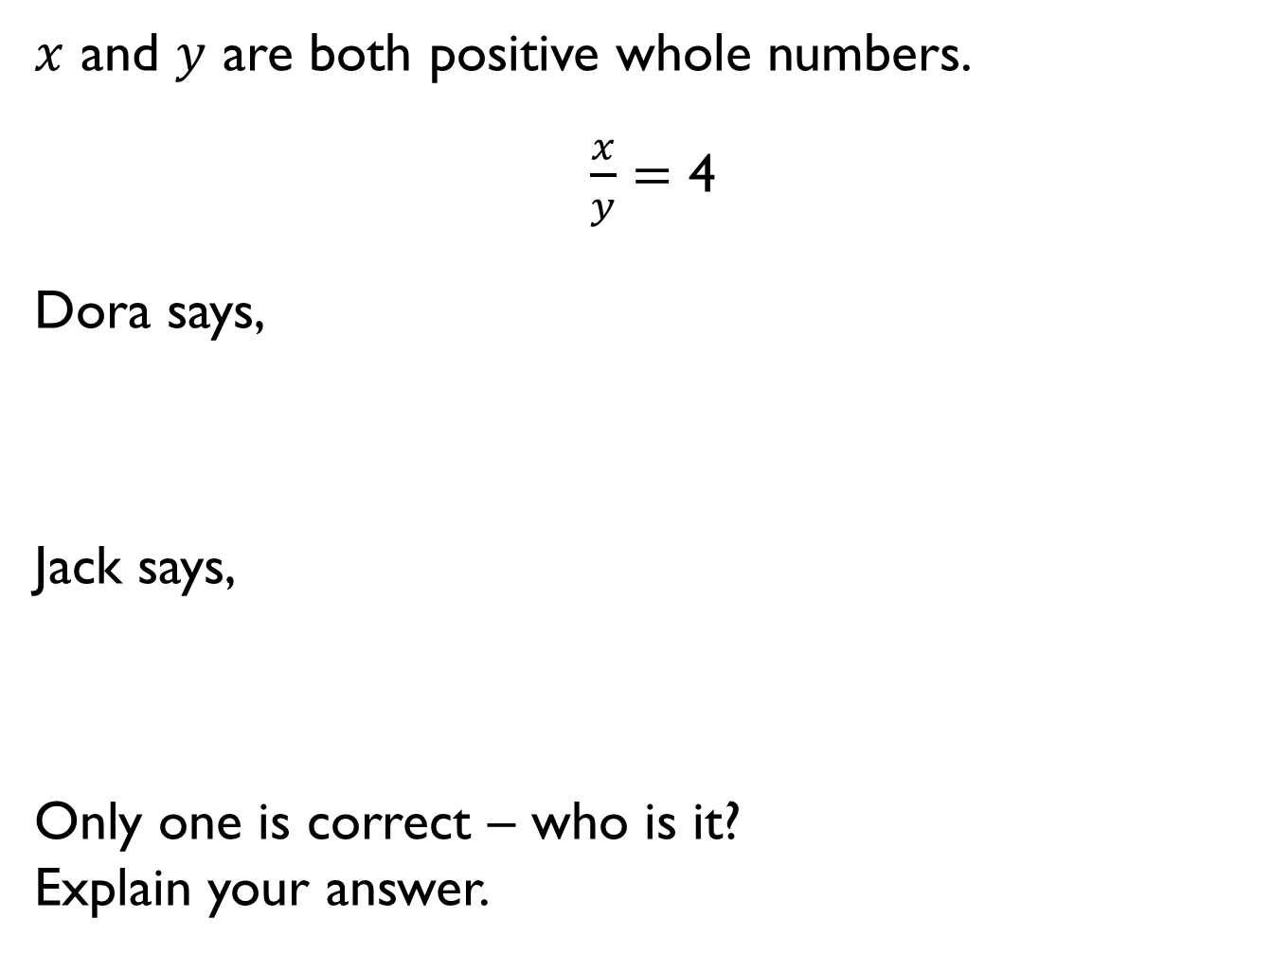
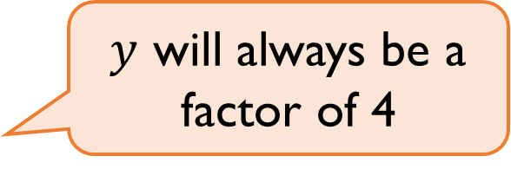
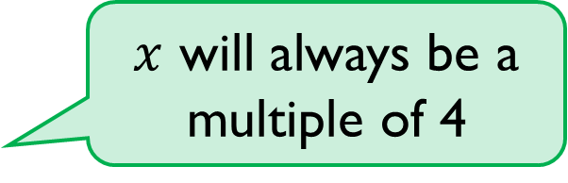
$x$ and $y$ are both positive whole numbers.
$\frac{x}{y}=\text{4}$
Dora says,
Jack says,
Only one is correct – who is it?
Explain your answer.
$x$ will always be a multiple of 4
$y$ will always be a factor of 4

Slide 23

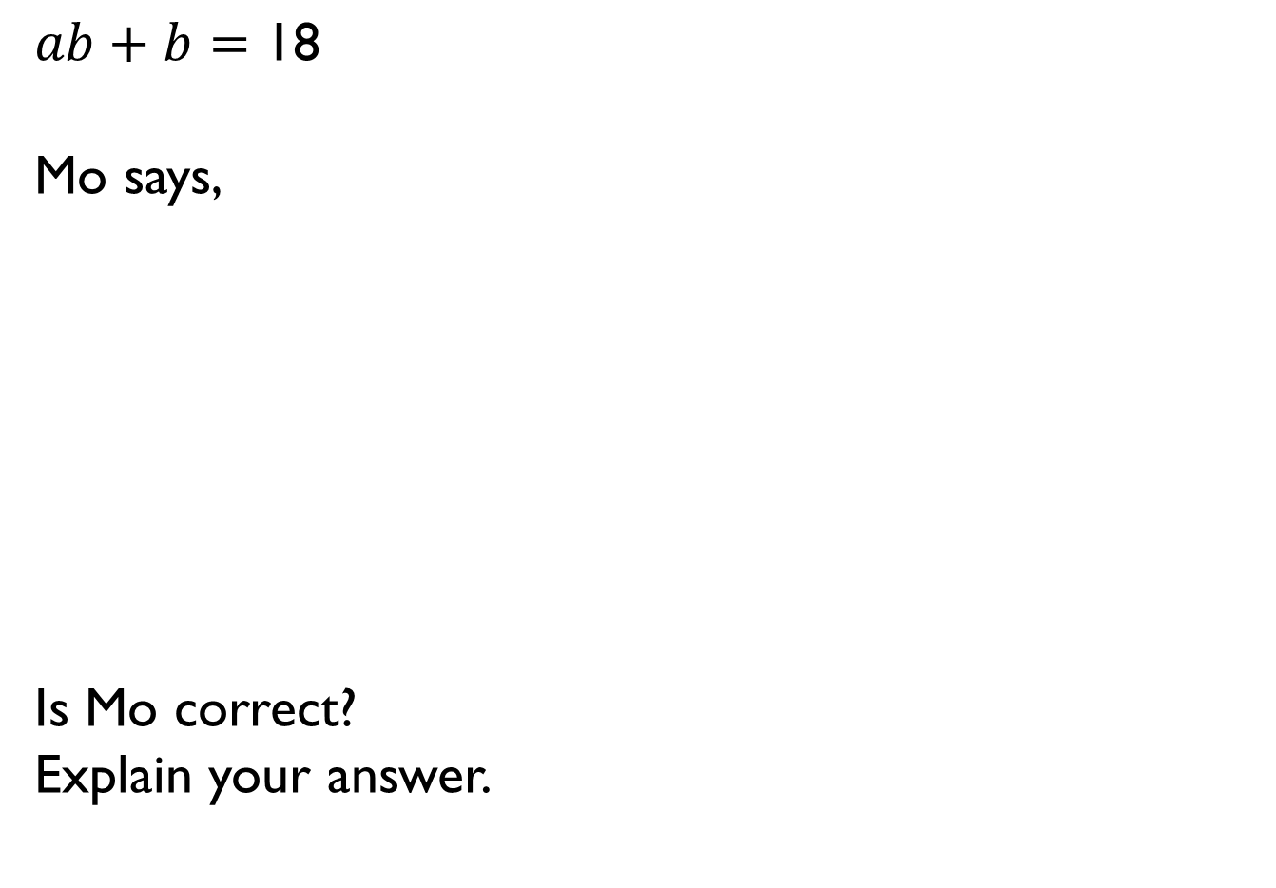
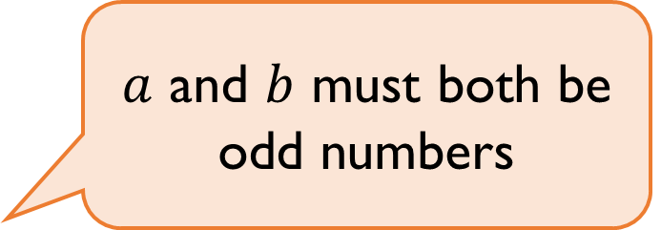
$ab+b=\text{18}$
Mo says,
Is Mo correct?
Explain your answer.
$a$ and $b$ must both be odd numbers

Slide 24
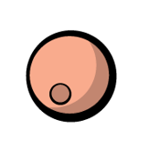

Large beads cost 5p and small beads cost 4p
Rosie has 79p to spend on beads.
How many different combinations of small and large beads can Rosie buy?
Can you write expressions that show all the solutions?
4p
5p

