Slide 1


Keep Calm and
Make Music
Weekly Wonder
Discovering the
Musical Dimensions KS1

Slide 2











Discovering the
Musical Dimensions
Pitch
Duration
Dynamics
Tempo
(there are seven altogether)
Texture
Structure
Timbre

Slide 3


Contents – homepage
Click on the to return to this page
There are seven musical dimensions – one for every day of the week!
Which one will you discover today? Click on one and off you go
Pitch – what it means and fun pitch activities
Duration – what it means and fun duration activities
Dynamics – what it means and fun dynamic activities
Tempo – what it means and fun tempo activities
Structure – what it means and fun structure activities
Texture - what it means and fun texture activities
Timbre – what it means and fun timbre activities
Quiz time
Don’t try and do them all in one go it could be a bit

Slide 4
DURATION is all about how long and short sounds are and beat and rhythm
Key words
Long
Short
Steady beat
Rhythm pattern xx xx x x
Click here
to find out about the steady beat
Click here
to find out about rhythm

Slide 5
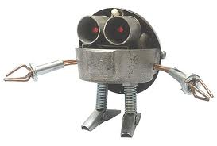


Fun duration activities
Listen to Only time will tell by Mike Oldfield
Tap along to the steady beat (beep) on your thighs
Can you move like a robot to this music?
Create a 4 item beet and cherry rhythm pattern to tap along to the music e.g.
or

