Slide 1
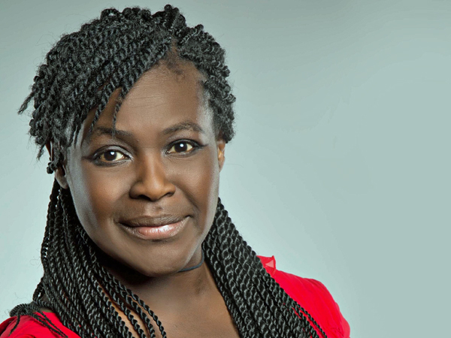
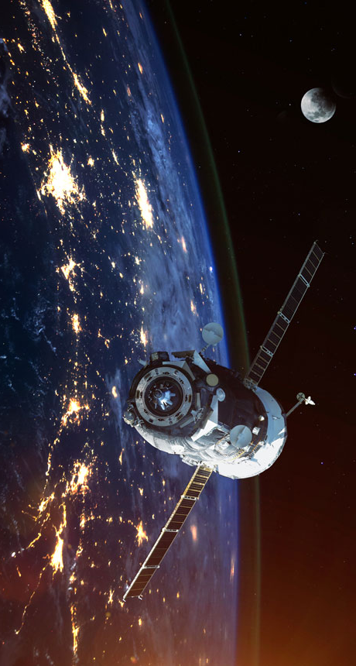
Maggie Aderin-Pocock

Slide 2
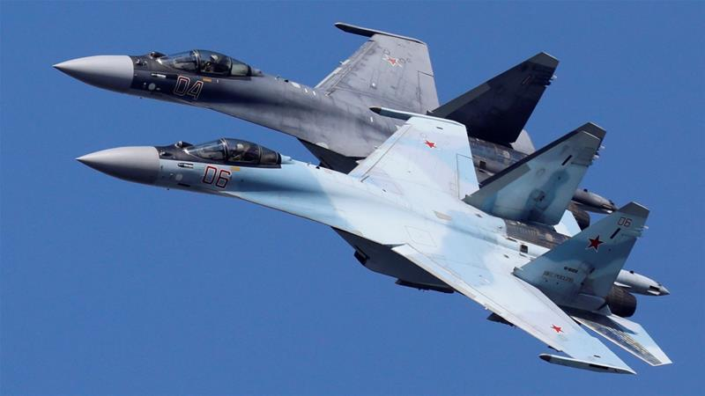
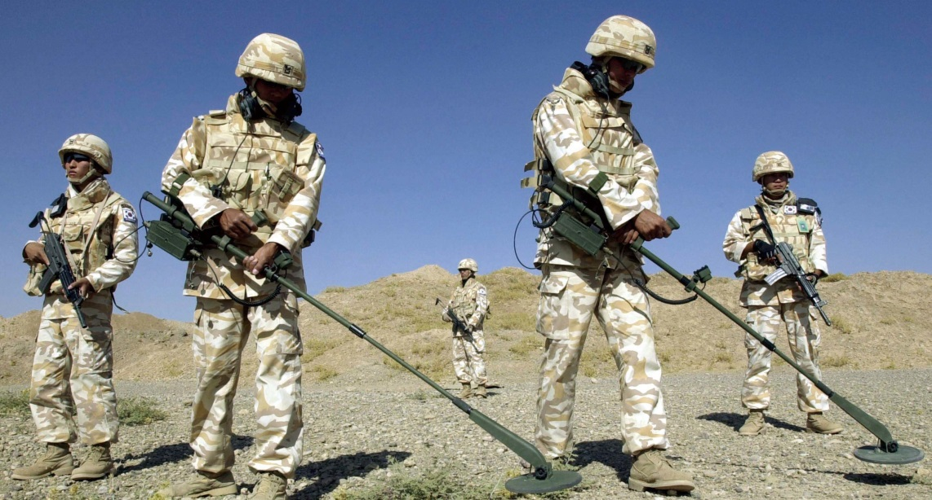
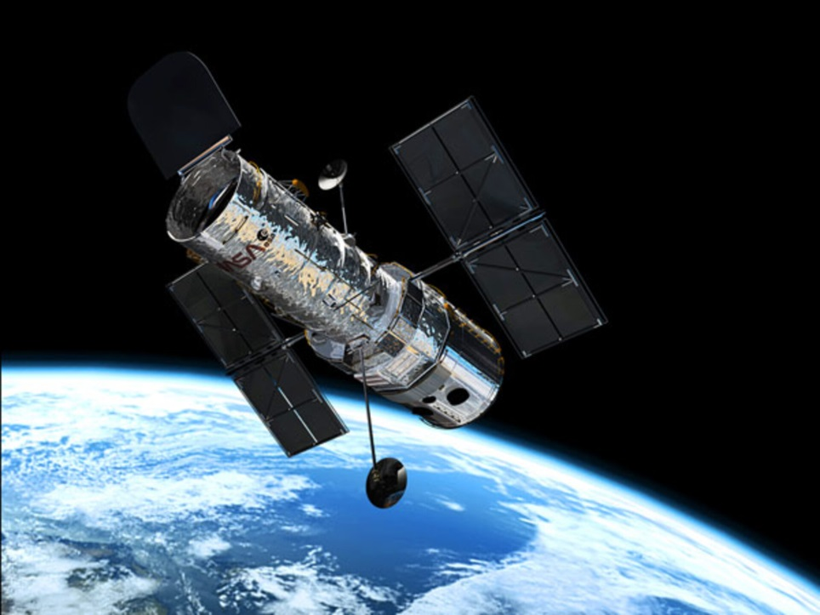
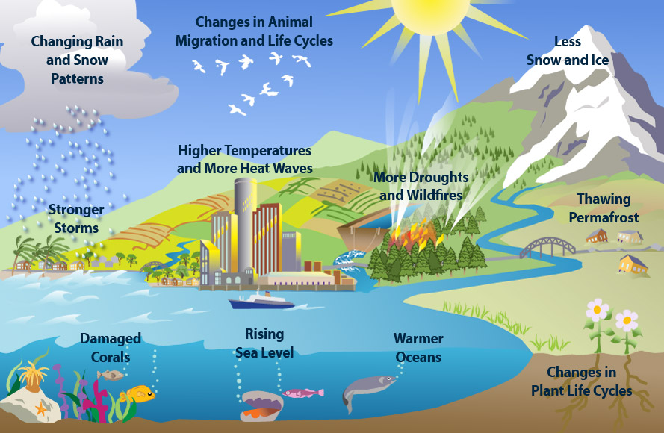
Maggie first worked on technology to find enemy aeroplanes then on designing machines to find buried bombs. Later, she helped design space telescopes and then satellites to monitor climate change.

Slide 3
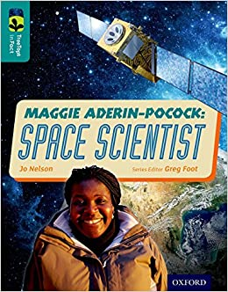
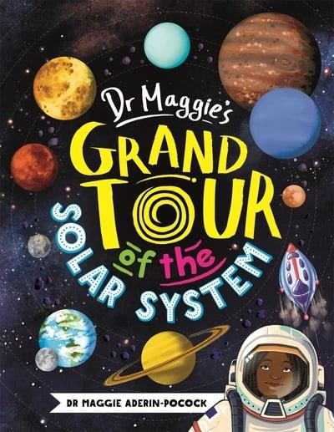
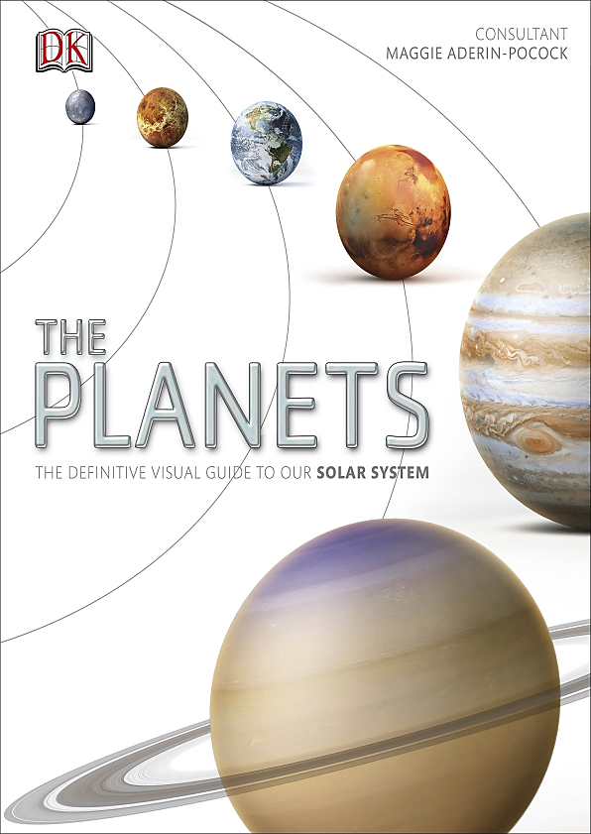
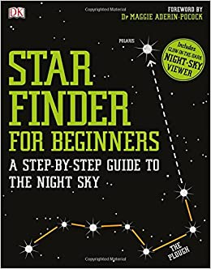
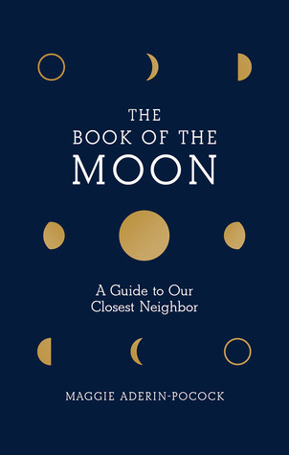

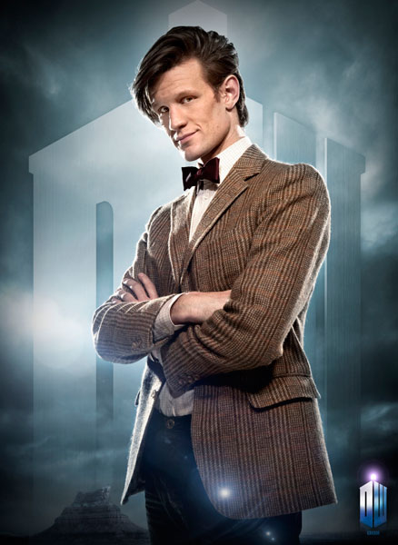


Maggie has written several books and helped to make TV dramas and programmes to help us understand Space.

Slide 4
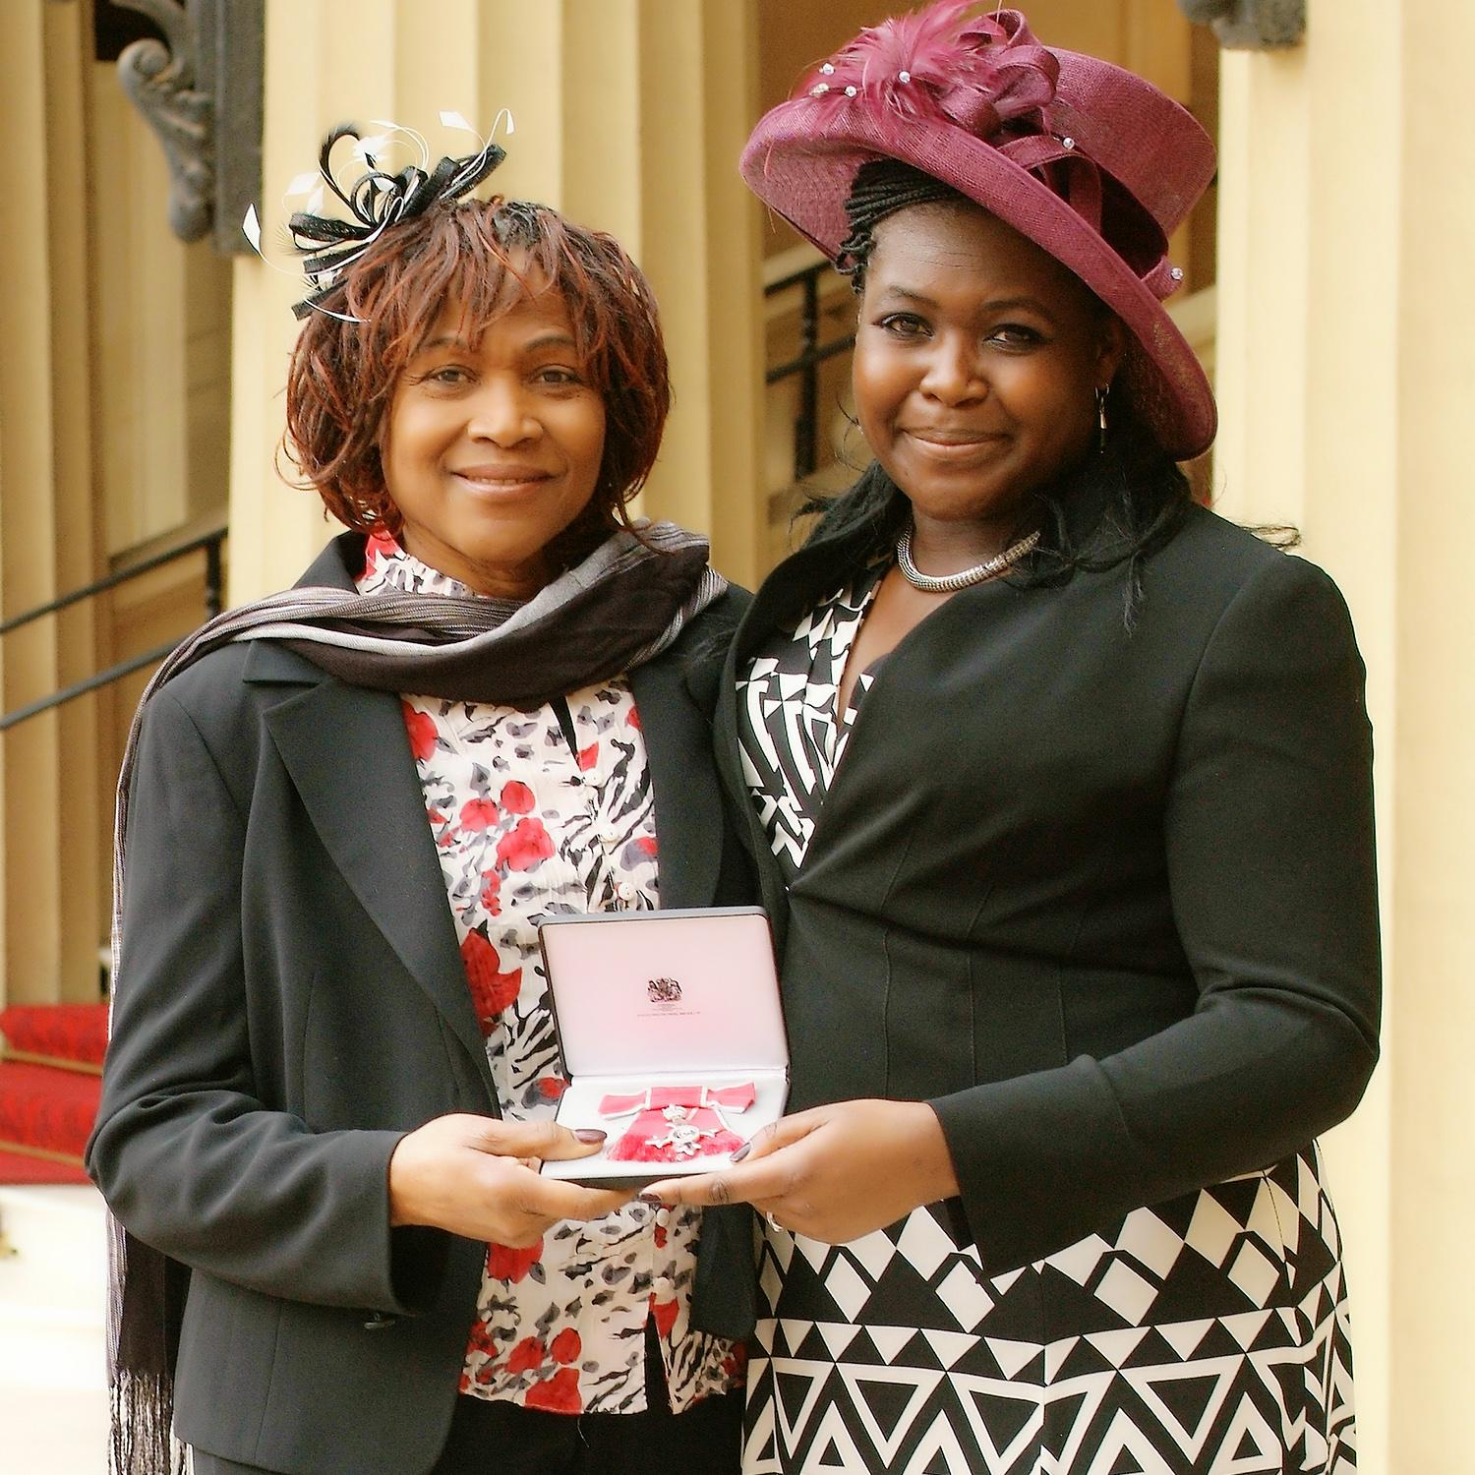
Her teachers told her she should be a nurse but she was awarded a medal called the MBE by the Queen for her scientific work.
Maggie wants more children to become scientists.
Will you be one?

