Slide 1
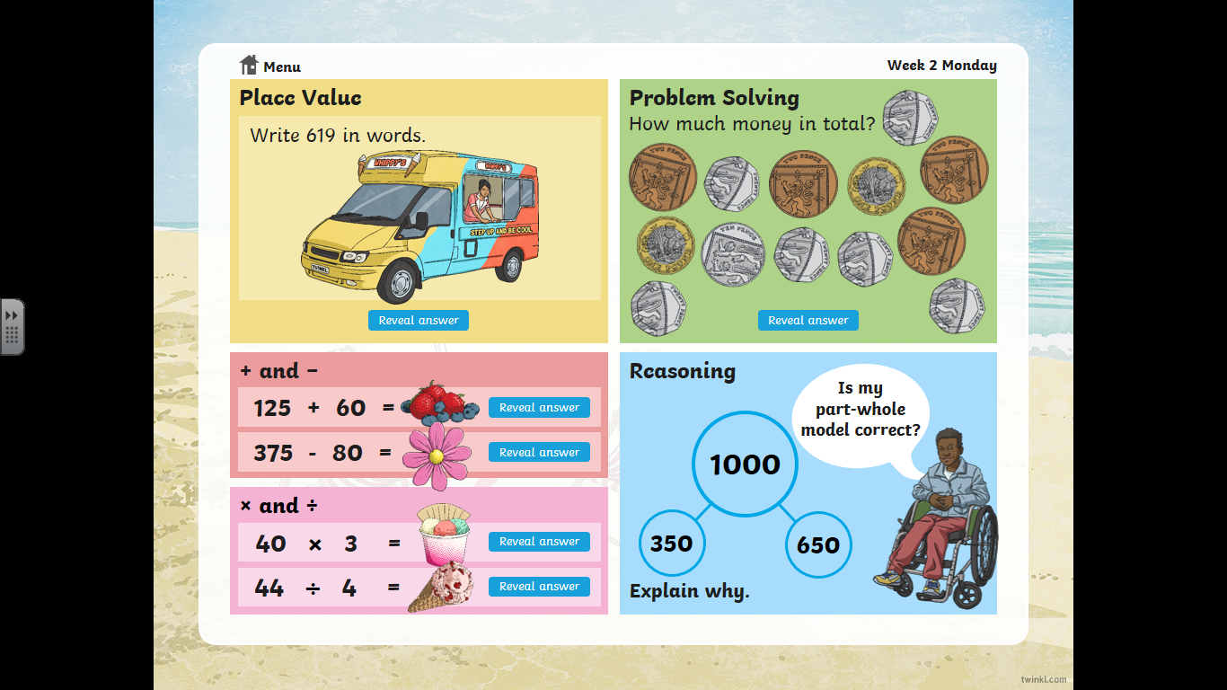

Slide 2
Answers

Slide 3


