Slide 1
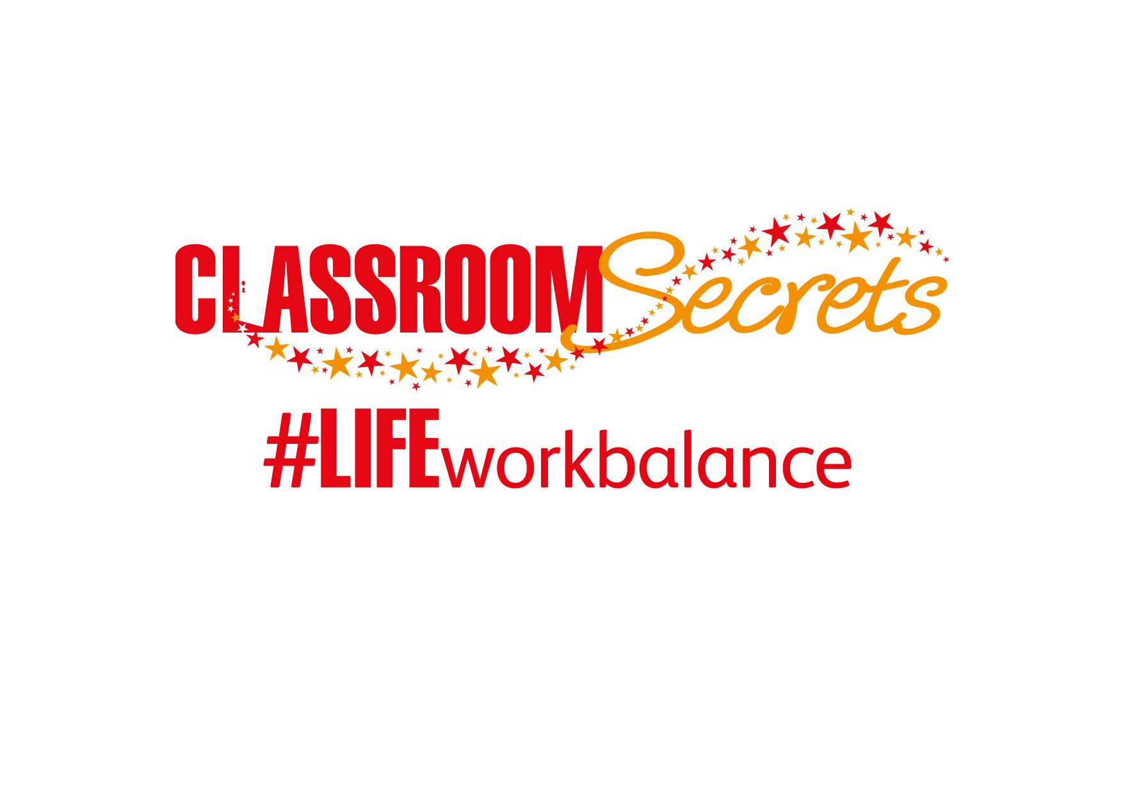


LIFE/work balance
We have started a #LIFEworkbalance campaign and we need your help to complete our LIFE/work balance survey.
We hope to publish the results soon, so please give 15 minutes of your time to help us get a true picture of school life.
Want to be a part of this campaign? Take the survey on our website and share it with your colleagues!
© Classroom Secrets Limited 2019

Slide 2
Year 6 – Summer Block 1 – Cohesion – Organising Sentences within Paragraphs
About This Resource:
This PowerPoint has been designed to support your teaching of this small step. It includes a starter activity and an example of each question from the Varied Fluency and Application and Reasoning resources also provided in this pack. You can choose to work through all examples provided or a selection of them depending on the needs of your class.
National Curriculum Objectives:
English Year 6: Linking ideas across paragraphs using a wider range of cohesive devices: repetition of a word or phrase, grammatical connections [for example, the use of adverbials such as on the other hand, in contrast, or as a consequence], and ellipsis
English Year 6: Layout devices [for example, headings, sub-headings, columns, bullets, or tables, to structure text]
Terminology for pupils:
  Ellipsis
More resources from our Grammar, Punctuation and Spelling scheme of work.
Did you like this resource? Don’t forget to review it on our website.
© Classroom Secrets Limited 2019

Slide 3
Year 6 – Summer Block 1 – Cohesion – Organising Sentences within Paragraphs
Notes and Guidance
In this step, children will look at how sentences are organised within paragraphs, for both fiction and non-fiction writing.
In fiction texts, sentences should follow a logical sequence which will be different depending on the intended outcome of the writing. For example: To build suspense, whatever is being described may not be revealed until the end of the paragraph. Whereas, if the focus of the paragraph is to introduce a character, they will be named and described straight away.
For non-fiction writing, sentences should also follow a logical sequence. They may begin with an opening sentence which introduces a new point and links back to the previous. They may contain explanation or information about the topic being discussed, followed by a closing sentence which links to the next paragraph.
Sentences should be linked using connecting words and phrases to contrast ideas, to give reasoning, to develop ideas and to sequence.
To contrast ideas, words or phrases can be used. For example: nevertheless, in contrast, however, on the other hand etc.
Therefore, accordingly, I’m sure you will agree that and as a result of may be used to reason an idea.
To develop an idea, language can be used such as: in addition to, moreover, also etc.
Sequencing ideas involves the use of adverbials of time. For example: firstly, secondly, next, finally etc.
Focused Questions
Organise these sentences into a logical order. Does it work if they are in a different order?
Are these sentences sequenced correctly? How do you know?
© Classroom Secrets Limited 2019

Slide 4
Year 6 – Summer Block 1 – Cohesion
Step 4: Organising Sentences within Paragraphs
© Classroom Secrets Limited 2019

Slide 5
Introduction
Sort the adverbials below into the correct place on the table.
Time | Place | Manner | Frequency
happily |  | yesterday |  | carefully |  | outside
afterwards |  | nearby |  | often |  | sometimes
far away |  | daily |  | earlier |  | hastily
© Classroom Secrets Limited 2019

Slide 6
Introduction
Sort the adverbials below into the correct place on the table.
Time | Place | Manner | Frequency
yesterday afterwards earlier | outside nearby far away | happily carefully hastily | often sometimes daily
happily |  | yesterday |  | carefully |  | outside
afterwards |  | nearby |  | often |  | sometimes
far away |  | daily |  | earlier |  | hastily
© Classroom Secrets Limited 2019

Slide 7
Varied Fluency 1
Underline the adverbials of time in paragraph two.
For as long as she could remember, people had been comparing her to her brother. How was that fair? He had always been the clever one, he’d always been the brave one. Maybe she should have died instead of him.
Once she’d stopped feeling sorry for herself, she prepared for the task ahead. First, she had to retrieve the serum. Then, she needed to locate Conrad. Finally, she’d have to convince him that injecting himself with the serum would help save this good-for-nothing, lousy population from extinction. No – she was being too harsh. She knew a handful of people who were worth saving.
Just then, her train of thought was interrupted by a loud bang on the door. Immediately, she slid the plans of the science lab safely between the crack in the wall. It was better to be safe than sorry, especially as she hadn’t been expecting visitors.
© Classroom Secrets Limited 2019

Slide 8
Varied Fluency 1
Underline the adverbials of time in paragraph two.
first, then, finally
For as long as she could remember, people had been comparing her to her brother. How was that fair? He had always been the clever one, he’d always been the brave one. Maybe she should have died instead of him.
Once she’d stopped feeling sorry for herself, she prepared for the task ahead. First, she had to retrieve the serum. Then, she needed to locate Conrad. Finally, she’d have to convince him that injecting himself with the serum would help save this good-for-nothing, lousy population from extinction. No – she was being too harsh. She knew a handful of people who were worth saving.
Just then, her train of thought was interrupted by a loud bang on the door. Immediately, she slid the plans of the science lab safely between the crack in the wall. It was better to be safe than sorry, especially as she hadn’t been expecting visitors.
© Classroom Secrets Limited 2019

Slide 9
Varied Fluency 2
In paragraph one, find and copy an example of a word or phrase used to show a contrast.
For as long as she could remember, people had been comparing her to her brother. How was that fair? He had always been the clever one, he’d always been the brave one. Maybe she should have died instead of him.
Once she’d stopped feeling sorry for herself, she prepared for the task ahead. First, she had to retrieve the serum. Then, she needed to locate Conrad. Finally, she’d have to convince him that injecting himself with the serum would help save this good-for-nothing, lousy population from extinction. No – she was being too harsh. She knew a handful of people who were worth saving.
Just then, her train of thought was interrupted by a loud bang on the door. Immediately, she slid the plans of the science lab safely between the crack in the wall. It was better to be safe than sorry, especially as she hadn’t been expecting visitors.
© Classroom Secrets Limited 2019

Slide 10
Varied Fluency 2
In paragraph one, find and copy an example of a word or phrase used to show a contrast.
instead of
For as long as she could remember, people had been comparing her to her brother. How was that fair? He had always been the clever one, he’d always been the brave one. Maybe she should have died instead of him.
Once she’d stopped feeling sorry for herself, she prepared for the task ahead. First, she had to retrieve the serum. Then, she needed to locate Conrad. Finally, she’d have to convince him that injecting himself with the serum would help save this good-for-nothing, lousy population from extinction. No – she was being too harsh. She knew a handful of people who were worth saving.
Just then, her train of thought was interrupted by a loud bang on the door. Immediately, she slid the plans of the science lab safely between the crack in the wall. It was better to be safe than sorry, especially as she hadn’t been expecting visitors.
© Classroom Secrets Limited 2019

Slide 11
Varied Fluency 3
True or false? The sentences below have been ordered logically.
Eventually, she’d be able to leave this planet and move on with her life. Before any of that could happen though, she needed to complete her mission first.
For as long as she could remember, people had been comparing her to her brother. How was that fair? He had always been the clever one, he’d always been the brave one. Maybe she should have died instead of him.
Once she’d stopped feeling sorry for herself, she prepared for the task ahead. First, she had to retrieve the serum. Then, she needed to locate Conrad. Finally, she’d have to convince him that injecting himself with the serum would help save this good-for-nothing, lousy population from extinction. No – she was being too harsh. She knew a handful of people who were worth saving.
Just then, her train of thought was interrupted by a loud bang on the door. Immediately, she slid the plans of the science lab safely between the crack in the wall. It was better to be safe than sorry, especially as she hadn’t been expecting visitors.
© Classroom Secrets Limited 2019

Slide 12
Varied Fluency 3
True or false? The sentences below have been ordered logically.
Eventually, she’d be able to leave this planet and move on with her life. Before any of that could happen though, she needed to complete her mission first.
True
For as long as she could remember, people had been comparing her to her brother. How was that fair? He had always been the clever one, he’d always been the brave one. Maybe she should have died instead of him.
Once she’d stopped feeling sorry for herself, she prepared for the task ahead. First, she had to retrieve the serum. Then, she needed to locate Conrad. Finally, she’d have to convince him that injecting himself with the serum would help save this good-for-nothing, lousy population from extinction. No – she was being too harsh. She knew a handful of people who were worth saving.
Just then, her train of thought was interrupted by a loud bang on the door. Immediately, she slid the plans of the science lab safely between the crack in the wall. It was better to be safe than sorry, especially as she hadn’t been expecting visitors.
© Classroom Secrets Limited 2019

Slide 13
Varied Fluency 4
What is the main focus of paragraph 3?
For as long as she could remember, people had been comparing her to her brother. How was that fair? He had always been the clever one, he’d always been the brave one. Maybe she should have died instead of him.
Once she’d stopped feeling sorry for herself, she prepared for the task ahead. First, she had to retrieve the serum. Then, she needed to locate Conrad. Finally, she’d have to convince him that injecting himself with the serum would help save this good-for-nothing, lousy population from extinction. No – she was being too harsh. She knew a handful of people who were worth saving.
Just then, her train of thought was interrupted by a loud bang on the door. Immediately, she slid the plans of the science lab safely between the crack in the wall. It was better to be safe than sorry, especially as she hadn’t been expecting visitors.
Thoughts and feelings |  | Making plans |  | Reacting to events
© Classroom Secrets Limited 2019

Slide 14
Varied Fluency 4
What is the main focus of paragraph 3?
For as long as she could remember, people had been comparing her to her brother. How was that fair? He had always been the clever one, he’d always been the brave one. Maybe she should have died instead of him.
Once she’d stopped feeling sorry for herself, she prepared for the task ahead. First, she had to retrieve the serum. Then, she needed to locate Conrad. Finally, she’d have to convince him that injecting himself with the serum would help save this good-for-nothing, lousy population from extinction. No – she was being too harsh. She knew a handful of people who were worth saving.
Just then, her train of thought was interrupted by a loud bang on the door. Immediately, she slid the plans of the science lab safely between the crack in the wall. It was better to be safe than sorry, especially as she hadn’t been expecting visitors.
Thoughts and feelings |  | Making plans |  | Reacting to events
© Classroom Secrets Limited 2019

Slide 15
Application 1
Rewrite the first sentence in paragraph four and include a different adverbial of time without changing the meaning.
It was exactly 7 o’clock when Arty screeched to halt in front of Ryan, who had been waiting impatiently on the corner of Marley Road.
“You took your time. It’s freezing out here this morning,” Ryan moaned as he got into the car. He had just enough time to get his seatbelt on before Arty roared off again. “Whoa, what’s the hurry Arty?”
“Early this morning, I got a tip-off from a trusted source. He said that Leon Mossi was expected to arrive in the country today. It’s thought he’s going to sign for a top English club. If it’s true, I need you to take photographs whilst I try and get the scoop,” explained Arty.
Just then, Arty’s mobile phone rang. He pulled over and accepted the call. “Yeah...ok...in ten minutes... at the airport...we’ll be there...thanks,” he replied in clipped tones. After ending the call, he turned to Ryan and smiled, “Let’s do this!”
© Classroom Secrets Limited 2019

Slide 16
Application 1
Rewrite the first sentence in paragraph four and include a different adverbial of time without changing the meaning.
Various answers, for example:
All of a sudden, Arty’s mobile phone rang.
It was exactly 7 o’clock when Arty screeched to halt in front of Ryan, who had been waiting impatiently on the corner of Marley Road.
“You took your time. It’s freezing out here this morning,” Ryan moaned as he got into the car. He had just enough time to get his seatbelt on before Arty roared off again. “Whoa, what’s the hurry Arty?”
“Early this morning, I got a tip-off from a trusted source. He said that Leon Mossi was expected to arrive in the country today. It’s thought he’s going to sign for a top English club. If it’s true, I need you to take photographs whilst I try and get the scoop,” explained Arty.
Just then, Arty’s mobile phone rang. He pulled over and accepted the call. “Yeah...ok...in ten minutes... at the airport...we’ll be there...thanks,” he replied in clipped tones. After ending the call, he turned to Ryan and smiled, “Let’s do this!”
© Classroom Secrets Limited 2019

Slide 17
Application 2
Add an extra sentence to paragraph three. Include a word from below to help contrast your idea.
It was exactly 7 o’clock when Arty screeched to halt in front of Ryan, who had been waiting impatiently on the corner of Marley Road.
“You took your time. It’s freezing out here this morning,” Ryan moaned as he got into the car. He had just enough time to get his seatbelt on before Arty roared off again. “Whoa, what’s the hurry Arty?”
“Early this morning, I got a tip-off from a trusted source. He said that Leon Mossi was expected to arrive in the country today. It’s thought he’s going to sign for a top English club. If it’s true, I need you to take photographs whilst I try and get the scoop,” explained Arty.
Just then, Arty’s mobile phone rang. He pulled over and accepted the call. “Yeah...ok...in ten minutes... at the airport...we’ll be there...thanks,” he replied in clipped tones. After ending the call, he turned to Ryan and smiled, “Let’s do this!”
despite |  | although |  | whereas
© Classroom Secrets Limited 2019

Slide 18
Application 2
Add an extra sentence to paragraph three. Include a word from below to help contrast your idea.
Various answers, for example: As we both know, I’m great at writing the stories, whereas you’re brilliant at getting the perfect shot.
It was exactly 7 o’clock when Arty screeched to halt in front of Ryan, who had been waiting impatiently on the corner of Marley Road.
“You took your time. It’s freezing out here this morning,” Ryan moaned as he got into the car. He had just enough time to get his seatbelt on before Arty roared off again. “Whoa, what’s the hurry Arty?”
“Early this morning, I got a tip-off from a trusted source. He said that Leon Mossi was expected to arrive in the country today. It’s thought he’s going to sign for a top English club. If it’s true, I need you to take photographs whilst I try and get the scoop,” explained Arty.
Just then, Arty’s mobile phone rang. He pulled over and accepted the call. “Yeah...ok...in ten minutes... at the airport...we’ll be there...thanks,” he replied in clipped tones. After ending the call, he turned to Ryan and smiled, “Let’s do this!”
despite |  | although |  | whereas
© Classroom Secrets Limited 2019

Slide 19
Reasoning 1
Dara has written the first sentence of paragraph five to continue the story.
Hours later, they were back on the road and heading for the airport.
Has he used an appropriate adverbial of time? Explain your answer.
Just then, Arty’s mobile phone rang. He pulled over and accepted the call. “Yeah...ok...in ten minutes... at the airport...we’ll be there...thanks,” he replied in clipped tones. After ending the call, he turned to Ryan and smiled, “Let’s do this!”
© Classroom Secrets Limited 2019

Slide 20
Reasoning 1
Dara has written the first sentence of paragraph five to continue the story.
Hours later, they were back on the road and heading for the airport.
Has he used an appropriate adverbial of time? Explain your answer.
Dara hasn’t used an appropriate adverbial of time because...
Just then, Arty’s mobile phone rang. He pulled over and accepted the call. “Yeah...ok...in ten minutes... at the airport...we’ll be there...thanks,” he replied in clipped tones. After ending the call, he turned to Ryan and smiled, “Let’s do this!”
© Classroom Secrets Limited 2019

Slide 21
Reasoning 1
Dara has written the first sentence of paragraph five to continue the story.
Hours later, they were back on the road and heading for the airport.
Has he used an appropriate adverbial of time? Explain your answer.
Dara hasn’t used an appropriate adverbial of time because Arty and Ryan need to get to the airport in ten minutes. Phrases such as ‘seconds later’ or ‘minutes later’ might be more appropriate
Just then, Arty’s mobile phone rang. He pulled over and accepted the call. “Yeah...ok...in ten minutes... at the airport...we’ll be there...thanks,” he replied in clipped tones. After ending the call, he turned to Ryan and smiled, “Let’s do this!”
© Classroom Secrets Limited 2019

