Slide 2


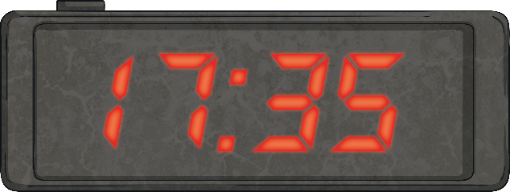




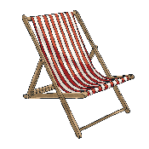
Menu
Summer 5 Thursday
Place Value
Problem Solving
Reveal answer
Put these numbers in order from greatest to smallest:
The seaside clock tower shows the time on an analogue clock and a 24-hour digital clock.
What will the analogue clock show at this time?
594
495
954
945
549
954
945
594
549
495
5:35 p.m. or twenty-five to six
Reveal answer
+ and −
Reasoning
243 + 25 = 268
Reveal answer
7
15
7
15
14
15
486 − 43 = 443
Reveal answer
+ =
× and ÷
70 × 10 = 700
Reveal answer
Is Alison correct?
Explain why.
96 ÷ 8 = 12
Reveal answer

Slide 3





Menu
Summer 5 Friday
Place Value
Problem Solving
Reveal answer
What are the next three numbers in this sequence?
What fraction of the smoothies sold were not vanilla?
450
400
350
Strawberry | 6
Lemon | 5
Vanilla | 9
11
20
300
250
200
Reveal answer
+ and −
Reasoning
451 + 38 = 489
Reveal answer
We had a packet of flags to share. I used
of them and Alison used of them.
924 − 14 = 910
Reveal answer
6
10
5
10
× and ÷
80 × 3 = 240
Reveal answer
Is Henry correct?
Explain why.
350 ÷ 5 = 70
Reveal answer

