Slide 2

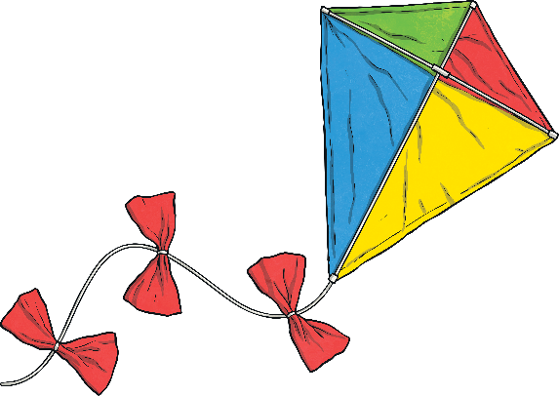
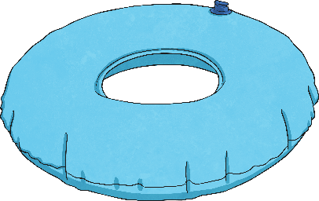
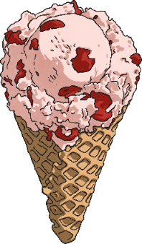

Monday
Tuesday
Wednesday
Thursday
Friday

Slide 3

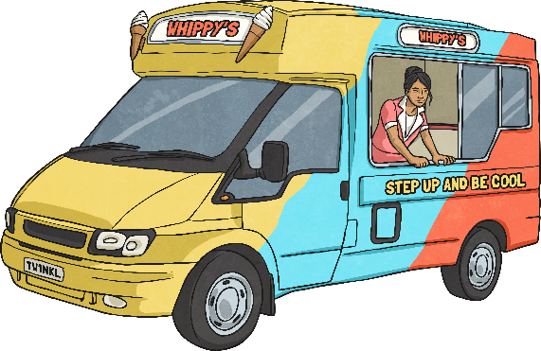
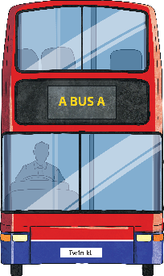





Menu
Summer 5 Monday
Place Value
Problem Solving
Write 605 in words.
Alison arrived at the beach at 9:20 a.m. The walk from the bus stop took her 25 minutes.
What time did she get
off the bus?
six hundred
and five
8:55 a.m.
Reveal answer
Reveal answer
+ and −
Reasoning
153 + 90 = 243
I have sorted these fractions in order from smallest to greatest.
Reveal answer
842 − 600 = 242
Reveal answer
1
16
1
12
1
9
1
7
× and ÷
70 × 5 = 350
Reveal answer
Is Henry correct?
Explain why.
80 ÷ 40 = 2
Reveal answer

Slide 4
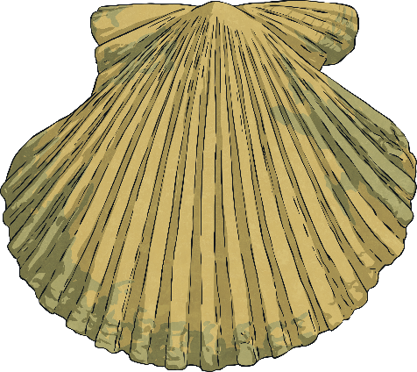
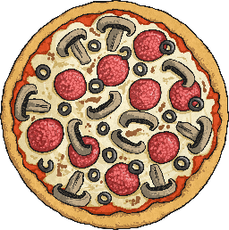



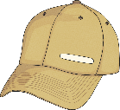

Menu
Summer 5 Tuesday
Place Value
Problem Solving
9
10
What is
one hundred more?
Alison eats of a pizza and Henry eats of his.
How much more did Alison eat than Henry?
3
10
454
354
6
10
Reveal answer
Reveal answer
+ and −
Reasoning
468 + 500 = 968
Reveal answer
It takes me 40 minutes to walk to the funfair. I need to meet Henry at
4:25 p.m. so I must leave by 3:35 p.m.
675 − 70 = 605
Reveal answer
× and ÷
80 × 2 = 160
Reveal answer
Is Alison correct?
Explain why.
400 ÷ 8 = 50
Reveal answer

Slide 5




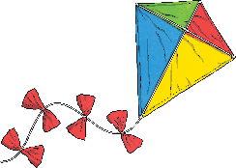
Menu
Summer 5 Wednesday
Place Value
Problem Solving
Reveal answer
Use the correct symbol to compare these numbers:
Find two different ways to complete this part-whole model using fractions.
<
Examples could include:
908 980
¼
1
8
3
10
½
¼
3
8
2
10
Reveal answer
+ and −
Reasoning
257 + 6 = 263
Reveal answer
803 − 8 = 795
½ is the same as .
Reveal answer
7
18
× and ÷
12 × 3 = 36
Reveal answer
Is Henry correct?
Explain why.
160 ÷ 4 = 40
Reveal answer

Slide 6
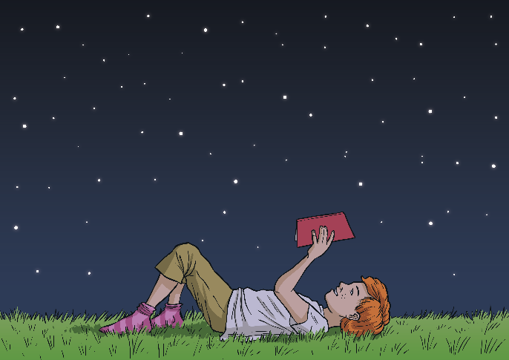
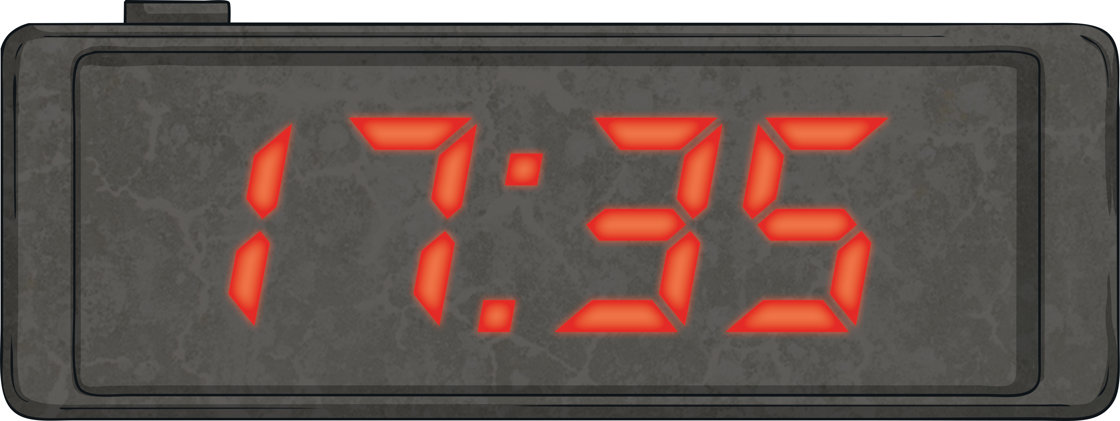



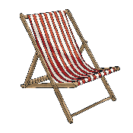
Menu
Summer 5 Thursday
Place Value
Problem Solving
Reveal answer
Put these numbers in order from greatest to smallest:
The seaside clock tower shows the time on an analogue clock and a 24-hour digital clock.
What will the analogue clock show at this time?
594
495
954
945
549
954
945
594
549
495
5:35 p.m. or twenty-five to six
Reveal answer
+ and −
Reasoning
243 + 25 = 268
Reveal answer
7
15
7
15
14
15
486 − 43 = 443
Reveal answer
+ =
× and ÷
70 × 10 = 700
Reveal answer
Is Alison correct?
Explain why.
96 ÷ 8 = 12
Reveal answer

Slide 7




Menu
Summer 5 Friday
Place Value
Problem Solving
Reveal answer
What are the next three numbers in this sequence?
What fraction of the smoothies sold were not vanilla?
450
400
350
Strawberry | 6
Lemon | 5
Vanilla | 9
11
20
300
250
200
Reveal answer
+ and −
Reasoning
451 + 38 = 489
Reveal answer
We had a packet of flags to share. I used
of them and Alison used of them.
924 − 14 = 910
Reveal answer
6
10
5
10
× and ÷
80 × 3 = 240
Reveal answer
Is Henry correct?
Explain why.
350 ÷ 5 = 70
Reveal answer

