Slide 2

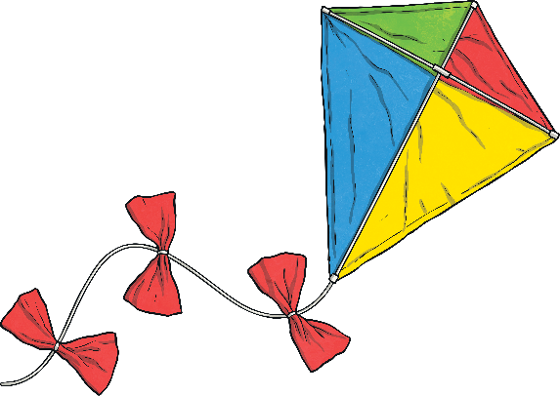
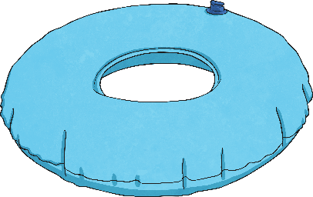


Monday
Tuesday
Wednesday
Thursday
Friday

Slide 3

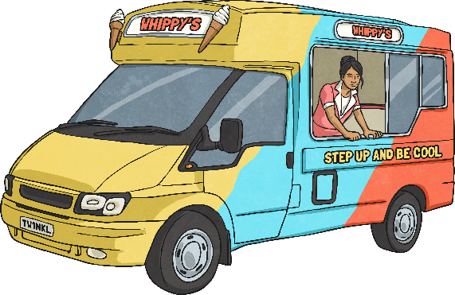


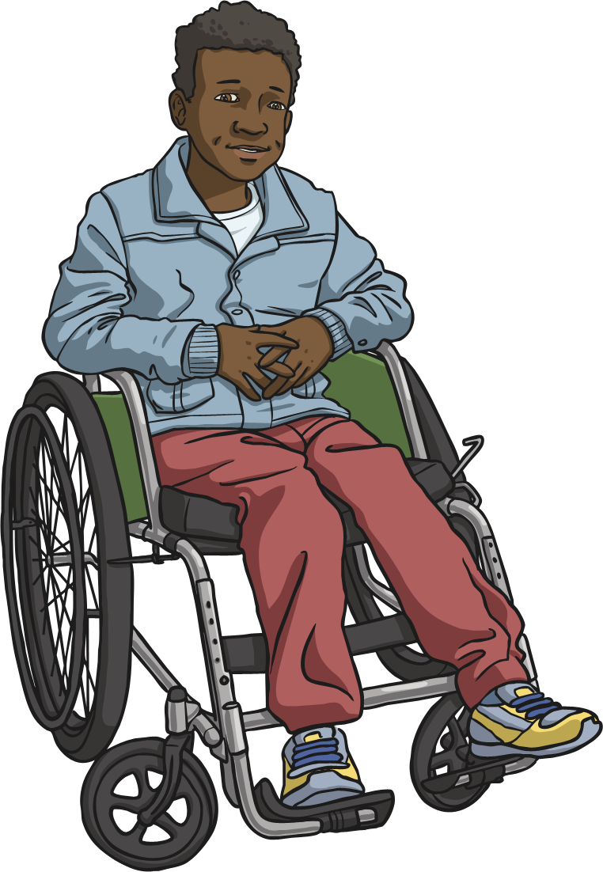



Menu
Summer 10 Monday
Place Value
Problem Solving
Write 928 in words.
Harry buys a bucket with a capacity of 5 litres. He uses two buckets to fill the moat of his sandcastle. How much water does he use?
nine hundred and twenty-eight
10 litres
Reveal answer
Reveal answer
+ and −
Reasoning
576 + 40 = 616
Reveal answer
If I count in multiples of eight, I will say the number 28.
555 - 500 = 55
Reveal answer
× and ÷
19 × 10 = 190
Reveal answer
Is Harry correct?
Explain why.
500 ÷ 50 = 10
Reveal answer

Slide 4
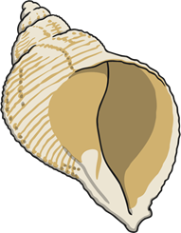
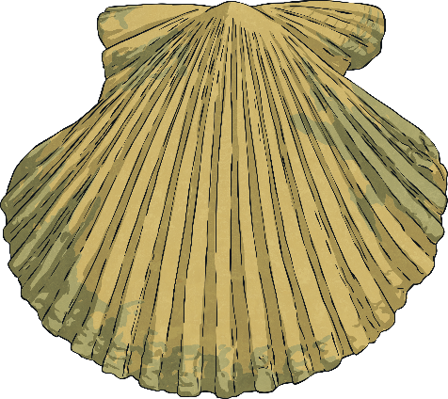






Menu
Summer 10 Tuesday
Place Value
Problem Solving
What is the value of the underlined digit?
Saniya collects 5 shells. Each shell has a mass
of 24g.
What is the total mass of the shells she collects?
900 or nine hundreds
907
120g
Reveal answer
Reveal answer
+ and −
Reasoning
The taller bottle contains more water.
624 + 300 = 924
Reveal answer
357 - 70 = 287
Reveal answer
1
500ml
2
× and ÷
litre
Complete this written multiplication:
2 | 9 | 2
540 ÷ 10 = 54
 | 7 | 3
× |  | 4
Is he correct?
Explain why.
Reveal answer
Reveal answer

Slide 5





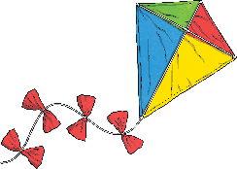
Menu
Summer 10 Wednesday
Place Value
Problem Solving
Use the correct symbol to compare these numbers:
Harry says “I will use a flag with
vertical stripes.” Which flag does Harry use?
=
384 - 60
224 + 100
Reveal answer
Reveal answer
+ and −
Reasoning
The perimeter of this shape
is 30cm.
314 + 9 = 323
Complete this column subtraction:
 | 1 | 6 | 2
 | 5 | 0 | 4
- | 3 | 4 | 2
Reveal answer
Reveal answer
Reveal answer
× and ÷
5cm
60 × 8 = 480
Reveal answer
Is Saniya correct?
Explain why.
350 ÷ 5 = 70
Reveal answer

Slide 6

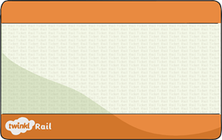





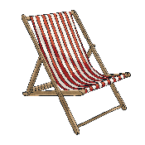
Menu
Summer 10 Thursday
Place Value
Problem Solving
Reveal answer
Reveal answer
Which number is a multiple of 50?
These are Harry’s train tickets for his summer holiday. How many nights will he be away??
453
425
23rd July
9th August
400
390
17 nights
+ and −
Reasoning
246 + 35 = 281
Reveal answer
1
6
476 - 55 = 421
Reveal answer
is more than .
2
16
× and ÷
110 × 4 = 440
Reveal answer
Is Harry correct?
Explain why.
450 ÷ 10 = 45
Reveal answer

Slide 7
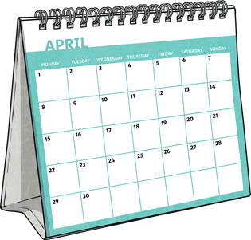


Menu
Summer 10 Friday
Place Value
Problem Solving
Reveal answer
What are the next three numbers in this sequence?
How many days are there in 20 weeks?
24
28
32
140
36
40
44
Reveal answer
+ and −
Reasoning
648 - 330 = 318
Complete this column addition:
 | 7 | 0 | 9
I need to colour in two more parts to make .
 | 3 | 9 | 4
+ | 3 | 1 | 5
Reveal answer
Reveal answer
Reveal answer
3
4
× and ÷
5 × 800 = 4000
Reveal answer
Is Saniya correct?
Explain why.
660 ÷ 10 = 66
Reveal answer

