Slide 1


Keep Calm and
Make Music
Weekly Wonder
Discovering the
Musical Dimensions KS1

Slide 2










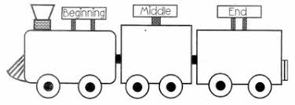
Discovering the
Musical Dimensions
Pitch
Duration
Dynamics
Tempo
(there are seven altogether)
Texture
Structure
Timbre

Slide 3


Contents – homepage
Click on the to return to this page
There are seven musical dimensions – one for every day of the week!
Which one will you discover today? Click on one and off you go
Pitch – what it means and fun pitch activities
Duration – what it means and fun duration activities
Dynamics – what it means and fun dynamic activities
Tempo – what it means and fun tempo activities
Structure – what it means and fun structure activities
Texture - what it means and fun texture activities
Timbre – what it means and fun timbre activities
Quiz time
Don’t try and do them all in one go it could be a bit

Slide 4

STRUCTURE is all about the order sounds happen in
Key words
Beginning, middle, ending
Call and echo, Call and response
Verse, chorus
ABA
Click here
to find out about call and echo
Click here
To join in with a call and response song
The lady sings the call, join in singing the response with the man

Slide 5

Fun structure activities
Listen to this song
Learn to sing the chorus
Na na na
I’m so happy
I’m so happy sing with me
x 2
Count how many times you sing the chorus
What other songs do you know that have a chorus?

Slide 6
TEXTURE is all about how many sounds can be heard at the same time
Key words
Solo
Unison
Layers
Click here
to watch how layers can slowly be added to a piece of music

Slide 7
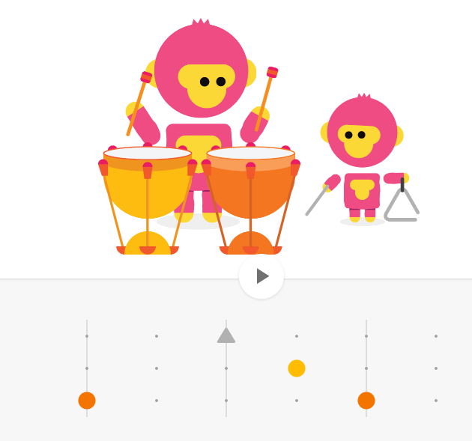
Fun texture activity
Click here
and enjoy adding layers by clicking on the dots to activate 1 2 or 3 sounds at the same time

