Slide 1
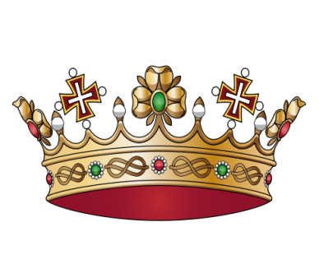
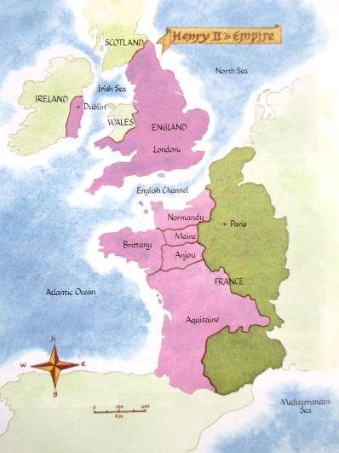
Richard I, ruled England 1189-
1199. At that time, much of what is now France was ruled by English kings. Richard was away on crusades or fighting wars with France, for
much of the time. While he
was away his brother, Prince
John looked after affairs of
state (ruled the country).
Richard I had no son to
succeed him but he had chosen his nephew Prince Arthur of Brittany, a French prince, as his successor. Richard later changed his mind and chose his brother John as his successor instead.
Notes:
Print out, cut each sheet in half, make sure the cards are not in order and issue one per pupil. Each pupil reads their card out then the group try to order themselves into chronological order. If insufficient for your class, some pupils work in pairs or they might help those with cards to order themselves into chronological order.

Slide 2
In 1193 King Richard I is held to ransom by Henry VI, the Holy Roman Emperor whilst crossing Europe.
John offers money for him to be kept in captivity!
The ransom is paid by King Richard’s mother, Eleanor of Acquitaine. She has to raise taxes and seize treasures from the church to pay it. .

Slide 3
In 1199 John’s brother, Richard I dies in France. His successor will be responsible for continuing his fight against the French – and paying for it!
John is crowned King John I. Although he is accepted as king by the barons of England and Normandy, the barons of Anjou and Maine think Prince Arthur should become king. They accuse John of seizing the throne by lying about Richard’s choice of successor.

Slide 4
In France, King Philip invades
Normandy to reclaim it for France, John, as King is expected to try and keep the French lands. He has to raise taxes to fund an army but then shows great military skill. He lands in France, marches 80 miles, and captures his French nephew Arthur who is besieging a castle.
Arthur dies in captivity and rumours spread that John murdered him or that he had fallen from a tower while trying to escape. Whether the rumours were true or not, John loses the support of the barons in Normandy.

Slide 5
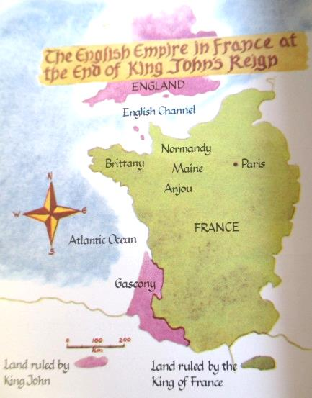
By 1204, without the support
of the Normandy barons, John has to return to England. Within
months Normandy is back
under French rule. A king’s
main role in medieval times
was as a warlord and John had
clearly failed. King Philip II of France 1 - King John I of England 0.
The loss of Normandy is a disaster.
After the Norman Conquest Normandy was the homeland of the English kings and most of the English barons. It was very rich and provided English kings with great wealth and resources. Normandy had not been in French control since before the Norman Conquest, so its loss was like losing part of the elite’s homeland.

Slide 6
King John has to squeeze even
more money out of the English barons now Normandy’s income is lost. He changes the taxation system making it simpler and more efficient. He raises four times more money than Richard had. Some of the extra money allows John to make the English navy bigger and stronger than it had ever been before.
King John soon has other
problems. When he rejects Pope Innocent III’s choice for Archbishop of Canterbury, the Pope stops all church services in England. People think they will go to Hell because they cannot go to church.

Slide 7
King John I retaliates against the
Pope by seizing church property. As well as revenge against the Pope’s actions this also helps to swell King John’s coffers! In 1209 the Pope excommunicates King John. Who reacts by taking yet more money from churches in England.
Eventually the Pope relaxes parts
the church services ban, in 1213 John offers to pay an annual amount to the Catholic Church. This is called the Golden Bull. In return John regains the Pope’s support for the rest of his reign. The Pope also demands the French drop plans to invade England.

Slide 8
In 1214 John begins a campaign
to regain Normandy. He is optimistic as he has built alliances with some French barons, however many English barons refuse to send troops. The campaign starts well but soon Louis has the upper hand and John has to sign a peace treaty and pay compensation. Normandy is lost forever.
By October 1214 John is back
in England. The Barons are very angry. King John’s taxes are hitting them really hard, they claim he ignores their advice, denies them fair trials and takes hostages to force them do as he wishes. They have been used to absentee kings who left them alone to do as they wished over many years. John interferes too much!

Slide 9
John tries to avoid open with the
barons. In January 1215 he calls a council to discuss reforms but he also contacts the Pope for added support. The council is a ploy to delay armed conflict until Papal support arrives. John even promises Pope Innocent he will raise an army and join his Fourth Crusade, to give him more protection by the church.
King John’s delaying tactics fail
and the Pope’s letters of support arrive too late. In May 1215 eighteen barons from the north, twelve from East Anglia and ten from the west assemble at Bury St Edmunds. Calling themselves the ‘Army of God’ the rebel army takes control of London, Exeter and Lincoln.

Slide 10
Once the rebels hold London,
more barons defect to their side. John has to ask the Archbishop of Canterbury to arrange peace talks.
John and the barons draw up a draft charter. In June 1215, King John and the barons meet at Runnymede and sign Magna Carta.
It seems likely that neither side seriously intended to put the terms of the charter into practice. Some barons even leave the Runnymede meeting early, to prepare for war. They simply want rid of King John.

Slide 11
King John calls for the Pope to intervene again. The Pope tells the bishops to support King John. John goes to war against the rebel barons and by March 1216 he has retaken control of everywhere except London.
In June 1216, King Philip II of France sends his son Louis to invade England and take the throne. Although King John’s powerful navy lies in wait off Dover, it is dispersed by storms and Louis lands in England unchallenged .

Slide 12
The Scots King, Alexander II, later joins Louis at Dover and some of John’s supporters join him too.
King John I is forced to flee west then north but is taken ill near Newark. He dies in October 1216.
After John's death his nine-year-old son Henry III becomes King. The civil war continues until the crown is victorious at the battles of Lincoln and Dover in 1217 and Louis of France signs a treaty giving up his claim to the English throne.

