Slide 1
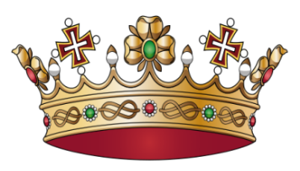
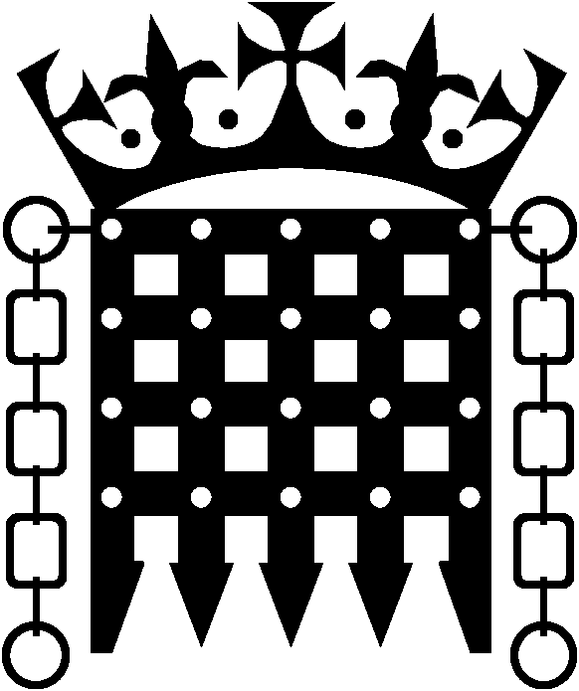

At the beginning of King John’s
reign the monarch was all
powerful. He owned all the land in England and Wales and the barons had to pay fees to live in the homes their families were given after the Normans took control in 1066. The King could increase the cost of fees whenever he wanted. The monarch also controlled the law and decided the fate of people who were on trial.
When English barons revolted
against King John he had to
make promises about how his barons and freemen would be treated and agree to consult them about raising taxes.
In 1215, Magna Carta which listed the King’s promises was signed by King John in the presence of the Archbishop of Canterbury, other leading churchmen and English barons.
Notes:
Print out, cut each sheet in half, and make sure the cards are not in order.

Slide 2
Soon after King John’s reign
the council of churchmen,
barons and earls who met to agree new laws with the King began to be called parliament. The name comes from the French verb parler, which means to speak or talk, because this was where the king talked to his Lords. Only lords, bishops and very wealth landowners were part of parliament.
The earliest Parliaments
only met when the King called
them. This was usually because they wanted to raise taxes, kings could only raise taxes with parliament’s agreement.
The council made petitions to the King asking for things they wanted done. The King did not have to agree to these but if he needed more money sometimes he had to agree to get what he wanted.

Slide 3
In the 13th century, monarchs
invited important officials from major
towns and landowners who owned less land to come to parliament.
By 1500 these made up the House of Commons (because the were commoners) whilst bishops, earls and barons made up the House of Lords. Parliament still consists of these two bodies today.
When James I became King
of England he had already
been King James VI of Scotland for 35 years. Scotland had its own parliament. Although the two countries now had one monarch, the parliaments remained separate.

Slide 4
Parliament only sat when
James I called it. During his 22 year reign in England, parliament only sat for total of 36 months (3 years). Sometimes there were years between meetings of parliament.
By Queen Anne’s reign
the monarch still had quite a
lot of power. She could attend parliament when it sat and attended the weekly meetings of the cabinet where she helped make decisions. However only parliament set taxes each year, part of which paid for the royal household.

Slide 5
After Queen Anne’s death, the
law was changed so monarchs
could not refuse to agree to laws passed by parliament but they could appoint ministers to try to influence parliament’s decisions. The chief minister headed the government, chaired cabinet meetings and reported to the monarch. The chief minister began to be called Prime Minister at this time. Sir Robert Walpole was Britain’s first Prime Minister.
By the time Queen Victoria
ruled Britain, Britain was a constitutional monarchy with the monarch as Head of State with very little real power. One of Queen Victoria’s main contributions was in making the monarch a public symbol of propriety (always behaving in the correct way).

