Slide 1


Keep Calm and
Make Music
Weekly Wonder
Discovering the
Musical Dimensions KS1

Slide 2


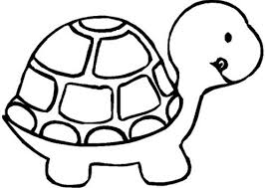

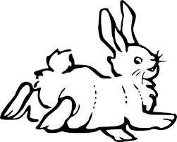

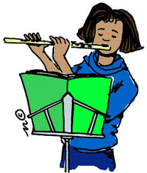

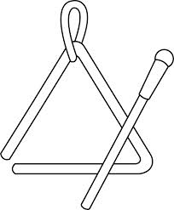
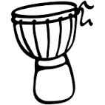
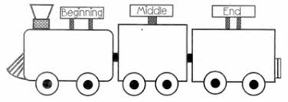
Discovering the
Musical Dimensions
Pitch
Duration
Dynamics
Tempo
(there are seven altogether)
Texture
Structure
Timbre

Slide 3


Contents – homepage
Click on the to return to this page
There are seven musical dimensions – one for every day of the week!
Which one will you discover today? Click on one and off you go
Pitch – what it means and fun pitch activities
Duration – what it means and fun duration activities
Dynamics – what it means and fun dynamic activities
Tempo – what it means and fun tempo activities
Structure – what it means and fun structure activities
Texture - what it means and fun texture activities
Timbre – what it means and fun timbre activities
Quiz time
Don’t try and do them all in one go it could be a bit

Slide 4


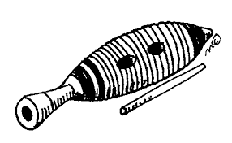
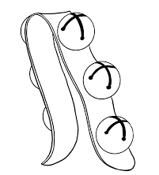
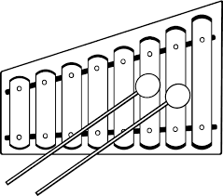
TIMBRE is all about what the sounds are like
Key words
Wood
Metal
Skinned
Shake
Tap
Scrape
Instrument names
Click here
to join in with the song and mime playing
Lots of different instruments

Slide 5
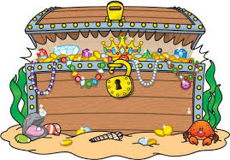

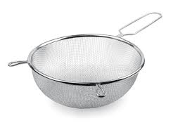
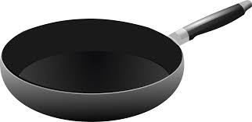
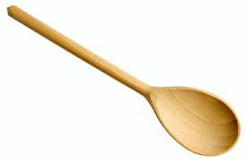
Fun timbre activities
Go on a treasure hunt for sound makers
Can you find a wooden sound to play?
Can you find a metal sound to play?
Can you find a skinned sound to play?
Can you find something to tap?
Can you find something to shake?
Can you find something to scrape?
Draw a treasure chest with all your sound makers around it
Make a list of all the wooden, metal and skinned instruments you can think of – which list is the longest?

Slide 6

Name the dimension quiz
Look at the slides below
Can you work out
which dimension each is about?

Slide 7

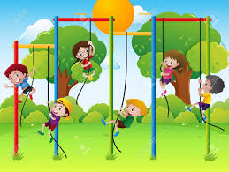
?
High
Low
Middle
Higher
Lower
Notes:
Pitch

Slide 8
?
Long
Short
Steady beat
Rhythm pattern xx xx x x
Notes:
Duration

Slide 9
?
Loud
Quiet
Louder
Quieter
Notes:
Dynamics

Slide 10
?
Fast
Slow
Faster
Slower
Notes:
Tempo

Slide 11

?
Beginning
Ending
Beginning, middle, ending
Call and echo, Call and response
Verse, chorus
ABA
Notes:
Structure

Slide 12

?
Solo
Unison
Layers
Notes:
Texture

Slide 13
?
Wood
Metal
Skinned
Shake
Tap
Scrape
Notes:
Timbre

