Slide 1


Slide 3
Work out the area of the shapes.
Each square represents 1 cm²
9 cm
5 cm
3 cm
4 cm

Slide 4
Work out the area of the shapes.
Each square represents 1 cm²
20 cm²
6 cm²
9 cm
5 cm
3 cm
15 cm²
36 cm²
4 cm

Slide 6

Each square represents 1 cm²
Have a think
20 cm²
Area of the triangle
10 cm²

Slide 7
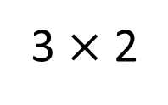
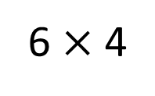
Each square represents 1 cm²
Have a think
Calculate the areas of the right-angled triangles.
6 $×$ 4
24 cm²
12 cm²
3 $×$ 2
3 cm²
6 cm²

Slide 8
Have a go at questions
1 - 3 on the worksheet

Slide 9

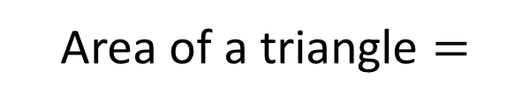

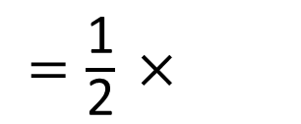
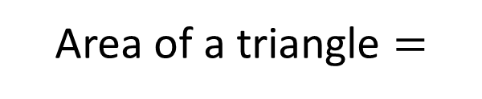

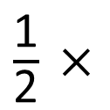
9 cm
7 cm
14 cm²
4 cm
Base
$$×$$
Area of a triangle $=$
Perpendicular height
2
$\frac{\text{1}}{\text{2}}$ $×$
Area of a triangle $=$
Base
$$×$$
Perpendicular height
$=\frac{\text{1}}{\text{2}}$ $×$
4
$$×$$
7

Slide 10

The base is along the bottom and the perpendicular height is up the side
Do you agree with Tiny?
Can you identify the base and perpendicular height?
Have a think

Slide 11
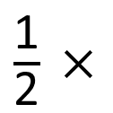

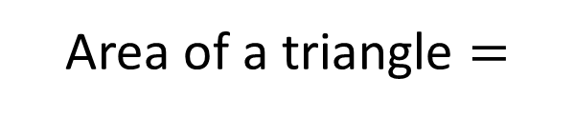
$\frac{\text{1}}{\text{2}}$ $×$
Base
Perpendicular height
Area of a triangle $=$
$$×$$
12 cm
6 cm
14 cm
8 cm
100 mm
50 mm
Have a think

Slide 12
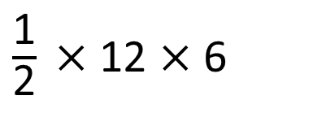
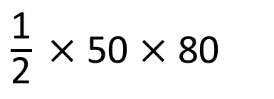
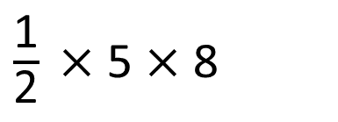
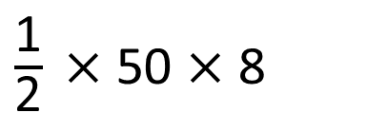
$\frac{\text{1}}{\text{2}}$ $×$
Base
Perpendicular height
Area of a triangle $=$
$$×$$
12 cm
6 cm
14 cm
8 cm
100 mm
$\frac{\text{1}}{\text{2}}$ $×$ 12 $×$ 6
50 mm
36 cm²
$\frac{\text{1}}{\text{2}}$ $×$ 50 $×$ 8
$\frac{\text{1}}{\text{2}}$ $×$ 5 $×$ 8
$\frac{\text{1}}{\text{2}}$ $×$ 50 $×$ 80
20 cm²
2,000 mm²

Slide 13
Have a go at the rest of the questions on the worksheet

