Slide 1


Slide 3
1) Work out the area of the rectangles.
2) Work out the area of the triangles.
90 mm
40 mm
8 m
1 m
5 cm
14 cm
4 cm
5 cm
11 cm
6 cm

Slide 4
1) Work out the area of the rectangles.
2) Work out the area of the triangles.
1) Work out the area of the rectangles.
2) Work out the area of the triangles.
90 mm
40 mm
8 m
8 m²
3,600 mm²
1 m
5 cm
14 cm
4 cm
5 cm
11 cm
6 cm
12 cm²
35 cm²

Slide 6

Each square represents 1 cm²
Have a think
How could we find the area of the parallelogram?

Slide 7

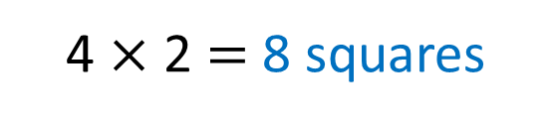
Each square represents 1 cm²
Cut and move
4 $×$ 2 $=$ 8 squares
8 cm²

Slide 8
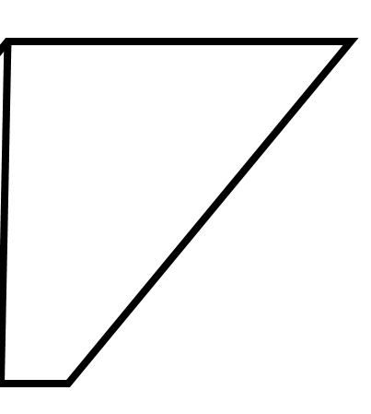
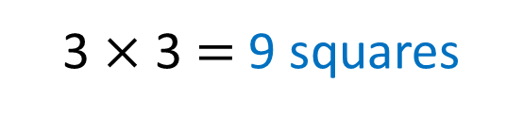
Each square represents 1 cm²
Have a think
3 $×$ 3 $=$ 9 squares
9 cm²

Slide 9
Have a go at questions
1 - 2 on the worksheet

Slide 10
Have a think
5 cm
6 cm
4 cm
If we were going to use the cut and move method, what would be the dimensions of the rectangle?

Slide 11


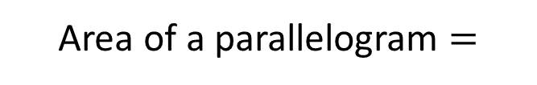

5 cm
6 cm
4 cm
Base
Area of a parallelogram $=$
Perpendicular height
$$×$$
20 cm² $=$
4 cm
$$×$$
5 cm

Slide 12
Have a think
Perpendicular height
Base
Which arrow is the base?
Which arrow is the perpendicular height?

Slide 13


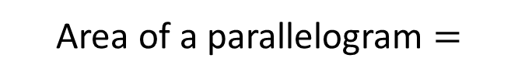

Base
Area of a parallelogram $=$
Perpendicular height
$$×$$
Use the formula to find the area of the parallelograms
Perpendicular height
7 cm
6 cm
5 cm
6 cm
Base
3 cm
Base
6 $×$ 7 $=$ 42 cm²
3 $×$ 5 $=$ 15 cm²
Have a think

Slide 14
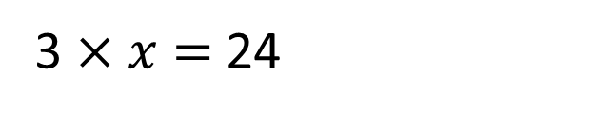


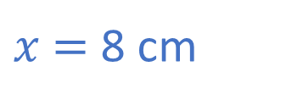
The area of the parallelogram is 24 cm²
What is the length of $x$?
$$x$$
3 cm
3 $×$ $x$ $=$ 24
$x$ $=$ 8 cm
Have a think

Slide 15
Have a go at the rest of the questions on the worksheet

