Slide 1


Slide 3

How many cubes are needed to create these 3D shapes?

Slide 4
How many cubes are needed to create these 3D shapes?
5 cubes
3 cubes
4 cubes
5 cubes
7 cubes

Slide 6


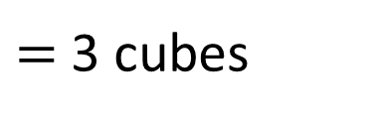
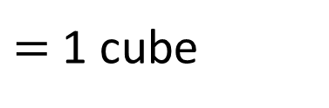
$=$ 1 cube
$=$ 3 cubes
Volume $=$ 3 cubes
Volume is the amount of space an object or liquid takes up.

Slide 7






Have a think
What is the volume of each 3D shape?
Volume $=$ 4 cubes
Volume $=$ 8 cubes
Volume $=$ 6 cubes

Slide 8

Have a think
What’s the same and what’s different about these 3D shapes?
The volume of each 3D shape is 4 cubes.
The cubes have been arranged differently.

Slide 9
Have a go at questions
1 - 2 on the worksheet

Slide 10
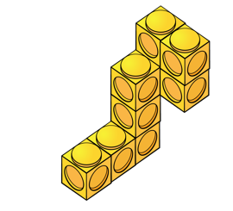


Have a think
The volume of this 3D shape is 8 cubes.
Volume $=$ 9 cubes

Slide 11
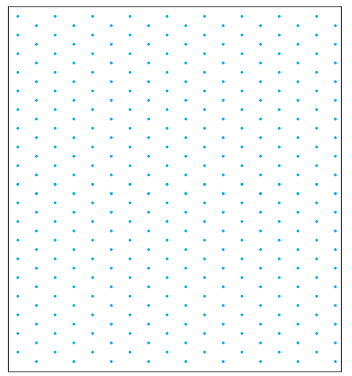

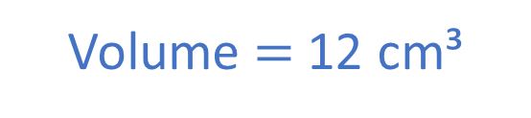
Have a think
How many cubes are needed to make the cuboid?
1 cm
Volume $=$ 12 cubes
Volume $=$ 12 cm³

Slide 12
Have a go at the rest of the questions on the worksheet

