Slide 1


Slide 3
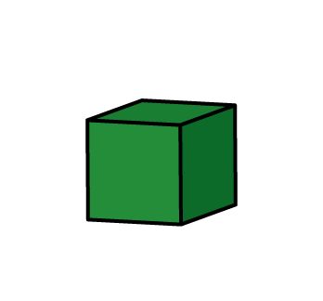
If the volume of each cube is 1 cm³, what is the volume of each shape?

Slide 4
If the volume of each cube is 1 cm³, what is the volume of each shape?
12 cm³
24 cm³
30 cm³

Slide 6
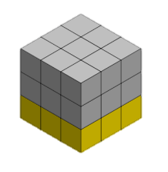
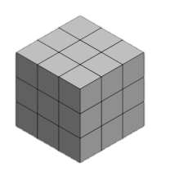
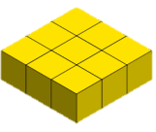
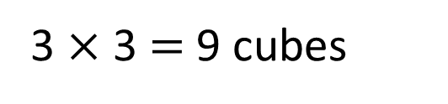
3 cubes
3 cubes
3 $×$ 3 $=$ 9 cubes

Slide 7

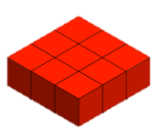

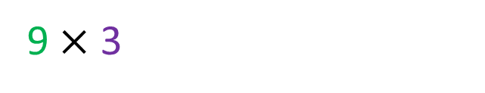



Have a think
Blue $=$ 9 cubes
Red $=$ 9 cubes
9$×$ 3
27 cubes
Yellow $=$ 9 cubes
What does the 9 represent?
What does the 3 represent?

Slide 8

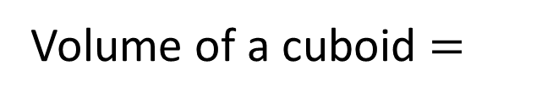

3
3
3
27 cubes
The volume of the cuboid is 27 cubes
Length
$$×$$
$$×$$
Volume of a cuboid $=$
Width
Height

Slide 9
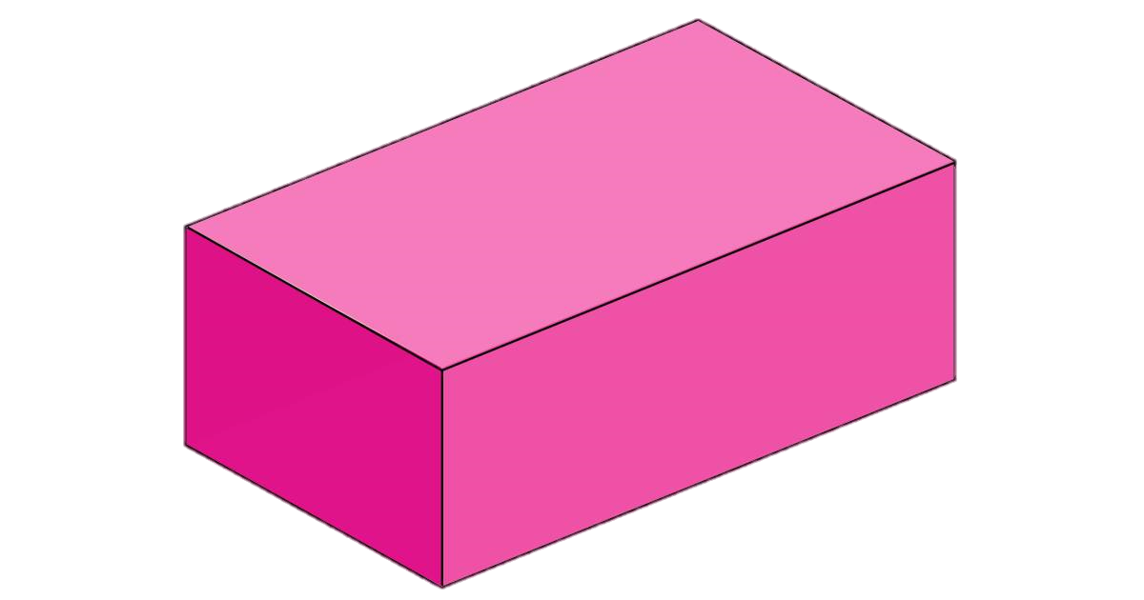

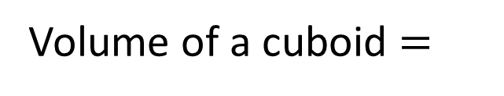
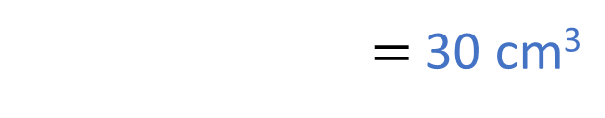
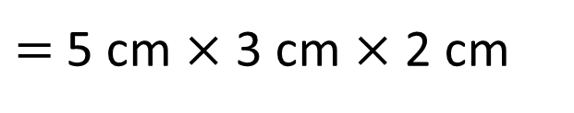

2 cm
3 cm
5 cm
Length
$$×$$
$$×$$
Volume of a cuboid $=$
Width
Height
$=$ 5 cm $×$ 3 cm $×$ 2 cm
$=$ 30 cm³

Slide 10
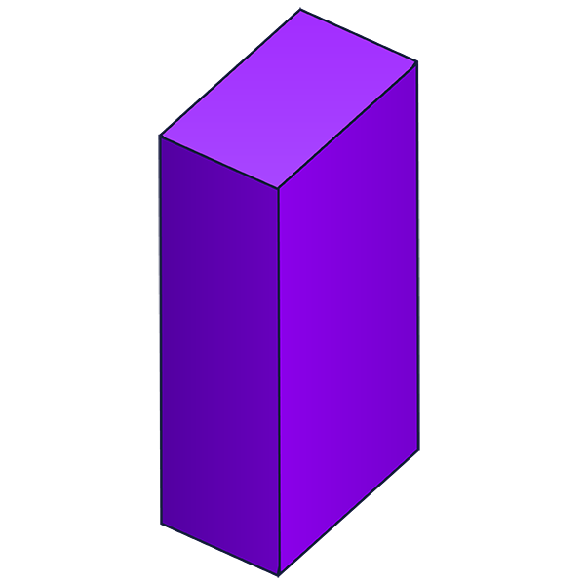

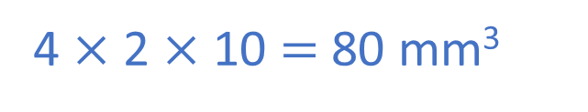


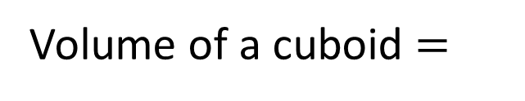
Have a think
Length
$$×$$
$$×$$
Volume of a cuboid $=$
Width
Height
Use the formula to calculate
the volume of the cuboids.
5 m
10 mm
7 m
3 m
4 mm
2 mm
7 $×$ 3 $×$ 5 $=$ 105 m³
4 $×$ 2 $×$ 10 $=$ 80 mm³

Slide 11
Have a go at questions
1 - 4 on the worksheet

Slide 12


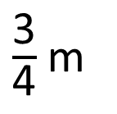
Who do you agree with?
What mistake has been made?
Have a think
$\frac{\text{3}}{\text{4}}$ m
1 m
20 cm
The volume is 1,500 cm³
The volume is 150,000 cm³

Slide 13
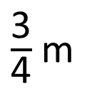

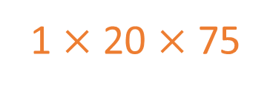
Who do you agree with?
What mistake has been made?
$\frac{\text{3}}{\text{4}}$ m
75 cm
100 cm
1 m
20 cm
The volume is 1,500 cm³
1 $×$ 20 $×$ 75
The volume is 150,000 cm³
100 $×$ 20 $×$ 75

Slide 14


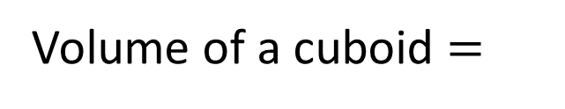



If a cuboid has a volume of 20 cm³, what could the length, width and height be?
Height
Length
$$×$$
$$×$$
Volume of a cuboid $=$
Width
L $×$ W $×$ H $=$ 20 cm³
1
$$×$$
2
4
5
10
5
$$×$$
4
$$=$$
20 cm³
Have a think

Slide 15




If a cuboid has a volume of 20 cm³, what could the length, width and height be?
L $×$ W $×$ H $=$ 20 cm³
1
$$×$$
5
$$×$$
4
$$=$$
20 cm³
2
$$×$$
1
2
10
$$×$$
5
$$=$$
20 cm³

Slide 16
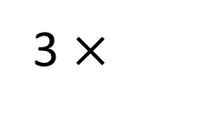
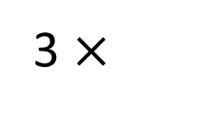
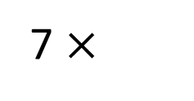
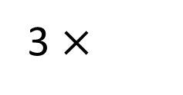
The shape is made up of two different size cuboids.
Calculate the total volume of the shape.
3 cm
5 cm
7 cm
8 cm
3 cm
72 cm³
63 cm³
3 cm
3 cm
7 $×$
3 $×$
3
3 $×$
3 $×$
8
135 cm³
Have a think

Slide 17
Have a go at the rest of the questions on the worksheet

