Slide 1


Slide 3
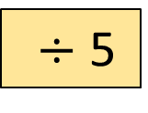
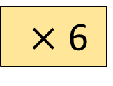


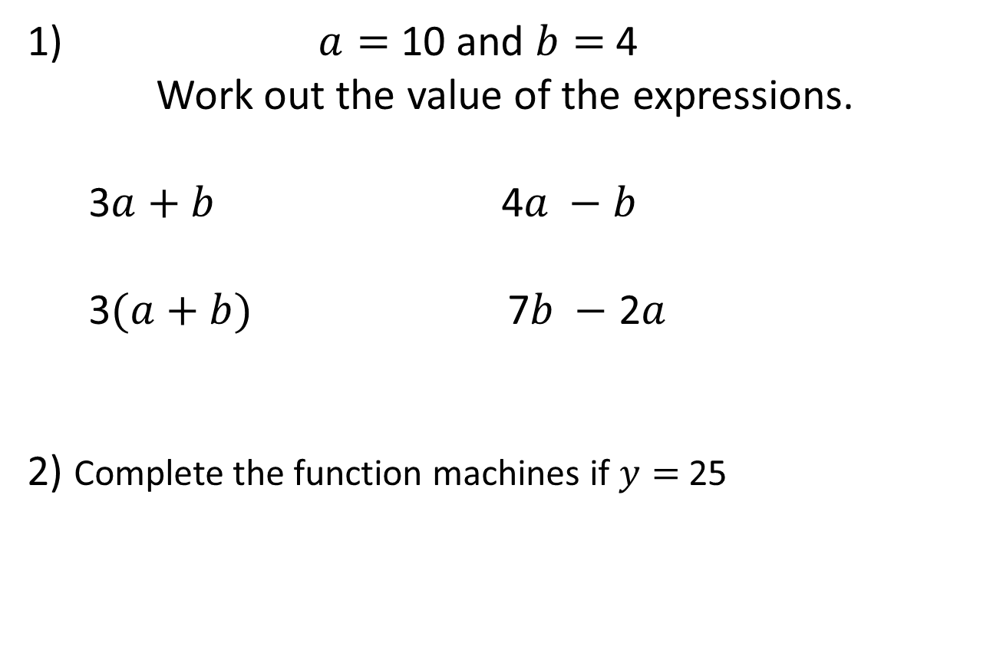
1) $a=$ 10 and $b=$ 4
Work out the value of the expressions.
3$a$ $+$ $b$ 4$a −b$
3$(a+b)$ 7$b −$ 2$a$
2) Complete the function machines if $y=$ 25
$$y$$
$÷$ 5
$$y$$
$×$ 6

Slide 4
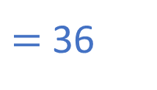
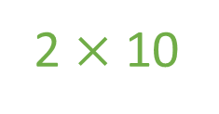
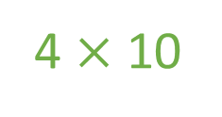
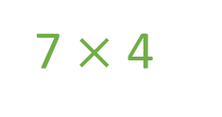
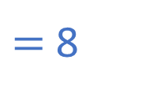
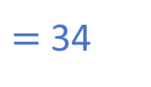
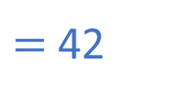
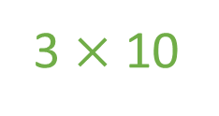
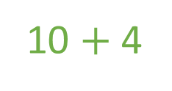
1) $a=$ 10 and $b=$ 4
Work out the value of the expressions.
3$a$ $+$ $b$ 4$a −b$
3$(a+b)$ 7$b −$ 2$a$
2) Complete the function machines if $y=$ 25
$=$ 34
$=$ 36
3 $×$ 10
4 $×$ 10
$=$ 42
$=$ 8
10 $+$ 4
7 $×$ 4
2 $×$ 10
$$y$$
$÷$ 5
5
$$y$$
$×$ 6
150

Slide 6
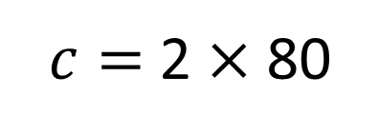
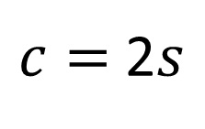
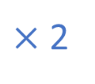
A formula is a rule or relationship that uses letters to represent amounts which can be changed.
Number of squares | 1 | 2 | 3 | 4 | 80
Number of circles
$×$ 2
2
4
6
8
160
$c=$ 2$s$
$c=$ 2 $×$ 80

Slide 7


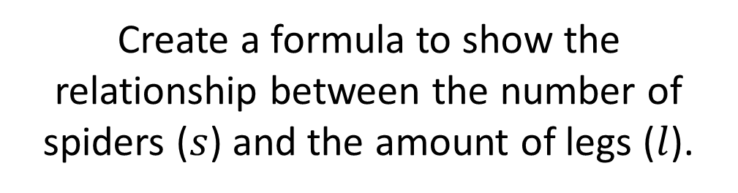
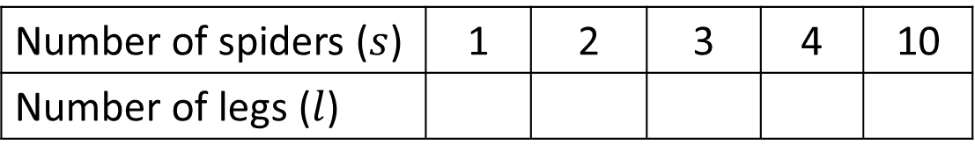
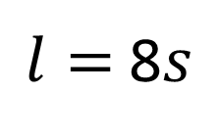

Complete the table.
Number of spiders ($s$) | 1 | 2 | 3 | 4 | 10
Number of legs ($l$)
$×$ 8
8
16
24
32
80
Create a formula to show the relationship between the number of spiders ($s$) and the amount of legs ($l$).
$l=$ 8$s$
Have a think

Slide 8
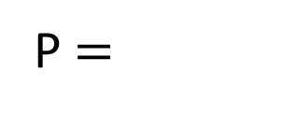
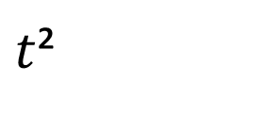



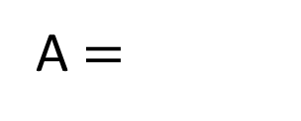
We can use formulae to find the area and perimeter.
$$t$$
$$t$$
$t$²
P $=$
A $=$
$$t ×t$$
Have a think

Slide 9

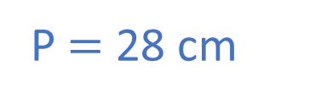

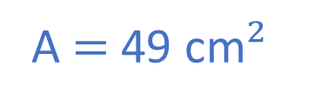

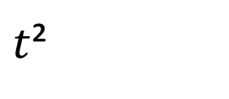
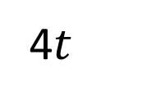
We can use formulae to find the area and perimeter.
Work out the area and perimeter if $t=$ 7 cm
$$t$$
$$t$$
$$t$$
$$t$$
$$t+t+t+t$$
A $=$
P $=$
$t$²
4$t$
A $=$ 49 cm$²$
P $=$ 28 cm
Have a think

Slide 10
Have a go at questions
1 - 4 on the worksheet

Slide 11


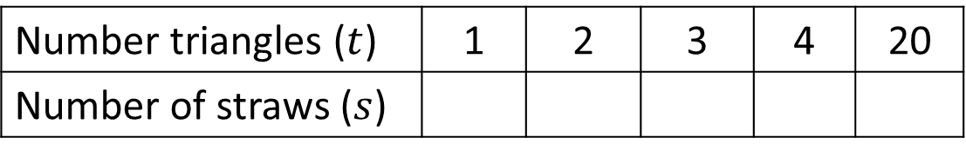
Eva is making a triangle pattern using straws.
Number triangles ($t$) | 1 | 2 | 3 | 4 | 20
Number of straws ($s$)
3
5
7
9
Can you create a formula that describes the pattern?
Have a think

Slide 12

Number triangles ($t$) | 1 | 2 | 3 | 4 | 20
Number of straws ($s$)
3
5
7
9
1
3
2
5
3
7
4
9

Slide 13
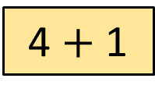
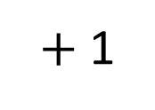
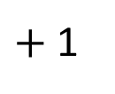
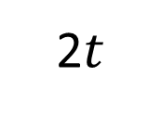
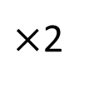
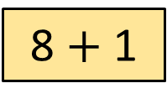
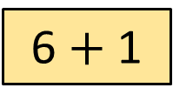

Number triangles ($t$) | 1 | 2 | 3 | 4 | 20
Number of straws ($s$)
3
5
7
9
41
$×$2
$+$ 1
1
3
2
4
4 $+$ 1
5
3
6
6 $+$ 1
7
4
8
8 $+$ 1
9
$s=$
$+$ 1
2$t$

Slide 14

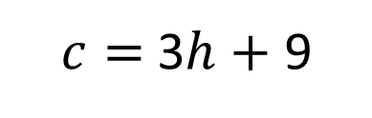
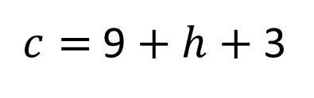
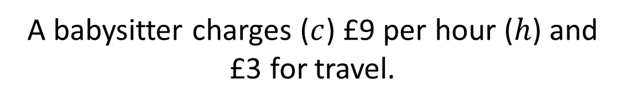
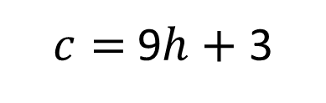
A babysitter charges ($c$) £9 per hour ($h$) and £3 for travel.
Which is the correct formula to use to work out the cost of the babysitter?
$c=$9 $+$ $h$ $+$ 3
$c=$ 3$h$ $+$ 9
$c=$ 9$h$ $+$ 3
Have a think

Slide 15
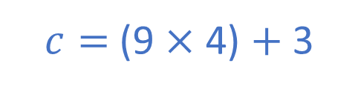
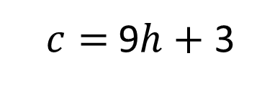

A babysitter charges ($c$) £9 per hour ($h$) and £3 for travel.
$c=$ 9$h$ $+$ 3
How much money would the babysitter receive if they babysat for 4 hours?
$c=$ (9 $×$ 4) $+$ 3
$=$ £39
Have a think

Slide 16
Have a go at the rest of the questions on the worksheet

