Slide 1
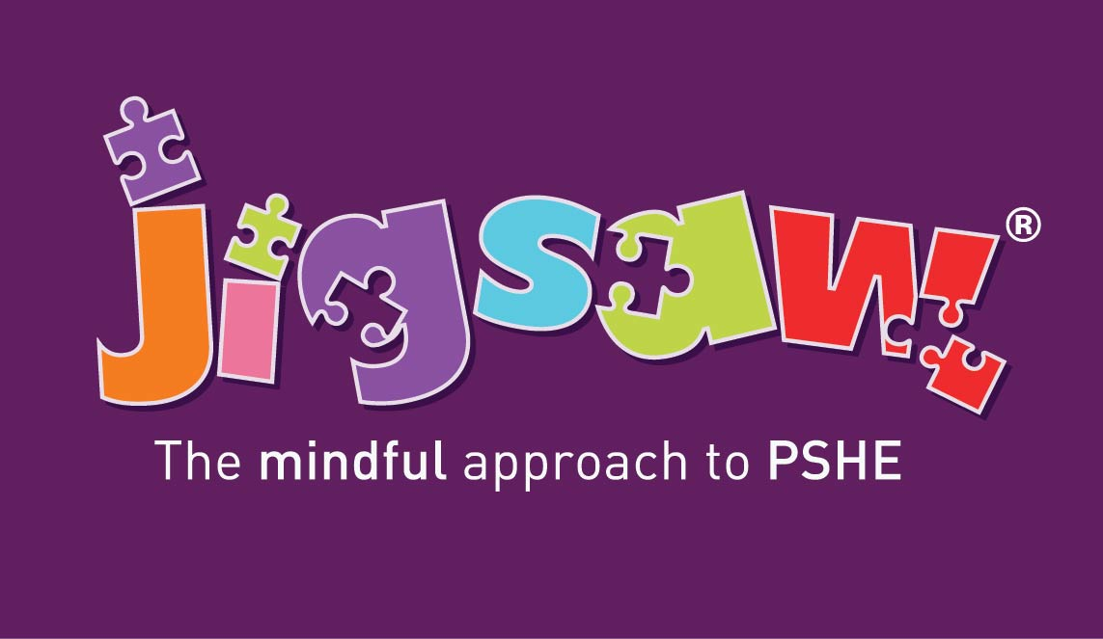

Slide 2
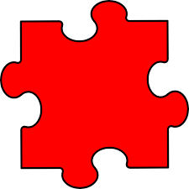
6 Puzzle Pieces
Being Me in my World
Celebrating Differences
Dreams and Goals
Healthy Me
Relationships
Changing Me
Each puzzles has 6 lessons which work towards an end goal for example creating a garden of dreams and goals.
Each lesson has 2 learning intentions:
Specific PSHE LEARNING
Emotional and social skills development

Slide 3
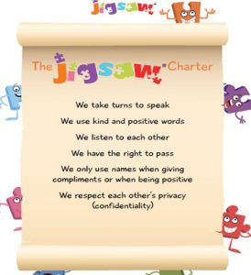
Jigsaw Charter

Slide 4
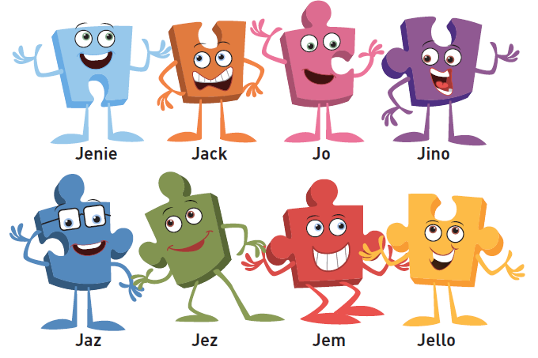
Jigsaw Friends to help the Children on their Learning Journey

Slide 5
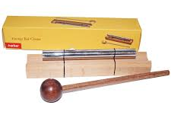






Each lesson contains a mindfulness moment:

Slide 6
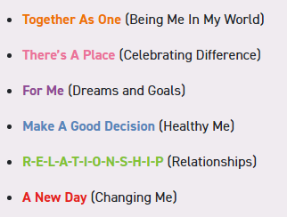

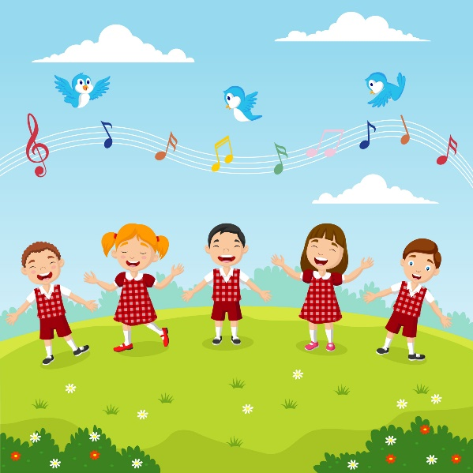
Jigsaw Songs

Slide 7
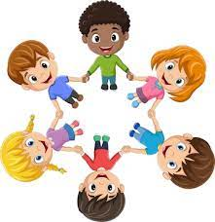
Connect Us - This is a game or activity designed to be fun and inclusive and to build and maximise social skills.
‘Connect us’ engenders positive relationships and enhances collaborative learning.
It sets the atmosphere at the beginning of each Jigsaw Piece and can also be used at the end if appropriate.

Slide 8


Calm Me - This section of the Piece helps children gain awareness of the activity in their minds, relaxing them and quietening their thoughts and emotions to a place of optimum learning capacity.
It creates a peaceful atmosphere within the classroom.
This is an invaluable life skill which enhances reflection and spiritual development. This underpins the mindful approach advocated in Jigsaw

Slide 9

Open my Mind - This part of the lesson is focused on allowing in information that is significant and therefore focused on the key learning focus of the lesson.
Tell Me or Show Me - This section of the lesson is used to introduce new information, concepts and skills, using a range of teaching approaches and activities.

Slide 10

Let Me Learn - Following Piaget’s learning model, after receiving new information/concepts, children need to manipulate, use, and play with that new information in order for it to make sense to them and for them to ‘accommodate’ it into their existing learning.
Help Me Reflect -Throughout Jigsaw, children are encouraged to reflect on their learning experiences and their progress. By reflecting, children can process and evaluate what they have learnt, which enables them to consolidate and apply their learning. They are also asked to stop and become aware of their thoughts and feelings in any given moment in Pause Points thus developing their mindfulness.

Slide 11


Slide 12

I love the deep breathing
It’s a really reflective time
It makes me feel calm
It’s calm and peaceful
The characters are super fun and colourful
The games are really fun
Jerry Cat is cute
PSHE gives me time to reflect
I enjoy the lessons because they are fun
I like the lessons because you do lots of things that you don’t normally get to do.
I am happy because we have 2 new members of the class – Jigsaw Jo and Jerry Cat.
I like the chime.
I am excited to learn how to relax.

Slide 13


Slide 14


