Slide 1
Timetable:
Y5/6 | Y3/4 | Y1/2 | YR | Pre-School
4:00-4:20 | 4:20 – 4:40 | 4:40 – 5:00 | 5:00 – 5:20 | 3:30- 3:50

Slide 2

Brockenhurst C of E Primary and Pre-School
Parent Workshops

Slide 3
Maths

Slide 4
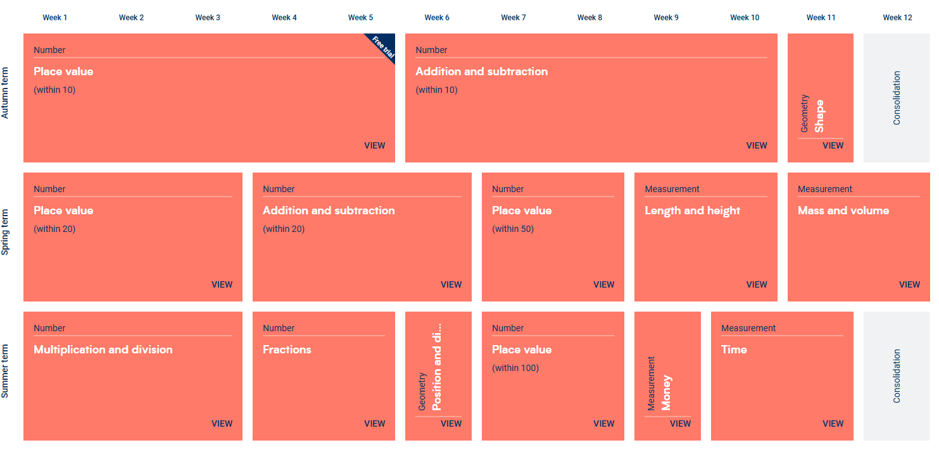
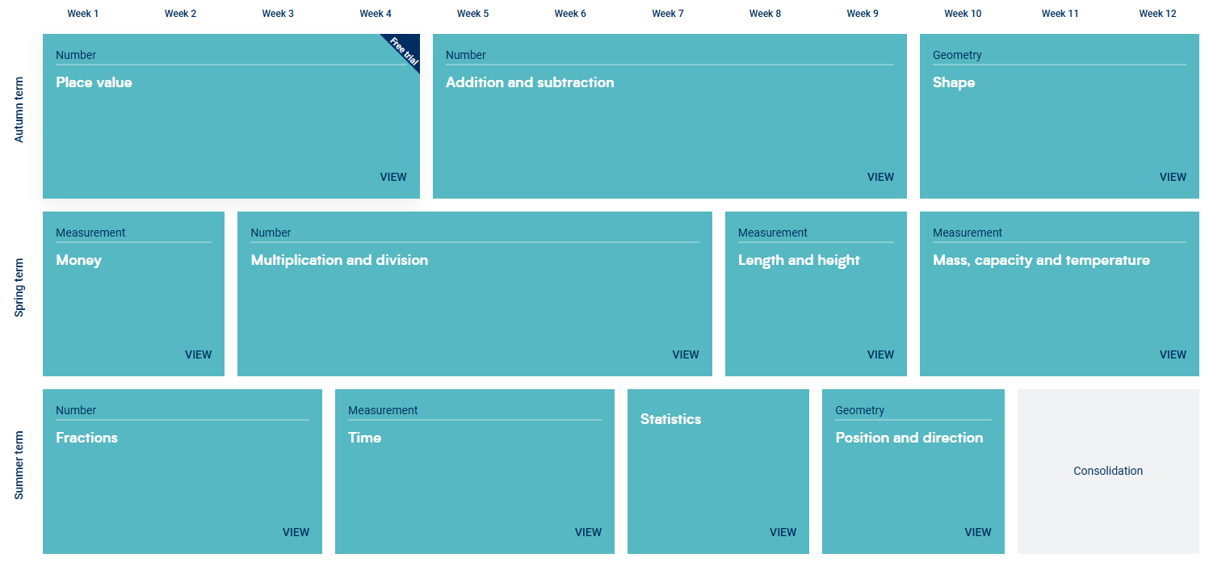
Notes:
Explain that we teach maths following the White Rose resources to support us, taught in blocks, and today we are going to be explaining our methods for teaching the four operations.
NFER papers

Slide 5
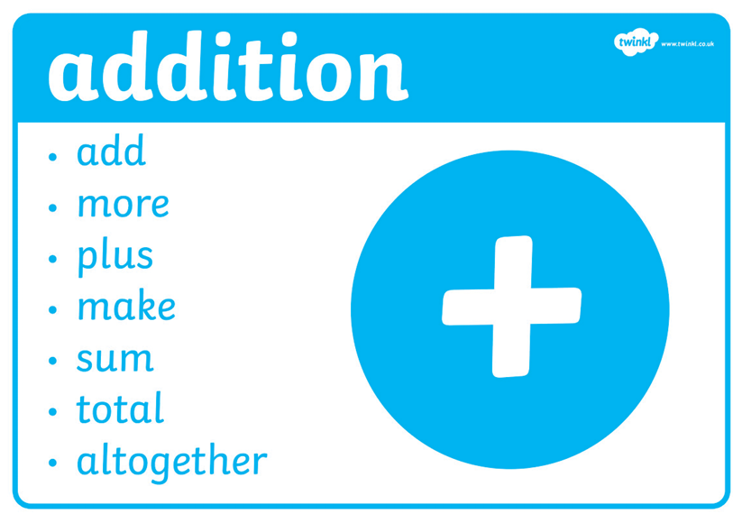
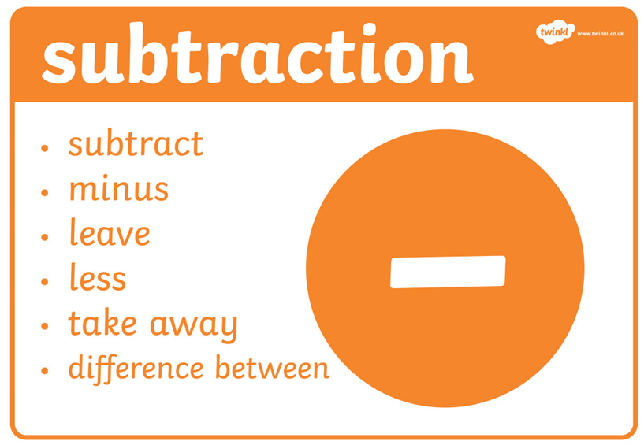
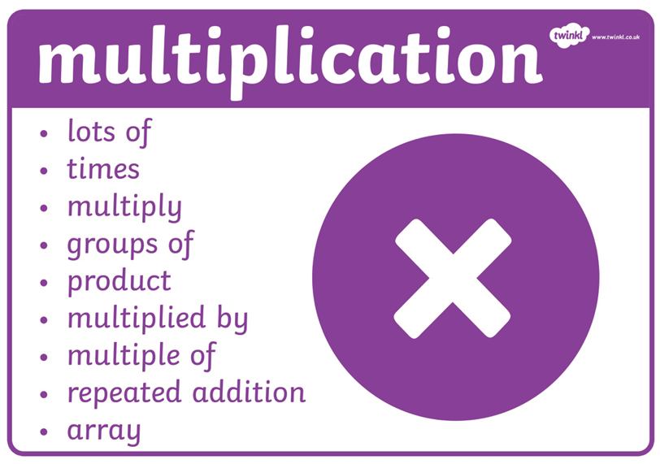
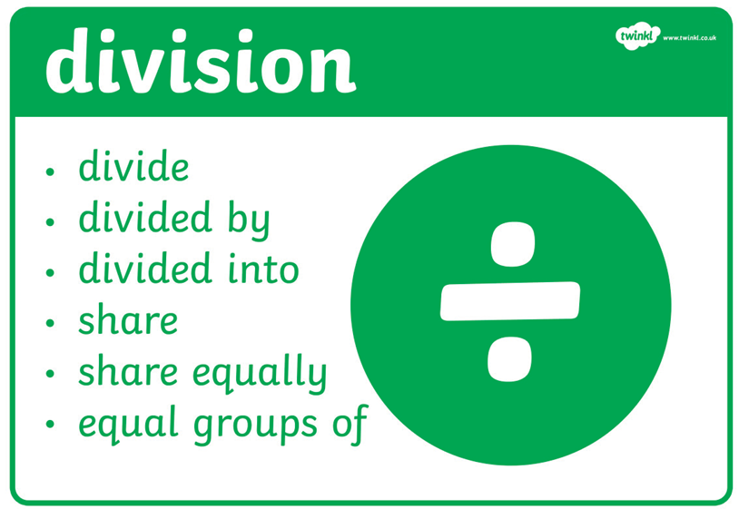
Four Operations:
Notes:
Pictures of relevant concrete resources that we use to support our teaching.
It’s up to you whether you want to live model how we teach each operation or if you want to have some examples prepared to direct the parents to. We need to emphasise the importance of the CPA approach within our classrooms, not just learning a method.

Slide 6
How can you help at home?
Practical Advice:
Counting to 100
Practically making numbers and understanding number
Number sense - 10’s and 1’s
Year 1 - Counting in 2’s, 5’s and 10’s
Year 2 – Timetables 2’s, 5’s and 10’s
Shape/Space and Measure- Time, money, capacity, weight, length,
End of year expectations
Fluency Cards
Ed shed - https://www.edshed.com/en-gb/menu
https://www.topmarks.co.uk/maths-games/hit-the-button
https://www.topmarks.co.uk/
Notes:
End of KS expectations, Times tables (KS2), fluency of number (KS1)
Maths Shed, TT Rockstars, Hit the Button, Topmarks, Fluency Cards
Blog

Slide 7
Reading

Slide 8
Reading in School
Speaking and Listening – building on early learning goals
Our reading environments
Book band books
Little Wandle Reading groups x 3 weekly
Whole class texts- English and Guided Reading sessions
Decoding, prosody and comprehension
Reading bookmark - Questions that could be asked including; retrieval, vocabulary and inference.
Notes:
Our whole approach to teaching reading:
KS2 – whole class Guided Reading, fluency focus, 1:1 reading, group interventions where required
KS1 – reading groups through phonics (3 reads), phonics, book band books, Year 2 Guided Reading
NFER paper examples

Slide 9
How can you help at home?
Ensure your child is bringing their book to school and home each day
Encourage the children to re-read their books for fluency – try to read books 3 times
Listen to your child read aloud
A rich reading diet
Blog – check for resources
Collins Ebooks
Tricky words

Slide 10
Spelling/Bridge to Spelling

Slide 11
Spelling/Bridge to Spelling
Daily phonics
Phonemes
Chunking
Context
Meaning of new vocabulary
Editing in writing
Feedback during writing
Dictation – common errors that we spot within class feed through our dictation lessons
Notes:
Share word lists, spelling journals, 10 ways to learn how to spell, grow the code

Slide 12
How can you help at home?
EdShed
Practising their spellings using pen and paper or other physical methods
If your child is struggling with a word, trying to replicate some of the methods that we use in school e.g. What sounds can you hear? What different ways can you make that sound? Try three times and see which one looks right.
Blog

Slide 13

Questions

